Slide 1
OVERVIEW AND ENTRY GUIDE
VISIT TRANSITIONS.COM/AWARDS
Notes:
The Transitions Innovation Awards program recognizes and celebrates loyal partners and individual optical industry professionals from Canada and the U.S. who have shown the highest level of commitment to growing its business with Transitions Optical’s family of products and programs over the past year.

Slide 2
WHO IS ELIGIBLE TO APPLY?
Independent eyecare professionals and practices
Optical industry professionals and educators
National and regional retailers
Optical laboratories
Managed Vision Care companies
Lens manufacturers and buying groups

Slide 3
CATEGORIES INCLUDE:
Transitions Brand Ambassador
Retailer of the Year U.S.
Retailer of the Year Canada
Eyecare Practice of the Year U.S.
Eyecare Practice of the Year Canada
Best in Training
Best in Marketing
Notes:
Transitions Brand Ambassador: This award goes to the individual who best showcases their dedication to being an influential advocate of the Transitions® brand, whether amplifying peer-to-peer conversations, social media or having an unparalleled commitment to incorporating Transitions® lens products into their business goals, patient interactions, training efforts or promotion of healthy vision in their community.
Retailer of the Year U.S., Retailer of the Year Canada: Awarded to a retailer for actively supporting the Transitions brand and demonstrating a commitment to enhancing the vision of their customers and communities. U.S. and Canadian retailers with 20 or more locations are eligible for this award. The award will be presented to one retailer from the US and one retailer from Canada. Nominees are judged on several factors, including overall photochromic growth; efforts to support the Transitions brand through marketing programs and promotions; quality of education provided to optical employees; efforts to promote healthy sight in their local community and support and involvement with public service programs; and an overall commitment to educating customers about the importance of healthy sight and benefits of Transitions lenses.
Eyecare Practice of the Year U.S., Eyecare Practice of the Year Canada: The Eyecare Practice of the Year Award recognizes independent eyecare practices and retailers with less than 20 locations in the U.S. and Canada that are actively promoting healthy sight to their patients and within their local communities, and who have demonstrated excellence in supporting the Transitions brand. The award will be presented to one retailer from the US and one retailer from Canada. All nominees are evaluated on their performance in several factors, including commitment to photochromic growth; alignment to Transitions Optical and participation in programs and promotions; marketing initiatives; education and training efforts; and community involvement.
Best in Training: Presented to an individual, company or educator that has shown creativity in developing or offering training and education opportunities that include dispensing photochromics, the Transitions brand or family of products. This could include integrating Transitions Optical’s messaging or education resources into staff or industry training efforts, or helping to increase participation in training events that include Transitions Optical (such as CE training seminars, education and other training offered through lab and/or lens manufacturer partners).
Best in Marketing: Awarded to an individual or company for employing creative and strategic marketing tactics to effectively promote the Transitions brand or family of products among customers or within their communities. Marketing initiatives could include incorporating the Transitions brand within marketing and advertising campaigns, sales/staff promotions, point-of-sale, in-office materials, or digital communications (email, website, social media, etc). Nominees should also demonstrate how the execution of the marketing tactics helped to “break through the clutter” and add value to their business objectives.

Slide 4
WHAT DO YOU WIN?
A trip for two to Transitions Academy in Orlando, Fla.*
Recognition at Transitions Academy
Coverage in trade news publications (examples follow)
A shiny trophy
Notes:
*Some restrictions may apply. Eyecare professionals are invited to consult their professional code of ethics.

Slide 5
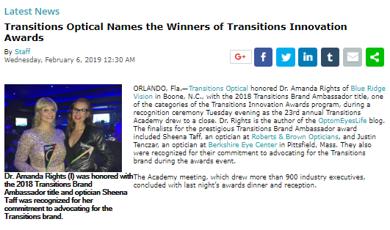
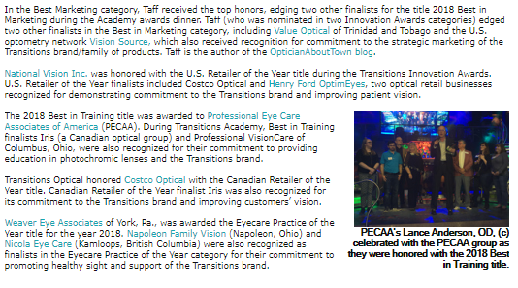
COVERAGE ON VISION MONDAY ONLINE
Notes:
http://www.visionmonday.com/latest-news/article/transitions-optical-names-the-winners-of-transitions-innovation-awards/

Slide 6
COVERAGE ON OPTICAL PRISM AND OPTIK ONLINE
Notes:
https://opticalprism.ca/transitions-optical-announces-2018-transitions-innovation-award-finalists/
https://optiknow.ca/2019/02/19/transitions-names-sheena-taff-as-the-winner-of-the-2018-best-in-marketing-award/

Slide 7
HOW DO YOU ENTER?
Nominations will be accepted online at Transitions.com/Awards from October 1 - 31, 2019
Notes:
Nominations will be accepted online at Transitions.com/Awards from October 1 - 31, 2019.
To enter, candidates must complete a nomination form and detail their 2019 efforts in the following evaluation areas: commitment and inspiration, goals, plan and creativity, and impact and results.
Nominees are welcome to enter more than one category and can self-enter, or can be nominated by a lab, lens manufacturer, industry colleague or other industry organization representative.

Slide 8
GET INSPIRED
Watch this video from the Innovation Awards Ceremony:
https://drive.google.com/open?id=1pdHz8Q45jHIqh34Mi9ffOAn0DILS0La7

Slide 9
HOW TO CREATE A WINNING ENTRY
Visit Transitions.com/Awards

Slide 10
START PLANNING NOW!
Start by deciding which specific award(s) you want to win and review the evaluation areas.
Set your goal for 2019 and benchmark where you are to measure your success.
Put a plan in place to help achieve that goal.
Start tracking now!
Use the Entry Guide and Workbook to Help!
Notes:
Start by deciding which specific award(s) you want to win and review the evaluation areas
Set your goal for 2019 and benchmark where you are to measure your success
TIP: Align your goal(s) with the award you want to enter. For example, if you are seeking the Best in Training award your goal might be to increase staff knowledge and recommendations. Benchmark where you are by testing their product knowledge now and at the end of the year to show your progress
Put a plan in place to help achieve that goal.
Whatever your goal is, make sure you are taking action now and throughout the year to help achieve it.
Start tracking now!
You’ve established your goal and your plans for achieving it. Now you need to keep track of the actions you are taking and your progress towards your goal along the way.
It can be difficult to remember all that you did at the end of the year, so we’ve included slides in this guide for you to document your journey along the way.

Slide 11
TIPS FROM THE JUDGES
Establish clear, measurable goals and show how your results align (even if you don’t achieve your goal).
Report your metrics (results, YOY data) graphically.
Show visuals of what you did to achieve your goals.
Highlight areas that you want the judges to pay particular attention to.
Correctly use branded product names, logos and images.
Try to keep submission to 10 slides.
Notes:
Tips from the Judges:
Don’t submit one PowerPoint presentation for multiple categories. Customize each submission to the category you are applying for.
Establish clear measurable goals right now. Show how your results align with your goal. Even if you don’t achieve your goal, show how you made progress towards it.
Report your metrics (results, YOY data) graphically.
Take pictures, videos and show visuals of what you did to achieve your goals. Snapshots taken on a smart phone are perfectly acceptable.
Highlight areas, through changed text/colors, that you want the judges to pay particular attention to.
Correctly use branded product names, logos and images.
Try to keep submission to 10 slides. Think critically about what information is needed and then only go over the limit if more slides are needed to communicate the information that is asked for.

Slide 12
PAST WINNER PROFILES

Slide 13
PROFESSIONAL EYECARE ASSOCIATES OF AMERICA BEST IN TRAINING
Alliance group of about 3,400 forward-thinking independent eye care professionals
Focused on educating members on the benefits of Transitions® lenses through high-impact in-person events and ongoing virtual trainings
Hosted peer-to-peer training events in eight cities
An increased focus on education helped PECAA achieve over 8% growth in Transitions lenses sales in 2018.
Comments from the judges: Professional Eyecare Associates of America embraced their learnings from Transitions Academy in 2018 by providing all the resources their members needed to best recommend Transitions lenses. With in-person training events and continuous virtual education, PECAA has truly impressed us with their commitment to training their members on the benefits of Transitions lenses.
Notes:
Professional Eye Care Associates of America (PECAA) is an alliance group of about 3,400 forward-thinking independent eye care professionals.
This year, PECAA focused on educating members on the benefits of Transitions® lenses and the style colors and style mirrors products through high-impact in-person events and ongoing virtual trainings. PECAA hosted peer-to-peer training events in eight cities that leveraged the Jason Dorsey generational research, introduced the brand rejuvenation and demoed the new products. To create further awareness and excitement, PECAA featured the style colors at their annual meeting happy hour with four unique cocktails in color changing cups.
PECCA’s increased focus on education helped them achieve over 8 percent growth in Transitions lenses sales in 2018, bringing their total share to 17.8 percent.
Comments from the judges: Professional Eyecare Associates of America embraced their learnings from Transitions Academy in 2018 by providing all the resources their members needed to best recommend Transitions lenses. With in-person training events and continuous virtual education, PECAA has truly impressed us with their commitment to training their members on the benefits of Transitions lenses.

Slide 14
SHEENA TAFF BEST IN MARKETING
A licensed Optician at Roberts & Brown Opticians, an optical blogger and Transitions Change Agent
Created an embodiment of the style colors with bold imagery and product descriptions
Educated her staff on the portfolio of products by creating a "Transitions Bingo" game
Achieved a 17.3% gain in overall Transitions lens sales in 2018 (32.2% of lenses sold are Transitions)
Comments from the judges: Sheena Taff turned a challenge into success by creating her own marketing materials to support the launch of the Transitions® Signature® Style Colors. Sheena’s entrepreneurial spirit was demonstrated through the true ingenuity displayed in the assets that she created. Sheena is a shining example that you don’t need a large marketing budget to make an impact.
Notes:
Sheena Taff is a licensed Optician at Roberts & Brown Opticians, an optical blogger and Transitions Change Agent.
To promote the launch of the Transitions® Signature® lenses style colors in 2018, Sheena created an embodiment of the style colors with bold imagery and product descriptions. Her unique approach to promoting the style colors was shared on social media as well as displayed in her storefront, resulting in an increase of customers starting the conversation about Transitions lenses.
Sheena also educated her staff on the portfolio of products by creating a "Transitions Bingo" game. This helped keep Transitions lenses top of mind and challenged her staff to recommend to all patients.
Comments from the judges: Sheena Taff turned a challenge into success by creating her own marketing materials to support the launch of the Transitions Signature Style Colors. Sheena’s entrepreneurial spirit was demonstrated through the true ingenuity displayed in the assets that she created. Sheena is a shining example that you don’t need a large marketing budget to make an impact.

Slide 15
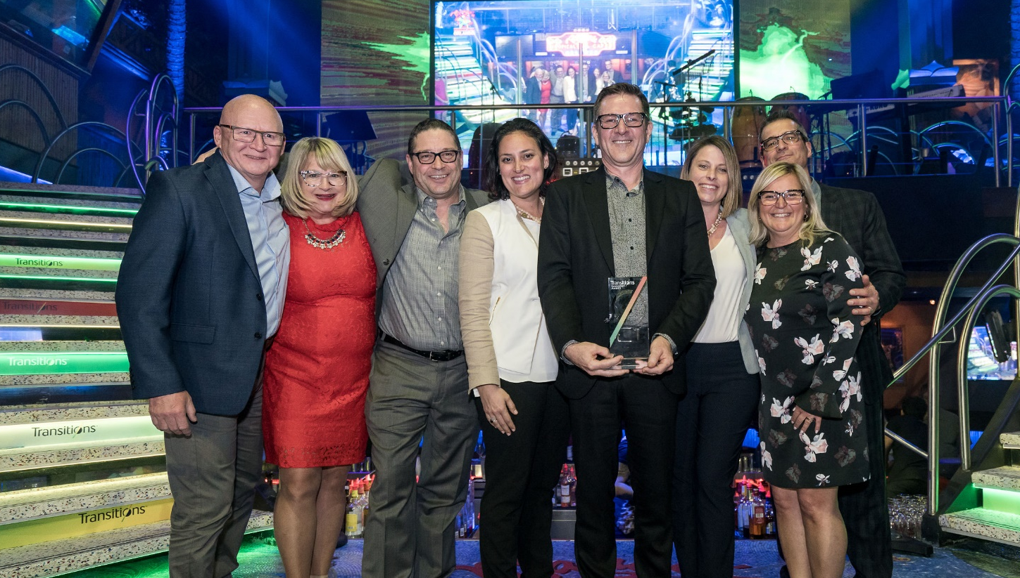
COSTCO OPTICAL CANADA RETAILER OF THE YEAR
An eyecare center with locations inside its warehouse-club locations across Canada
Set a new Transitions® lens benchmark in their stores
Developed a new training program and added new POS to stores
Associates focused on the Transitions benefits of UV protection and blue light filtering
Of overall lenses sold, 20% are Transitions lenses.
Comments from the judges: Not only did Costco Optical create numerous unique training materials in order to educate their staff on the benefits of Transitions lenses, but they also set a new benchmark in their stores that exceeded the Canadian national average for the sale of Transitions lenses.
Notes:
Costco Optical is an eyecare center with locations inside its warehouse-club locations across Canada.
To start off 2018, Costco set a new Transitions® lens benchmark in their stores that exceeded the Canadian national average. To achieve their benchmark, Costco developed a new training program to educate stores and added new Transitions point of sale and style posters in 100 optical stores across Canada.
Costco Optical associates also focused on the Transitions benefits of UV protection and blue light filtering by sharing personal stories about how Transitions lenses keep Canadian members safe.
These efforts helped Costco Optical achieve an overall share of 20 percent for Transitions lenses.
Comments from the judges: Not only did Costco Optical create numerous unique training materials in order to educate their staff on the benefits of Transitions lenses, but they also set a new benchmark in their stores that exceeded the Canadian national average for the sale of Transitions lenses.

Slide 16
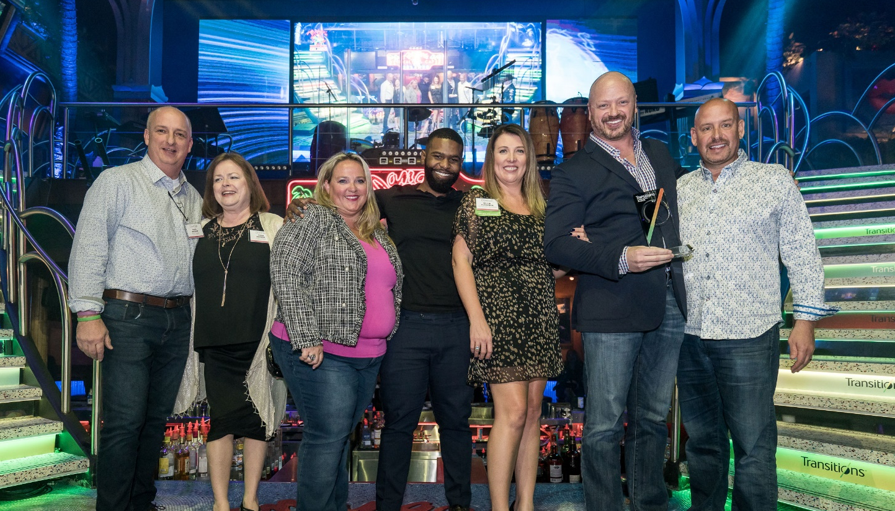
NATIONAL VISION, INC. US RETAILER OF THE YEAR
National retailer and leader in the attractive value segment
Incentivized both district managers and store associates through a summer sales contest for the top performing store in each region
Dedicated to educating patients on Transitions® lenses by equipping stores with the latest resources, including brand new lens mats, and running coupon promotions to encourage patients to try the brand
Increased overall Transitions lens sales by 15.1%
Comments from the judges: National Vision truly put their best foot forward this past year with targeted sales contests, quarterly training materials and Transitions lens messaging across various channels. We applaud National Vision’s unique solutions to educate patients and staff about the value of Transitions lenses through brand new point-of-sale tools and incentives.
Notes:
National Vision, Inc. (NVI) is a national retailer and a leader in the attractive value segment of the U.S. optical retail industry. To drive growth in 2018, NVI incentivized their team with three summer sales contests and recognized the top performing store in each region.
NVI is dedicated to education, and ensures their stores and brands are equipped with the latest tools and training materials. To encourage patients to try Transitions® lenses, NVI ran promotions across its stores and brands and featured brand messaging on the sales floor and in the OD waiting areas, including a TV informational loop and wall signage. NVI helped patients understand the differences between the Transitions portfolio of products by creating new lens mats.
These efforts helped NVI to increase their Transitions lens sales by 15.1 percent.
Comments from the judges: National Vision truly put their best foot forward this past year with targeted sales contests, quarterly training materials and Transitions lens messaging across various channels. We applaud National Vision’s unique solutions to educate patients and staff about the value of Transitions lenses through brand new point-of-sale tools and incentives.

Slide 17
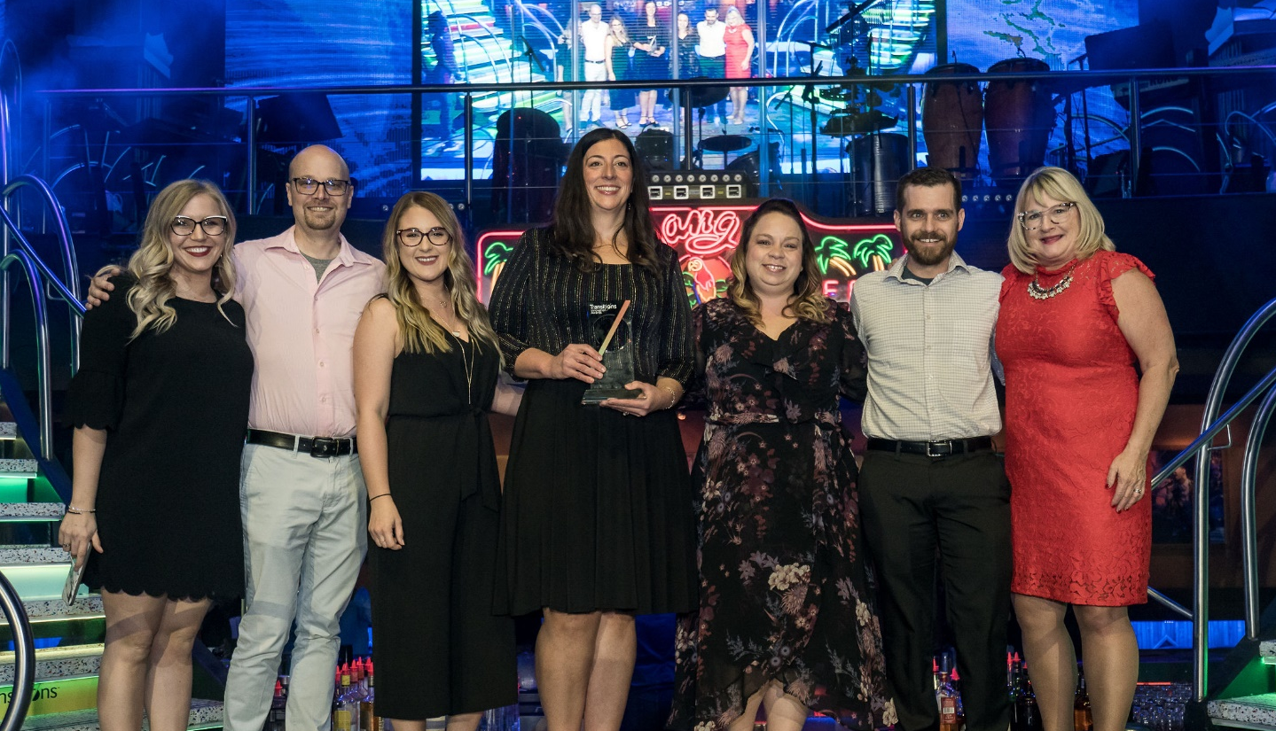
WEAVER EYE ASSOCIATES EYECARE PRACTICE OF THE YEAR
An independent practice with four locations in Pennsylvania.
Closed all four of their offices and brought all 100+ staff together for a training
Created a “Transition Tuesday” on Facebook
Played a video about the importance of harmful blue light protection in the exam room
Achieved a 22% increase in Transitions® lenses sold
Comments from the judges: Weaver Eye Associates’ investment in education really paid off! Closing all of their practices and bringing all of their staff together showed a great commitment to educating on the benefits of Transitions lenses. Once their staff began prescribing instead of recommending, they were able to significantly increase their Transitions lens sales.
Notes:
Weaver Eye Associates is an independent practice with four locations in Pennsylvania.
To start off 2018, Weaver Eye Associates closed all four of their offices and brought all 100+ staff together for a training on the importance of eye health with Transitions. The staff training helped "knock down the walls" for their staff members on their misconceptions about Transitions® lenses and focused on providing more patient education as well.
They created a “Transition Tuesday” on Facebook, which is a Q&A post sent out every week educating patients on the importance of Transitions for everyone. They also played a video about the harmful effects of blue light and the importance of harmful blue light protection in the exam room while the patients waited for the doctor.
Through these efforts, Weaver Eye was able to increase their Transitions lens sales by 22 percent.
Comments from the judges: Weaver Eye Associates’ investment in education really paid off! Once their staff began prescribing instead of recommending, they were able to significantly increase their Transitions lens sales.

Slide 18
DR. AMANDA RIGHTS TRANSITIONS BRAND AMBASSADOR
O.D. at Blue Ridge Vision, Transitions Change Agent and founder of OptomEyesLife
Made it her mission to be a positive voice for the Transitions® brand and demonstrate how Transitions ® lenses can enhance eye health and style
Challenged herself to increase brand awareness and lens sales at her practice
Successfully changed perceptions at her practice—now every staff member owns/wears Transitions lenses
Comments from the judges: Dr. Rights’ commitment to promote lifelong ocular wellness truly embodies the spirit of a Transitions Brand Ambassador. She not only advocates for the brand in her practice, but she educates other eyecare professionals and students through her blog and social media channels.
Notes:
Dr. Amanda Rights is a primary care optometrist, Transitions Change Agent and founder of OptomEyesLife, an ocular health and wellness website specializing in eye care, eyewear, and nutrition. Dr. Rights demonstrates a passion for Transitions lenses both inside and outside the practice. She drives conversations around the brand in industry publications and on her blog and social media pages. Dr. Rights also hosted a "takeover" of New Grad Optometry's Instagram, sharing the benefits of Transitions lenses. Additionally, she contributed to developing content for Transitions Academy 2017 & 2018.
Dr. Rights was key in helping to change perceptions around Transitions lenses among other eye care professionals at her practice by leading training sessions and fitting staff with a pair.
Comments from the judges: Dr. Rights’ commitment to promote lifelong ocular wellness truly embodies the spirit of a Transitions Brand Ambassador. She not only advocates for the brand in her practice, but she educates other eyecare professionals and students through her blog and social media channels.

Slide 19
ENTRY GUIDE
Use these slides and the entry guide and workbook to make your plan

Slide 20
COMMITMENT AND INSPIRATION
What prompted your dedication to the Transitions® brand this year? What was the inspiration behind your work? Was it in response to an existing problem or was it a new objective?
Suggestions from the judges: Consider answering these questions as you set your goals and plan

Slide 21
GOALS
What did you hope to achieve? Who were you trying to reach and how did their needs, preferences, opinions play a role?
Suggestions from the judges: Align your goals with the award you are entering for and benchmark where you are now.
Notes:
Determine your S.M.A.R.T. (specific, measurable, attainable, relevant, time-bound) goal(s)

Slide 22
PLAN AND CREATIVITY
How did you plan to achieve your goals? What innovative approaches did you use to help you succeed? Did you use a completely new approach, a tried-and-true tactic or a mix of both? How was the Transitions® brand or products included in your plans?
Suggestions from the judges: Keep your engagement high throughout the year by refreshing your efforts quarterly.

Slide 23
TRACK YOUR ACTIVITIES
Suggestions from the judges: Capture photos and / or examples of your activities throughout the year.
 | Dispensary | Social Media | Team Building | Doctor Involvement | Incentives | Promotions | Training | Other
January
February
March
April
May
June
July
August
September
October
November
December

Slide 24
IMPACT AND RESULTS
How did things turn out? How did you evaluate your success? Did you meet - or exceed - your goals? How will you build on your success? How did you impact Transitions® lens sales?
Suggestions from the judges: Track your progress monthly or quarterly. Success isn’t just evaluated by sales; consider other ways to evaluate your impact such as staff or customer satisfaction.
 | 2018 | 2019 | % Increase
Pairs of Transitions® lenses sold (If relevant, split out Transitions® Signature® lenses, Transitions® XTRActive® lenses, Transitions® Vantage® lenses, Transitions® Drivewear® lenses, etc.)
Share of overall sales (% of your overall lenses sold that are Transitions® lenses)
Notes:
If relevant, be sure to include your photochromic lens sales (including pair growth and share of overall mix).

Slide 25
GOOD LUCK!

