Slide 1
OVERVIEW AND ENTRY GUIDE
VISIT TRANSITIONS.COM/AWARDS
Notes:
The Transitions Innovation Awards program recognizes and celebrates loyal partners and individual optical industry professionals from Canada and the U.S. who have shown the highest level of commitment to growing its business with Transitions Optical’s family of products and programs over the past year.

Slide 2
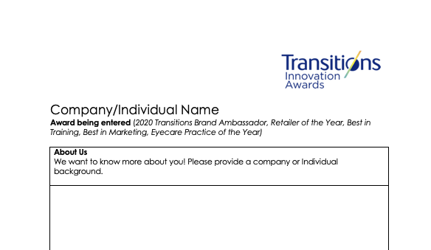
WHO IS ELIGIBLE TO APPLY?
Independent eyecare professionals and practices
Optical industry professionals and educators
National and regional retailers
Optical laboratories
Managed Vision Care companies
Lens manufacturers and buying groups

Slide 3

CATEGORIES INCLUDE:
Transitions Brand Ambassador
Retailer of the Year U.S.
Retailer of the Year Canada
Eyecare Practice of the Year U.S.
Eyecare Practice of the Year Canada
Best in Training
Best in Marketing
Notes:
Transitions Brand Ambassador: This award goes to the individual who best showcases their dedication to being an influential advocate of the Transitions® brand, whether amplifying peer-to-peer conversations, social media or having an unparalleled commitment to incorporating Transitions® lens products into their business goals, patient interactions, training efforts or promotion of healthy vision in their community.
Retailer of the Year U.S., Retailer of the Year Canada: Awarded to a retailer for actively supporting the Transitions brand and demonstrating a commitment to enhancing the vision of their customers and communities. U.S. and Canadian retailers with 20 or more locations are eligible for this award. The award will be presented to one retailer from the US and one retailer from Canada. Nominees are judged on several factors, including overall photochromic growth; efforts to support the Transitions brand through marketing programs and promotions; quality of education provided to optical employees; efforts to promote healthy sight in their local community and support and involvement with public service programs; and an overall commitment to educating customers about the importance of healthy sight and benefits of Transitions lenses.
Eyecare Practice of the Year U.S., Eyecare Practice of the Year Canada: The Eyecare Practice of the Year Award recognizes independent eyecare practices and retailers with less than 20 locations in the U.S. and Canada that are actively promoting healthy sight to their patients and within their local communities, and who have demonstrated excellence in supporting the Transitions brand. The award will be presented to one retailer from the US and one retailer from Canada. All nominees are evaluated on their performance in several factors, including commitment to photochromic growth; alignment to Transitions Optical and participation in programs and promotions; marketing initiatives; education and training efforts; and community involvement.
Best in Training: Presented to an individual, company or educator that has shown creativity in developing or offering training and education opportunities that include dispensing photochromics, the Transitions brand or family of products. This could include integrating Transitions Optical’s messaging or education resources into staff or industry training efforts, or helping to increase participation in training events that include Transitions Optical (such as CE training seminars, education and other training offered through lab and/or lens manufacturer partners).
Best in Marketing: Awarded to an individual or company for employing creative and strategic marketing tactics to effectively promote the Transitions brand or family of products among customers or within their communities. Marketing initiatives could include incorporating the Transitions brand within marketing and advertising campaigns, sales/staff promotions, point-of-sale, in-office materials, or digital communications (email, website, social media, etc). Nominees should also demonstrate how the execution of the marketing tactics helped to “break through the clutter” and add value to their business objectives.

Slide 4
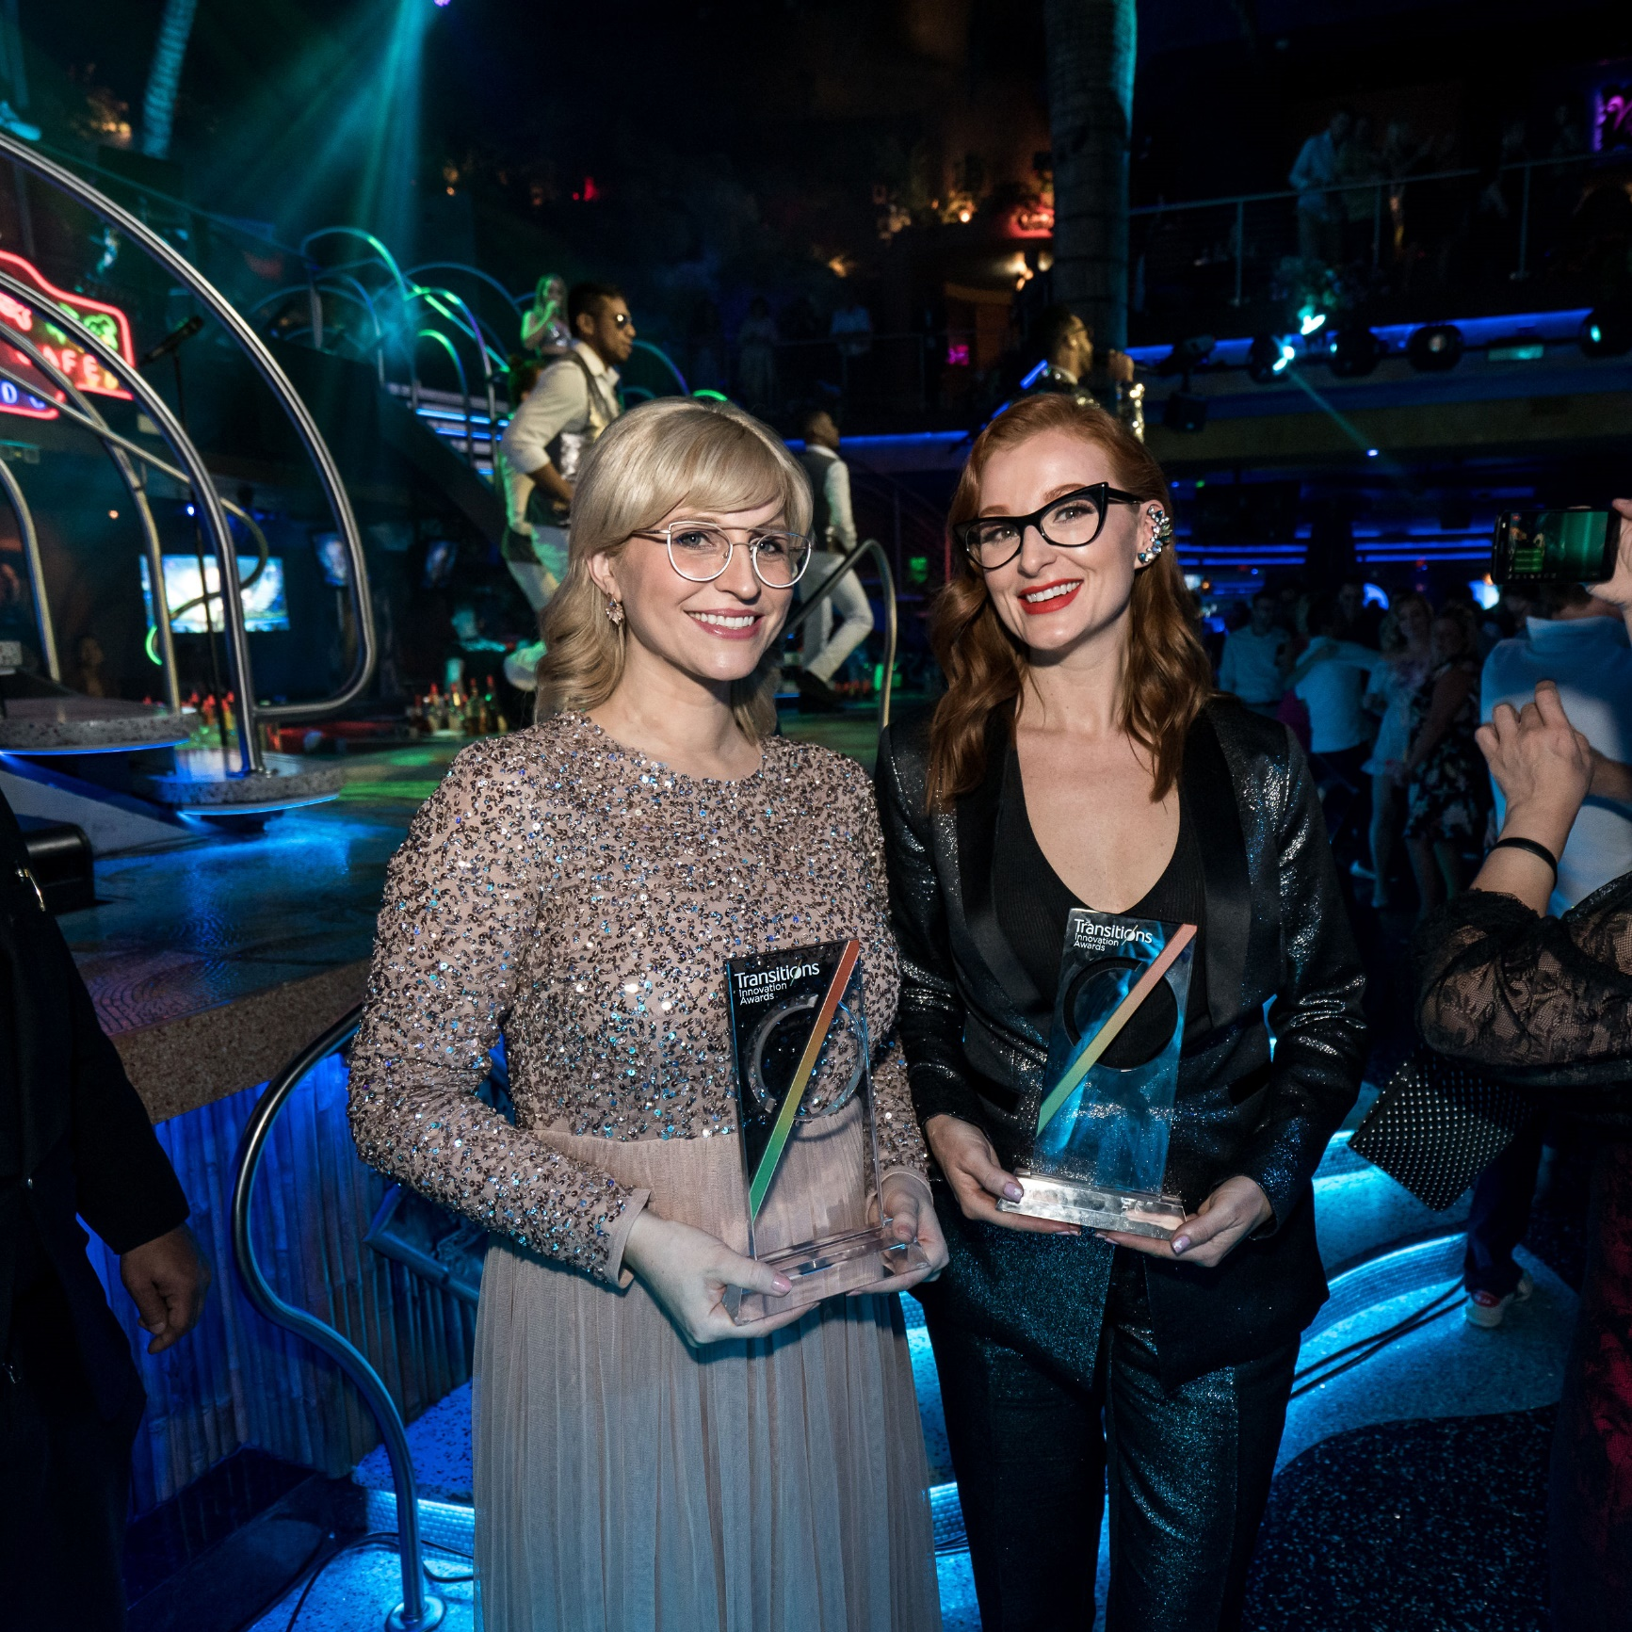
WHAT DO YOU WIN?
A trip for two to Transitions Academy in Orlando, Fla.*
Recognition at Transitions Academy
Coverage in trade news publications (examples follow)
A shiny trophy
Notes:
*Some restrictions may apply. Eyecare professionals are invited to consult their professional code of ethics.

Slide 5
COVERAGE ON OPTIK
Notes:
https://optiknow.ca/2020/02/04/transitions-academy-award-winners

Slide 6
COVERAGE ON OPTICAL PRISM
Notes:
https://opticalprism.ca/transitions-optical-names-vision-care-centre-as-the-winner-of-the-2019-canadian-eyecare-practice-of-the-year-award
https://opticalprism.ca/transitions-optical-names-grimard-optique-as-the-winner-of-the-2019-canadian-retailer-of-the-year-award

Slide 7
HOW DO YOU ENTER?
Nominations will be accepted online at Transitions.com/Awards in January 2021
Notes:
Nominations will be accepted online at Transitions.com/Awards in January 2021.
To enter, candidates must complete a nomination form and detail their 2020 efforts in the following evaluation areas: commitment and inspiration, goals, plan and creativity, and impact and results.
Nominees are welcome to enter more than one category and can self-enter, or can be nominated by a lab, lens manufacturer, industry colleague or other industry organization representative.

Slide 8
HOW TO CREATE A WINNING ENTRY
Visit Transitions.com/Awards

Slide 9

START PLANNING NOW!
Start by deciding which specific award(s) you want to win and review the evaluation areas.
Set your goal for 2020 and benchmark where you are to measure your success.
Put a plan in place to help achieve that goal.
Start tracking now!
Use the Entry Guide and Workbook to Help!
Notes:
Start by deciding which specific award(s) you want to win and review the evaluation areas
Set your goal for 2020 and benchmark where you are to measure your success
TIP: Align your goal(s) with the award you want to enter. For example, if you are seeking the Best in Training award your goal might be to increase staff knowledge and recommendations. Benchmark where you are by testing their product knowledge now and at the end of the year to show your progress
Put a plan in place to help achieve that goal.
Whatever your goal is, make sure you are taking action now and throughout the year to help achieve it.
Start tracking now!
You’ve established your goal and your plans for achieving it. Now you need to keep track of the actions you are taking and your progress towards your goal along the way.
It can be difficult to remember all that you did at the end of the year, so we’ve included slides in this guide for you to document your journey along the way.

Slide 10
TIPS FROM THE JUDGES
Establish clear, measurable goals and show how your results align (even if you don’t achieve your goal).
Report your metrics (results, YOY data) graphically.
Show visuals of what you did to achieve your goals.
Highlight areas that you want the judges to pay particular attention to.
Correctly use branded product names, logos and images.
Try to keep submission to 10 slides.
Notes:
Tips from the Judges:
Don’t submit one PowerPoint presentation for multiple categories. Customize each submission to the category you are applying for.
Establish clear measurable goals right now. Show how your results align with your goal. Even if you don’t achieve your goal, show how you made progress towards it.
Report your metrics (results, YOY data) graphically.
Take pictures, videos and show visuals of what you did to achieve your goals. Snapshots taken on a smart phone are perfectly acceptable.
Highlight areas, through changed text/colors, that you want the judges to pay particular attention to.
Correctly use branded product names, logos and images.
Try to keep submission to 10 slides. Think critically about what information is needed and then only go over the limit if more slides are needed to communicate the information that is asked for.

Slide 11
ENTRY GUIDE
Use these slides and the entry guide and workbook to make your plan

Slide 12
COMMITMENT AND INSPIRATION
What prompted your dedication to the Transitions® brand this year? What was the inspiration behind your work? Was it in response to an existing problem or was it a new objective?
Suggestions from the judges: Consider answering these questions as you set your goals and plan

Slide 13
GOALS
What did you hope to achieve? Who were you trying to reach and how did their needs, preferences, opinions play a role?
Suggestions from the judges: Align your goals with the award you are entering for and benchmark where you are now.
Notes:
Determine your S.M.A.R.T. (specific, measurable, attainable, relevant, time-bound) goal(s)

Slide 14
PLAN AND CREATIVITY
How did you plan to achieve your goals? What innovative approaches did you use to help you succeed? Did you use a completely new approach, a tried-and-true tactic or a mix of both? How was the Transitions® brand or products included in your plans?
Suggestions from the judges: Keep your engagement high throughout the year by refreshing your efforts quarterly.

Slide 15
TRACK YOUR ACTIVITIES
Suggestions from the judges: Capture photos and / or examples of your activities throughout the year.
 | Dispensary | Social Media | Team Building | Doctor Involvement | Incentives | Promotions | Training | Other
January
February
March
April
May
June
July
August
September
October
November
December

Slide 16
IMPACT AND RESULTS
How did things turn out? How did you evaluate your success? Did you meet - or exceed - your goals? How will you build on your success? How did you impact Transitions® lens sales?
Suggestions from the judges: Track your progress monthly or quarterly. Success isn’t just evaluated by sales; consider other ways to evaluate your impact such as staff or customer satisfaction.
 | 2019 | 2020 | % Increase
Pairs of Transitions® lenses sold (If relevant, split out Transitions® Signature® GEN 8™ Transitions® Signature® lenses, Transitions® XTRActive® lenses, Transitions® Vantage® lenses, Transitions® Drivewear® lenses, etc.)
Share of overall sales (% of your overall lenses sold that are Transitions® lenses)
Notes:
If relevant, be sure to include your photochromic lens sales (including pair growth and share of overall mix).

Slide 17
GOOD LUCK!

