Slide 1
The BRIGHT Side of KidZ
Notes:
We’ve heard so much about Baby Boomers and Millennials. Millennials are the most researched generation in history.
In today’s presentation we would like to take a closer look at our kids, those in the “Z” generation. We are just beginning to understand their unique eye care needs and behaviors.
Childhood is a critical time in development of the eye, and when good and bad eye care habits are formed, meaning regular eye care and protection habits should begin early in life.
((Unless noted, all pictures are from Transitions Optical or purchased from Dreamtimes.com or ThinkStock.))

Slide 2
Who is Gen Z?
Born in 1994+, aged 23 or younger
22% of Canada’s population
Half wear eyeglasses, more likely to have lens purchase subsidized
Major traits: Political mistrust, always connected, multi-taskers
Influences household purchases
Add
photo?
Sources: 2017 Wakefied Research, VisionWatch , “Meet Generation Z” by Sparts & Honey
Notes:
Age 23 or younger, Gen Z represents 22% of Canada’s population. Approximately half wear eyeglasses making them a patient group you can’t ignore.
What is interesting is that Gen Z is using their eyes in different ways and this could have consequences – short and long term. There used to be fluorescent lighting in the classroom, today there is LED. Books are being replaced by iPads. We’ve gone from board games to video games and now VR and mobile games.
Millennials often are influenced by hyper-attentive or helicoptering parents. Gen Z tends to have parents that empower their kids to answer questions themselves and resolve problems independently. Gen Z uses the internet from a young age resulting in great adeptness with digital technology. This gives Gen Z more access to information about products and services. And studies show that Gen Z already influences household purchases more than past generations. (Source JWT Intelligence).
This is an indicator that these children will also influence their parents on the eyewear they purchase.

Slide 3
Do You Know?
80% of learning in a child’s first 12 years comes through the eyes
However…
6 out of 10 children experiencing reading difficulties have uncorrected or undetected vision problems.
Almost 25% of school-age children have vision problems.
Sources: Canadian Association of Optometrists , National Coalition for Vision Health
Notes:
The studies are there that prove we need to pay more attention to kids’ vision.
The Canadian Association of Optometrists shares that 80% of learning in the first 12 years of a child is with their eyes. This alone tells us how critical vision is in the early years.
The National Coalition for Vision Health estimates that 6 out of 10 children in Canada experiencing reading difficulties have uncorrected or undetected vision problems and almost 25% of school-age children have vision problems.
Unfortunately, kids don’t always know they are experiencing a vision problem. The symptoms might not be too difficult for us to notice as professionals, but we can do a better job on educating the parents, teachers, caretakers and their loved ones on symptoms to look for with children. We will go into more details on the symptoms a little later in the presentation.
There are many reasons children that need glasses don’t have them. Our hopes are that this number will decrease as we increase awareness about children’s vision and development.

Slide 4
Talk to Parents / Teachers About the Symptoms to Watch For:
Consistently sitting close to the TV or holding a book close | Frequent eye rubbing | Losing place while reading or using a finger to guide eyes when reading | Sensitivity to light and/or excessive tearing
Closing one eye to read or watch TV | Receiving lower grades than usual | Avoiding using a computer, because it “hurts my eyes” | Squinting or tilting the head to see the classroom board
Notes:
Kids don’t always know they are experiencing a vision problem. The symptoms might not be difficult for us to notice as professionals, but we can do a better job educating the parents, teachers and caretakers on symptoms to look for.
While it is myth that sitting too close to the TV will ruin your eyes, this habit could be a sign of a vision problem.
Yes, children do often rub their eyes when they are tired or upset. But if the child rubs his eyes while he is trying to concentrate on something, or while he is being active, it could mean that he has a vision problem.
When kids learn to read, they’ll often use their finger to track which word they are on. But eventually they should be able to focus and not lose their place.
Children with photophobia, or extreme sensitivity to light, can develop headaches and nausea.
Frequently closing one eye could indicate a refractive or binocular vision problem that interferes with the ability of the two eyes to work together comfortably as a team. While these problems are not life threatening, they need to be corrected early in order to avoid short- and long-term consequences that can follow them into adulthood.
If a child is having a hard time seeing what their teacher writes on the board because of poor vision, they may not tell you about it. As a result their grades can suffer.
Digital eye strain is common among children who are frequent users of computers or other digital devices.
8. Teachers should be on the lookout for students who have to squint or tilt their heads to see the board.

Slide 5
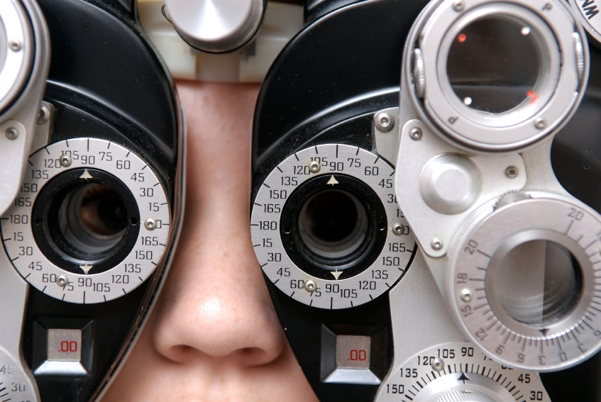
Recommended Frequency
Age | Exam Interval
Infants and Toddlers (Birth to 24 months) | First eye exam should occur between the ages of 6 and 9 months
Preschool Children (2 to 5 years) | One eye exam between the ages of 2 and 5 years
School Age Children (6 to 19 years) | Annually
Source: Canadian Association of Optometrists
Notes:
The Canadian Association of Optometrists recommends that children get a comprehensive eye exam at the following intervals if they are low risk:
Infants and Toddlers (Birth to 24 months) -- Infants and toddlers should undergo their first eye examination between the ages of 6 and 9 months
Preschool Children (2 to 5 years)-- Preschool children should undergo at least one eye examination between the ages of 2 and 5 years
School Age Children (6 to 19 years) -- School children aged 6 to 19 years should undergo an eye examination annually
https://opto.ca/health-library/frequency-of-eye-examinations

Slide 6
The Need for Protection
Notes:
Kids’ protection will only get better as we learn more about the different needs of kids. Let's take a closer look at the child’s developing eye to understand their needs.

Slide 7
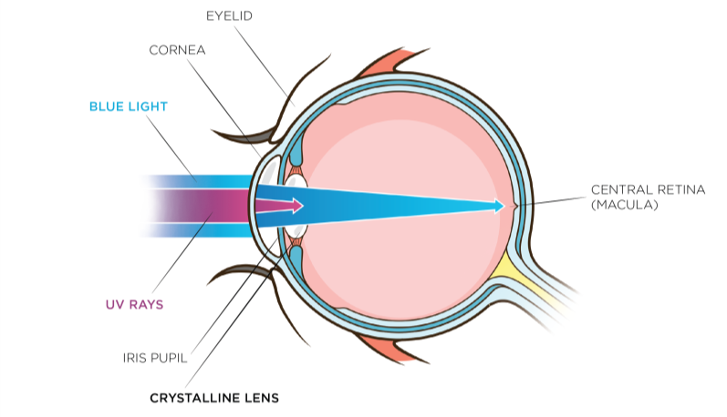
UV and Blue Light
Young eyes allow more damaging light in.
Long-term exposure to harmful blue light has been linked to increased risk of developing age-related macular degeneration.
Sources: Sparrow 2000, Arnault 2013
Notes:
A child’s crystalline lenses are not fully developed to adequately filter UV rays, therefore they are more vulnerable to UV radiation and increased transmission inside the eye than an adult. Given that a child’s eye lets in six times the UV radiation as an adult’s eye, it is never too early to start protecting the eyes.
While UV transmittance is blocked primarily by the cornea and crystalline lens in healthy adults, as a part of visible light, blue light passes through the eye structure, reaching the retina. The amount of blue light reaching the retina depends on the age of the eye as, during a lifetime, there is a slight yellowing of the crystalline lens that would typically provide some absorption in the blue violet region.
This is important, because long term exposure to harmful blue light has been linked to increased risk of developing age-related macular degeneration.
Simply put, a child’s eyes are more vulnerable to UV and harmful blue light because their eyes are not fully developed. Making protection even more important for young eyes.
Sources:
Sanford BE et al. Acta Ophtalmologica Scandinavica. 1996; 74:553-557.
Arnault E. Barrau C, Nanteau C. Gondouin P, Bigot K, et al. Phototoxic Action Spectrum on a Retinal Pigment Epithelium Model of Age-Related Macular Degeneration, PlosOne 8 (2013) http://dx.doi.org/10.1371/journal.pone.0071398
Sparrow J.R., Nakanishi K., Parish C.A., The Lipofuscin Fluorophore A2E Mediates Blue Light-Induced Damage to Retinal Pigmented Epithelial Cells, Invest. Ophthalmol. Vis. Sci. 41 (2000) 1981-1989 http://www.ncbi.nlm.nih.gov/pubmed/10845625

Slide 8
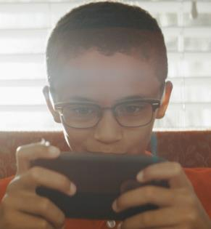
Digital Device Usage
Harmful blue light and eye strain are at the forefront of public consciousness because of the increased use of digital devices in recent years.
2 HOURS PER DAY IN FRONT OF SCREENS
Source: Active Healthy Kids Canada
Notes:
As we discussed, children today are living a different childhood.
In fact, on average, 3- to 5-year-olds in Canada spend about half of their waking hours in sedentary pursuits and an average of 2 hours per day in front of screens.
61% of Canadian parents agree that their kids spend too much time watching tv or using the computer.
Source: Active Healthy Kids Canada, 2014 Active Healthy Kids Canada Report Card On Physical Activity For Children And Youth
http://www.participaction.com/sites/default/files/downloads/Participaction-2014FullReportCard-CanadaInTheRunning_0.pdf
Some of our kids will never know the sound of a dial tone because they have only known cell phones. Kids today talk to their travelling parents with FaceTime. Consideration of time spent on digital devices because of the harmful blue light emitted, and eyestrain should be at the forefront of concern when it comes to kids’ vision. With studies of Gen Z and how they are using digital devices, we can offer better protection for them.

Slide 9
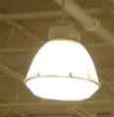
Blue Light Sources
INDOORS – Harmful blue light
OUTDOORS – UV and harmful blue light
LED Lights
OVER 100 TIMES
MORE INTENSE THAN ELECTRONIC DEVICES AND SCREENS
Digital Devices
THE SUN
Metal
Halide Lamps
Source: Baillet G., Granger B., How Transitions® lenses filter harmful blue light, Points de Vue, International Review of Ophthalmic Optics, March 2016
Notes:
However, what most people don’t know is that the sun is the largest singular source of harmful blue light, emitting over 100 times the intensity of electronic devices and screens.
And with all the activities that kids do outdoors (recess, soccer, baseball) – they are at risk for exposure.
With the combination of outdoor sun and indoor time with harmful blue light sources, it is important to provide a blue light filter for the developing children’s eyes. Transitions lenses are a great solution as they filter both UV and harmful blue light both indoors and especially outdoors.
---
Source: Baillet G., Granger B., How Transitions® lenses filter harmful blue light, Points de Vue, International Review of Ophthalmic Optics, online publication, March 2016
http://www.pointsdevue.com/article/how-transitionsr-lenses-filter-harmful-blue-light

Slide 10
Time Outdoors and Myopia
Spending time outdoors may lower risk of nearsightedness
70% of youth spend less than 1 hour outside daily
Source: David Suzuki Foundation, Youth Survey on Nature and the Outdoors
Notes:
70% of youth (between the ages of 13-20) spend about an hour or less outside each day.
(Source: David Suzuki Foundation's 2012 Youth Survey on Nature and the Outdoors
http://www.davidsuzuki.org/media/news/2012/09/majority-of-canadian-youth-spend-an-hour-or-less-outside-each-day/)
With less time outdoors, we are seeing an increase of myopia.
There is growing evidence that spending more time outdoors may lower the risk of nearsightedness in children and adolescents. The AAO also reported that nearsightedness is more common today in the US and many other countries than it was in the 1970s. The findings show that because kids are spending more time indoors on digital devices, instead of out door play time, we are seeing increased myopia.
One of the studies showed that for each additional hour the children spend outdoors per week, their risk of being nearsighted dropped by about 2 percent.
Nearsighted children in this study spent an average of 3.7 fewer hours per week outdoors than those with normal or farsighted vision
Studies have shown that daily light exposure required in childhood to slow axial eye growth and in turn, reduce the development and progression of myopia. We can already see the increasing myopia in China as daily light exposure has been reduced over the years.

Slide 11
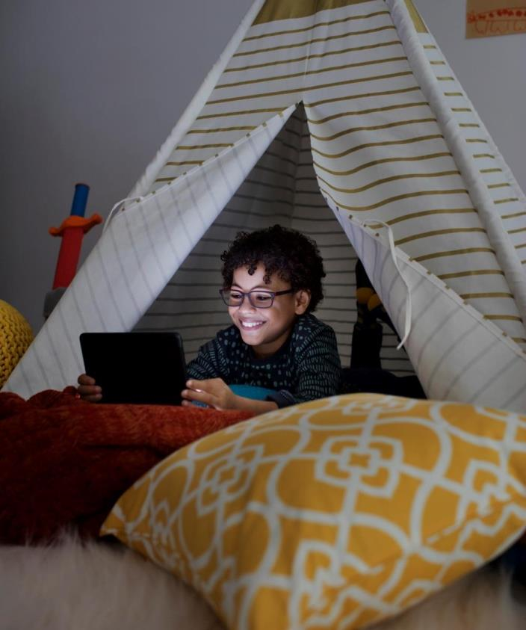
Visual Fatigue
20-20-20 rule
Every 20 minutes, look at something about 20 feet away for 20 seconds.
Computer Eyewear
Don’t be afraid to address visual fatigue with small plus lens
Notes:
So Gen Z is spending less time outside and more time on digital devices which brings us to the next issue we need to protect kids from. Visual Fatigue. We need remind patients of all ages to take breaks following the new 20/20/20 rule. This helps to alleviate digital fatigue, encourages blinking and reduces eye strain.
There is also the opportunity to recommend eyewear with a small plus lens to help.

Slide 12
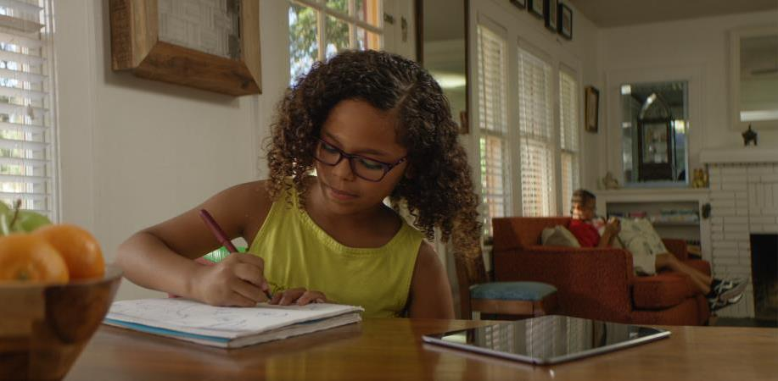
What Do Kids Think About Eyewear?
They look smart
They look honest
9 out of 10 Kids prefer Transitions® lenses to regular clear lenses
Glasses are a great accessory
Sources: Ophthalmic and Physiological Optics, May 2008, Romeu ML 2003
Notes:
When taking to kids about eyewear, let them know what their peers think about glasses.
In a study of kids ages 6 to 10, kids said eyeglasses make other kids Look Smart and Look Honest.
A study performed in the U.S. by optometrist, Dr. Madeline Romeu found that children significantly preferred photochromic lenses over clear lenses. In fact, 9 out of 10 Kids Prefer Transitions lenses to regular clear lenses.
Glasses can be a great accessory – some kids are purchasing non-prescription glasses at retailers such as Claire’s as an fun accessory.

Slide 13
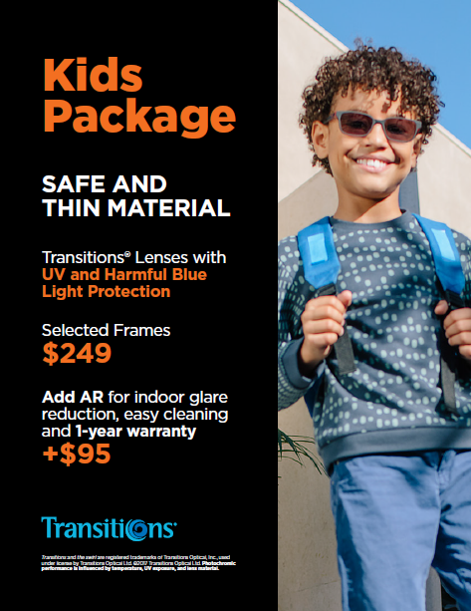
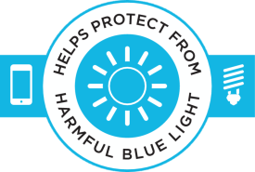
Transitions® Lenses are the Ideal Choice for Kids
One pair does it all, seamlessly!
UV protection
Filters harmful blue light – from devices and especially the SUN
Glare
Fatigue
+ Polycarbonate for Impact resistance
+ AR for glare protection and cleanability
Notes:
Transitions lenses are the ideal choice for kids… One pair does it all, seamlessly! They block 100% of UVA and UVB rays and they help to filter harmful blue light both indoors and especially outdoors. They reduce painful glare, allowing children to see their best in any light condition reducing eye fatigue and improving visual comfort
To make the ideal kids package add polycarbonate for important impact resistance. More than 40,000 sports-related eye injuries occur each year. 90% could have been prevented with the right eyewear.
There are also many good reasons to include AR in your prescription for kids. The vision and aesthetic improvements AR provides helps facilitate a positive experience, and give kids clear and comfortable vision – reducing glare and reflections in polycarbonate lenses and from digital devices.
This bundled lens option provide visual comfort and savings to the family. It keeps things simple so parents are more comfortable, the child has less time to be distracted, and you are able to offer premium lens solutions without hesitation.
Offer warranties but do limit them as kids Rx’s are only for a year rather than the adult 2-year Rx. Warranties represent added value, so make sure to talk about every warranty even if it is coming from the manufacturer.

Slide 14
Frame and Other Recommendations
_{Second Pair}
Sports pair
Backup pair
Computer pair
Fashion - Whether full or part-time eyeglass wearers, kids like their glasses to look “cool.” We want them to wear the glasses. Fun colour, patterns and styles make glasses appealing.
Plastic or Metal – In the past plastic was considered better as they were considered more durable. That is no longer the case with improvements from manufacturers.
Proper Bridge Fit – Young children’s noses are not fully developed so fit can make the difference of glasses staying in place.
Temples – Cable temples, straps, skull temples.
Spring Hinges – Prevents the need for frequent adjustment and repair.
Notes:
It’s important with kids, as with adults, that we start with lenses first. Then we move to finding the best frame that matches the child's activity level, face shape, bridge, eye size (giving room to grow, but not too much as comfort is more important).
Sports Rx for protection should be considered just like protective sports gear. Can the child study at school, ride a bike etc., without their glasses? If not, a back up pair is a necessity. Besides being a back up pair, they can be a fashion statement or accessory. Two different styles can make wearing glasses more fun by changing it up a bit.
When recommending Transitions lenses, find a frame that looks equally good as an indoor pair as well as an outdoor pair.

Slide 15
Tips for Success
Prescribe the BEST visual solution(s) for your patient’s needs
Talk with the child and the parent together – GenZ influences decisions
Communicate in shorter bursts of “snackable content” – their attention span is only about 8 seconds
Use kid-friendly language or buzz words
Talk to them about value
Feed their curiosity
UV flashlight or Transitions lens demo
Notes:
In our conversations, it is the combination of product, knowledge, price and how we present it to our patients, parents or guardians. Stop thinking “parents don’t want to spend money on their kids glasses.” We have to be confident in prescribing the best solution – that might include a sports pair or back-up pair.
Gen Z has more influence on parents than the past, so remember to talk directly to them.
Connecting with Gen Z can be a little different. Studies have shown that these young minds have famously short attention spans of a brief 8 to 4 seconds. Short and to the point dominates any strategy for reaching Gen Z.
Use kid-friendly language or buzz words, like “Transitions lenses are magic or transformer lenses” and “computer lenses are for Xbox or technology lenses”
Talk to them about value (they care about the cost of things).
We are fortunate to have tools to help us spike their curiosity. Help them understand the importance of UV and blue light protection. Show them the amazing magic of Transitions lenses with a UV flashlight or demo unit.

Slide 16
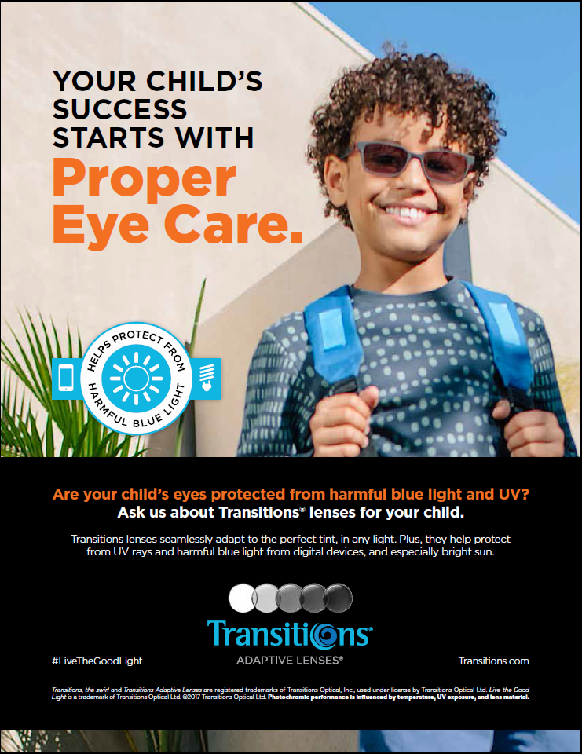
Kids’ Resources
Available at Transitions.com/kid
Counter card
Package sell sheet
Kids’ eyes brochure
Social media images/content
Sample letters
Permission note to allow photochromics in school
Note offering vision screenings
Introduction to healthcare professionals

Slide 17
No doubt there is a BRIGHT side of KidZ
THANK YOU
Notes:
We wish you success and fun as you approach the opportunities with our Gen Z Kids.

