Slide 1
The BRIGHT Side of KidZ
Notes:
Kids, their beautiful eyes and smiles can brighten our day, or perhaps bring a few grey hairs. But as we know, they grow up so fast. In the blink of any eye they are teenagers, and you know how the rest goes.
We’ve heard so much about Baby Boomers and Millennials – generations that have their own unique eye care needs and behaviors. In today’s presentation we would like to take a closer look at our kids, those in the “Z” generation. They are a large group: two billion worldwide, and one-quarter of the North American population. Today, we would like to focus on better a understanding of childhood development and our kids’ market.
((Unless noted, all pictures are from Transitions Optical or purchased from Dreamtimes.com or ThinkStock.))

Slide 2
Today’s Objectives
Explore how different generations think about and use their eyes – and what this means for Gen Z
The importance of vision in childhood development
The need for kids’ eye care and eye protection from UV and harmful blue light
How we as opticians and staff can provide the best possible eye care to our younger patients
Notes:
Life is different today than how past generations grew up. What is interesting is that Gen Z is using their eyes in different ways and this could have consequences – short and long term.
There used to be fluorescent lighting in the classroom, today there is LED. Books are being replaced by iPads. We’ve gone from board games like Candy Cane Lane and Monopoly to PlayStation and Nintendo and now VR and mobile games like Pokemon Go.
We’ve improved the safety of kids … seatbelts and now car seats that grow up with them. Past generations didn’t use a helmet to ride a bike like kids do today.
I can go on and on, but today we will focus on the Bright Side of Kidz vision and the not so bright so we can better understand how to work with our Generation Z kids.

Slide 3
Canadian Populous by Age
Source: Statistics Canada, 2011 Census
Notes:
Generation Z is 22% of Canada’s population according to Statistics Canada.
Millennial’s are the most researched generation in history. However, we are just beginning to understand the impact of what Gen. Z will have on the future.
Source: http://www12.statcan.gc.ca/census-recensement/2011/as-sa/98-311-x/2011003/tbl/tbl3_2-1-eng.cfm

Slide 4
 | BABY BOOMERS | GEN X | MILLENNIAL | GEN Z
Years | 1946-1964 | 1965-1976 | 1977-1993 | 1994 -
Ages | 71 - 53 | 52 - 41 | 40 - 24 | 23 and younger
Major Events | Civil rights Women’s liberation Cold War | Watergate Advent of MTV | AIDS Technology | 9/11 Iraq / Afghanistan Wars Market crash
Major Traits | Explore Optimistic Work-centric | Individualistic Flexible Skeptical | Tech-dependent Family-centric Optimistic | Political mistrust Always connected Multi-taskers
Attitudes About Eyewear | 77% wear eyeglasses Highest repurchase cycle and private pay More likely to buy from independents | 72% wear eyeglasses Almost 60% of all Sun Rx sold is sold to presbyopes | Most likely to… Feel blue light protection is important Prefer online customer service / text Buy from retail | ~Half wear eyeglasses More likely to have lens purchase subsidized
Sources: 2017 Wakefied Research, VisionWatch
Notes:
The differences in childhood shape how we see the world and even our attitudes about eyewear.
With their dependency on technology it’s not surprising that millennials are more likely to say it is important to have blue light protection in their prescription eyeglasses (83% of Millennials, versus 77% of Gen X and 75% of Boomers). (Source: 2017 Transitions Employee Perceptions of Vision Benefits, Wakefield Research)
Millennials often are influenced by hyper-attentive or helicoptering parents. Gen Z tends to have parents that empower their kids to answer questions themselves and resolve problems independently. Gen Z uses the internet from a young age resulting in great adeptness with digital technology much earlier in life. This access gives Gen Z more to think about and information about products and services. This information is a great indicator that these children will also influence their parents on the eyewear they purchase for them.
(Other eyewear data is from VisionWatch a continuous consumer survey from The Vision Council)

Slide 5
Purchase Decisions Influenced by Gen Z
Source: “Meet Generation Z” by Sparts & Honey
Notes:
Studies show that Gen Z already influences household purchases more than the past generation kids. (Source JWT Intelligence)
(Another study with New York Agency Sparts & Honey’s report called “Meet Generation Z” found that GenZ influences major purchasing decision according to moms.) Their ability to influence purchase decisions shouldn’t be taken likely as this ability is very powerful.
Marcie Merriman, Executive director of Growth Strategy and Retail innovation at Ernst & Young, told Business Insider that Gen Z is influencing the way their parents are spending, more than millennials ever did, So talking to our Gen Z patients and parents is definitely different than previous generations when it comes to products.

Slide 6
Insert Meet GenZ Video
Video can be downloaded from here:
https://drive.google.com/drive/folders/0B8jvqvV77pcJejF2LUQwbmtGVUU?usp=sharing
Source: Washington Post

Slide 7
Do You Know?
80% of learning in a child’s first 12 years comes through the eyes
However…
6 out of 10 children experiencing reading difficulties have uncorrected or undetected vision problems.
Almost 25% of school-age children have vision problems.
Sources: Canadian Association of Optometrists , National Coalition for Vision Health
Notes:
The studies are there that prove we need to pay more attention to our kids’ vision.
The Canadian Association of Optometrists shares that 80% of learning in the first 12 years of a child is with their eyes. This alone tells us how critical vision is in the early years.
The National Coalition for Vision Health estimates that 6 out of 10 children in Canada experiencing reading difficulties have uncorrected or undetected vision problems and almost 25% of school-age children have vision problems.
Unfortunately, kids don’t always know they are experiencing a vision problem. The symptoms might not be too difficult for us to notice as professionals, but we can do a better job on educating the parents, teachers, caretakers and their loved ones on symptoms to look for with children. We will go into more details on the symptoms a little later in the presentation.
There are many reasons children that need glasses don’t have them. Our hopes are that this number will decrease as we increase awareness about children’s vision and development.

Slide 8
A Need for Advocates
Kids with undetected vision problems can suffer from low self-esteem, frustration, poor literacy or physical side effects, like headaches.
Sometimes, they are even wrongly viewed as “slow learners.”
Vision problems can limit the ability of a child to learn as well as interact with other children.
Notes:
The last thing a parent wants to hear is that their child has a learning disability. Unfortunately many teachers and parents don’t know what to look for, so vision problems easily go undetected. Sometimes they are not only viewed as a “slow learner” but often a “problem child” as reported by the American Optometric Association. (According to the American Optometric Association, 6 out of 10 students identified as “problem learners” have undetected vision problems.)
According to the National Parent Teacher Association, more than 10 million children in this country have vision problems that contribute to poor academic performance
We often think about vision with visual acuity, but it is easy to forget how much vision can affect the social development of children. Simple daily activities like playing and interacting with others can be difficult for kids with vision problems. Sometimes you see little ones on the soccer team completely in their own world. This doesn’t necessarily mean a vision issue, but it can. Teachers often think children have ADD when behavior issues can actually be an indication of vision difficulties. It is especially important for those dealing with kids to be aware of the symptoms of vision problems.
We can be an advocate for kids by increasing awareness.

Slide 9
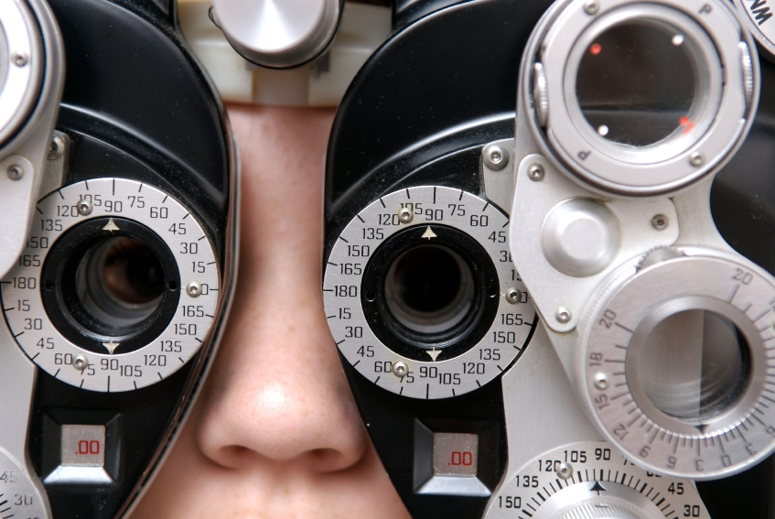
Childhood is When Regular Eye Care and Protection Should Begin
61% of Canadian parents mistakenly believe they would know if their child is having a problem with their eyesight.
Canadian parents rank child eye health as one of their lowest health priorities, with only 25% choosing it as one of their top three concerns.
Fewer than 14% of children in Canada under age 6 have had eye examinations.
Sources: Canadian Association of Optometrists, National Coalition for Vision Health
Notes:
Childhood is a critical time in development of the eye, and when good and bad eye care habits are formed, meaning regular eye care and protection habits should begin early in life.
61% of Canadian parents mistakenly believe they would know if their child is having a problem with their eyesight.
Canadian parents rank child eye health as one of their lowest health priorities, with only 25% choosing it as one of their top three concerns.
(Source: Canadian Association of Optometrists
http://www.newswire.ca/news-releases/canadian-parents-turn-a-blind-eye-to-childrens-eye-health-589456541.html)
Fewer than 14 per cent of children in Canada under age 6 have had eye examinations.
(Source: National Coalition for Vision Health
http://www.cos-sco.ca/wp-content/uploads/2012/09/VisionLossinCanada_e.pdf)
We hope to stop the problem now so that it doesn’t continue to effect the lives of children into adulthood. ~ Yes, a new world indeed!

Slide 10
Opportunity Awaits
To educate parents, teachers and loved ones
To understand the visual health differences of Generation Z and the opportunities for practice growth
To influence the lives of kids in a way that will influence their future as well as ours
Notes:
We see the changes and challenges of today’s world, but this just gives us opportunities as we begin to take a closer look at Generation Z. We always hear, the Kids are our future. Yes they are, and we can make a difference. This information leads us to realize that presenting eyewear to the child is just as important as presenting to the parent.

Slide 11
Educate Parents, Teachers and Loved Ones

Slide 12
Talk to Parents / Teachers About the Symptoms to Watch For:
44% of parents are not aware that behavioral problems can be an indication that a child’s vision is compromised
Consistently sitting close to the TV or holding a book close
Notes:
First step. We need to get parents to realize they need to bring their kids in for an exam then this needs to be a message ECPs push to new potential patients -- through a blog, social, or through schools.
While it is myth that sitting too close to the TV will ruin your eyes, this habit could be a sign of a vision problem.

Slide 13
Talk to Parents / Teachers About the Symptoms to Watch For:
Consistently sitting close to the TV or holding a book close | Frequent eye rubbing
Notes:
2. Yes, children do often rub their eyes when they are tired or upset. But if the child rubs his eyes while he is trying to concentrate on something, or while he is being active, it could mean that he has a vision problem.

Slide 14
Talk to Parents / Teachers About the Symptoms to Watch For:
Consistently sitting close to the TV or holding a book close | Frequent eye rubbing | Losing place while reading or using a finger to guide eyes when reading
Notes:
2. When kids learn to read and are sounding out words, they’ll often use their finger to track which word they are on. But eventually they should be able to focus and not lose their place.

Slide 15
Talk to Parents / Teachers About the Symptoms to Watch For:
Consistently sitting close to the TV or holding a book close | Frequent eye rubbing | Losing place while reading or using a finger to guide eyes when reading | Sensitivity to light and/or excessive tearing
Notes:
4. Are your child’s eyes particularly sensitive to indoor lighting, sunshine or camera flashes? Children with photophobia, or extreme sensitivity to light, can develop headaches and nausea.

Slide 16
Talk to Parents / Teachers About the Symptoms to Watch For:
Consistently sitting close to the TV or holding a book close | Frequent eye rubbing | Losing place while reading or using a finger to guide eyes when reading | Sensitivity to light and/or excessive tearing
Closing one eye to read or watch TV
Notes:
5. Frequently closing one eye could indicate a refractive or binocular vision problem that interferes with the ability of the two eyes to work together comfortably as a team. While these problems are not life threatening, they need to be corrected early in order to avoid short- and long-term consequences that can follow them into adulthood.

Slide 17
Talk to Parents / Teachers About the Symptoms to Watch For:
Consistently sitting close to the TV or holding a book close | Frequent eye rubbing | Losing place while reading or using a finger to guide eyes when reading | Sensitivity to light and/or excessive tearing
Closing one eye to read or watch TV | Receiving lower grades than usual
Notes:
6. If a child is having a hard time seeing what their teacher writes on the board because of poor vision, they may not tell you about it. As a result their grades can suffer.

Slide 18
Talk to Parents / Teachers About the Symptoms to Watch For:
Consistently sitting close to the TV or holding a book close | Frequent eye rubbing | Losing place while reading or using a finger to guide eyes when reading | Sensitivity to light and/or excessive tearing
Closing one eye to read or watch TV | Receiving lower grades than usual | Avoiding using a computer, because it “hurts my eyes”
Notes:
7. Digital eye strain is common among children who are frequent users of computers or other digital devices.

Slide 19
Talk to Parents / Teachers About the Symptoms to Watch For:
Consistently sitting close to the TV or holding a book close | Frequent eye rubbing | Losing place while reading or using a finger to guide eyes when reading | Sensitivity to light and/or excessive tearing
Closing one eye to read or watch TV | Receiving lower grades than usual | Avoiding using a computer, because it “hurts my eyes” | Squinting or tilting the head to see the classroom board
Notes:
8. Teachers should be on the lookout for students who have to squint or tilt their heads to see the board. Until an eye exam can be performed, consider moving the child closer to the board for easier viewing.

Slide 20
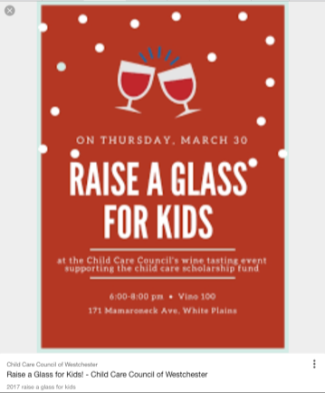
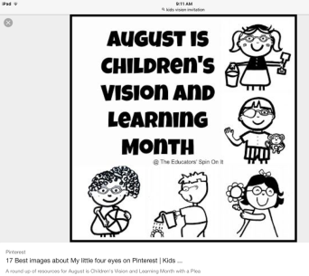
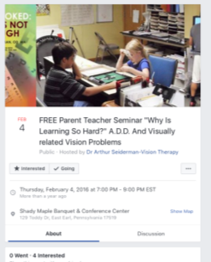
Think Outside the Box
Spread the message through…
Social media
School / PTAs
Teachers / school visits
Nurses / eye first aid kits (DistinctiveStratagies.com)
Coaches / community sports teams
Notes:
Only a few organizations outside of those dedicated to eye care are addressing poor vision in children as an issue affecting literacy, which makes it so important that we as eyecare professions help our Z generation kids.
(ZabaJN, Mozlin R, Reynolds WT. Insights on the efficacy of vision examinations and vision screening for children first entering school. J Behav Optom 2003:123-126)
We can talk to parents, but there is so much more we can do to help parents and others realize the importance of eye exams throughout childhood. As professionals we can reach out to our communities through social media, school PTAs, school teachers, etc. We can think outside the box to get our message out there. Eye First Aid kits to every school, evening educational seminar for teachers, reaching out to coaches / community sports teams, etc.
Pinterest has great ideas when it comes to invitations for events that can invite teachers, school nurses, pediatricians or whoever you would like to make aware of understanding kids vision. This is a great opportunity to “give back” to the community but often it ends up “giving back” to the practice with referrals. DistinctiveStratagies.com has pre-made eye first aid kits for purchase. All you need to do is put your business card in them. If you go to a PTA meeting, present to the school nurse or principal.
Most recreational team sports have a signup day. AYSO, football, swimming, etc. Ask permission from appropriate personnel to attend. Bring a table and eye safety information/frames to share with attendees. Bring lens cleaner and cloths to clean glasses while you educate. We all fear kids getting hurt during sports, so this would be a great addition to any signup event.

Slide 21
The Need for Protection
Notes:
The sweet smile of a child is the reward for the love and protection we give them.

Slide 22
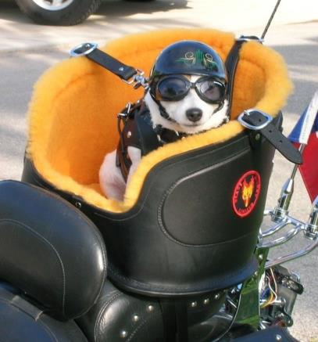
Protecting Pets…..
Notes:
(These photos were not purchased)
It’s almost humorous the way we protect our four-legged friends. We need to do the same and better for our kids.

Slide 23
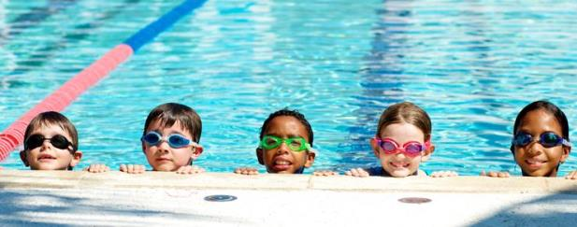
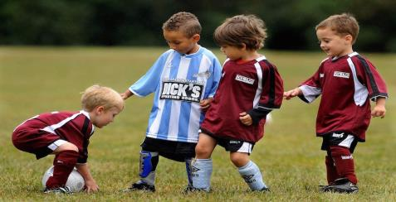
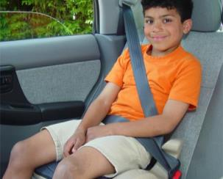
Body / Skin Protection #1 with Parents
Car seats
Sports gear – bike, baseball, soccer, swimming, basketball, track, volleyball, motorcycle riding, skiing, surfing, tennis, etc.
Hats/clothing/sunscreen
Socks to prevent blisters
Jackets, ear muffs, gloves to protect from cold
Notes:
Kids’ protection has only gotten better as we learn more about the different needs of kids. We provide for our kids to make sure they are protected in sports, the car and from the weather.
We protect our kids in other ways too. When we learn about the soft spot on an infants head and neck muscles aren’t fully developed we hold them to support and protect them from injury. We also have learned about the developing child that is it good for them to crawl as it assists with hand eye coordination. So as we learn more about protection and safety we are making great changes. We are now better understanding the developing eyes of a child and just like other parts of their body, we need to be aware of protection and safety as well. Let's take a closer look at the developing child's eye.

Slide 24
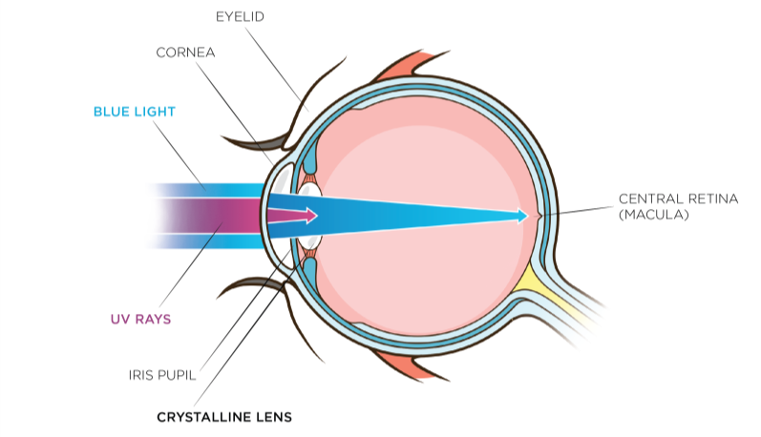
UV and Blue Light
Young eyes allow more damaging light in.
Long-term exposure to harmful blue light has been linked to increased risk of developing age-related macular degeneration.
Sources: Sparrow 2000, Arnault 2013
Notes:
A child’s crystalline lenses are not yet fully developed to adequately filter UV rays, therefore more vulnerable to UV radiation and increased transmission inside the eye than an adult. (Sanford BE et al. Acta Ophtalmologica Scandinavica. 1996; 74:553-557.) Simply put, a child’s eyes are more vulnerable to UV and harmful blue light because their eyes are not fully developed.
Due to its higher level of energy than the other wavelengths in the visible spectrum, blue light is potentially harmful to the retina. Long term exposure to harmful blue light has been linked to increased risk of developing age-related macular degeneration (AMD) (Arnault 2013)
While UV transmittance is blocked primarily by the cornea and crystalline lens in healthy adults (not as much in kids), as a part of visible light, blue light passes through the eye structure, reaching the retina.
The amount of blue light reaching the retina depends on the age of the eye as, during a lifetime, there is a slight yellowing of the crystalline lens that would typically provide some absorption in the blue violet region.
Understanding the development a child’s eyes is important as we increase awareness on protection.
Sources:
Arnault E. Barrau C, Nanteau C. Gondouin P, Bigot K, et al. Phototoxic Action Spectrum on a Retinal Pigment Epithelium Model of Age-Related Macular Degeneration, PlosOne 8 (2013) http://dx.doi.org/10.1371/journal.pone.0071398
Sparrow J.R., Nakanishi K., Parish C.A., The Lipofuscin Fluorophore A2E Mediates Blue Light-Induced Damage to Retinal Pigmented Epithelial Cells, Invest. Ophthalmol. Vis. Sci. 41 (2000) 1981-1989 http://www.ncbi.nlm.nih.gov/pubmed/10845625

Slide 25
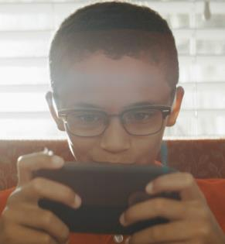
Digital Device Usage
Harmful blue light and eye strain are at the forefront of public consciousness because of the increased use of digital devices in recent years.
2 HOURS PER DAY IN FRONT OF SCREENS
Source: Active Healthy Kids Canada
Notes:
As we discussed, children today are living a different childhood.
In fact, on average, 3- to 5-year-olds in Canada spend about half of their waking hours in sedentary pursuits and an average of 2 hours per day in front of screens.
61% of Canadian parents agree that their kids spend too much time watching tv or using the computer.
Source: Active Healthy Kids Canada, 2014 Active Healthy Kids Canada Report Card On Physical Activity For Children And Youth
http://www.participaction.com/sites/default/files/downloads/Participaction-2014FullReportCard-CanadaInTheRunning_0.pdf
Some of our kids will never know the sound of a dial tone because they have only known cell phones. Kids today talk to their travelling parents with FaceTime. Consideration of time spent on digital devices because of the harmful blue light emitted, and eyestrain should be at the forefront of concern when it comes to kids’ vision. With studies of Gen Z and how they are using digital devices, we can offer better protection for them.

Slide 26
% of 8-12 Year Olds Using Device Daily
Source: “Meet Generation Z” by Sparts & Honey
Notes:
We can see with this chart that kids are using all kinds of devices that project blue light. The study also shows that as kids get older, 13-17, the device usage goes up dramatically in all categories with the exception of the E-Reader. Even without studies, we can see little ones that are still in strollers and grocery shopping carts using devices. So, we know kids are using devices from toddler age on up. Let’s take a closer look at harmful blue light.

Slide 27
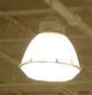
Blue Light Sources
INDOORS – Harmful blue light
OUTDOORS – UV and harmful blue light
LED Lights
OVER 100 TIMES
MORE INTENSE THAN ELECTRONIC DEVICES AND SCREENS
Digital Devices
THE SUN
Metal
Halide Lamps
Source: Baillet G., Granger B., How Transitions® lenses filter harmful blue light, Points de Vue, International Review of Ophthalmic Optics, March 2016
Notes:
What most people don’t know is that the sun is the largest singular source of harmful blue light, emitting over 100 times the intensity of electronic devices and screens.
And with all the activities that kids do outdoors (recess, soccer, baseball, etc.) – they are at risk for exposure.
With the combination of outdoor sun and indoor time with harmful blue light sources, it is important to provide a blue light filter for the developing children’s eyes. Transitions lenses are a great remedy as they filter both UV and harmful blue light.
---
Source: Baillet G., Granger B., How Transitions® lenses filter harmful blue light, Points de Vue, International Review of Ophthalmic Optics, online publication, March 2016
http://www.pointsdevue.com/article/how-transitionsr-lenses-filter-harmful-blue-light

Slide 28
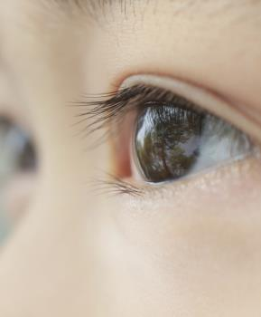
Light – Major Factor in Human Development
ESSENTIAL TO HEALTHY DEVELOPMENT
NEEDED FOR OCCULAR GROWTH
Notes:
We need to protect kids from UV and harmful blue light whether they are an indoor or outdoor kid. But light is a major environmental factor in human development. Given that a child’s eye lets in six times the UV radiation as an adult’s eye, it is never too early to start protecting the eyes.
Numerous deprivation experiments have demonstrated that ocular growth and refraction development are regulated by visual information. Light is essential in providing this information.
The American Academy of Ophthalmology just reported early this year (2017) that research shows the sun is a key to our eye health. They also mentioned that the eyes and skin need protection from UV while outdoors.

Slide 29
Time Outdoors and Myopia
Spending time outdoors may lower risk of nearsightedness
70% of youth spend less than 1 hour outside daily
Source: David Suzuki Foundation, Youth Survey on Nature and the Outdoors
Notes:
70% of youth (between the ages of 13-20) spend about an hour or less outside each day.
(Source: David Suzuki Foundation's 2012 Youth Survey on Nature and the Outdoors
http://www.davidsuzuki.org/media/news/2012/09/majority-of-canadian-youth-spend-an-hour-or-less-outside-each-day/)
With less time outdoors, we are seeing an increase of myopia.
There is growing evidence that spending more time outdoors may lower the risk of nearsightedness in children and adolescents. The AAO also reported that nearsightedness is more common today in the US and many other countries than it was in the 1970s. The findings show that because kids are spending more time indoors on digital devices, instead of out door play time, we are seeing increased myopia.
One of the studies showed that for each additional hour the children spend outdoors per week, their risk of being nearsighted dropped by about 2 percent.
Nearsighted children in this study spent an average of 3.7 fewer hours per week outdoors than those with normal or farsighted vision
Studies have shown that daily light exposure required in childhood to slow axial eye growth and in turn, reduce the development and progression of myopia. We can already see the increasing myopia in China as daily light exposure has been reduced over the years.

Slide 30
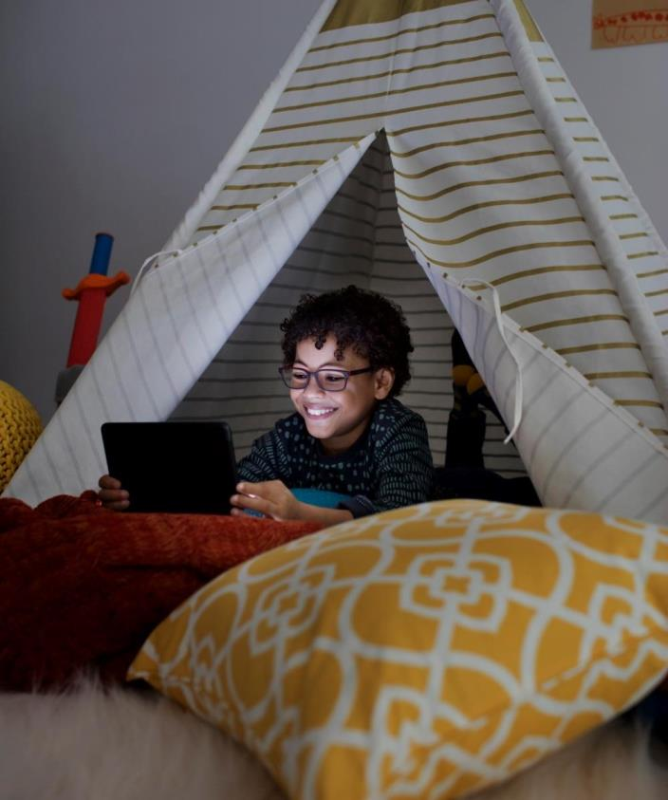
Visual Fatigue
20-20-20 rule
Every 20 minutes, look at something about 20 feet away for 20 seconds.
Computer Eyewear
Don’t be afraid to address visual fatigue with small plus lens
Night Shift Mode
On iPhone after 7pm, or change electronic device screens from blue to brown.
Notes:
So our Generation Z kids are spending less time outside and more time on digital devices which brings in the next issue we need to protect kids from: visual fatigue. We need remind patients of all ages of the new 20/20 rule. We need to see if there is another opportunity to solve the vision problem with eyewear to protect them from the symptoms of visual fatigue.

Slide 31
Medications
Many medications, both prescription and over-the counter, can cause the pupil to remain in a dilated state, making the eye more sensitive to visible and UV light.
Antibiotics
Pain relievers
Medicine for allergies, asthma and ADHD
12% of kids take prescription
medication
Source: Canadian Health Measures Survey
Notes:
Increased UV sensitivity and dry eye can be related to medications kids are taking.
Some medications that fall into this category include antibiotics, pain relievers, and medicine for allergies or asthma.
It is important that this factor is looked at when we look at eye protection for kids.
According to results of the 2007 to 2011 Canadian Health Measures Survey from Statistics Canada, 12% of 6- to 14-year-olds are taking prescription medication.
(Source: http://www.statcan.gc.ca/pub/82-003-x/2014006/article/14032-eng.htm)

Slide 32
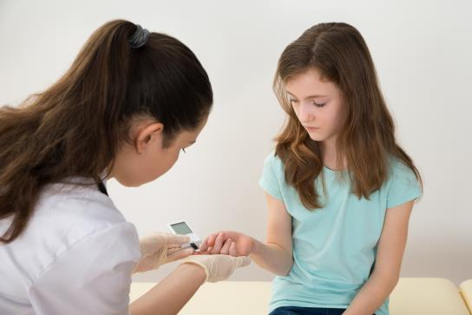
Overall Health Issues
Diabetes is one of the most common chronic diseases affecting children.
Can lead to serious vision problems or blindness
Complications from diabetic retinopathy may appear earlier or be more severe with kids
Kids with diabetes may also be more likely to develop cataract and glaucoma as adults
Notes:
Kids may not know or understand diabetes. Most caretakers understand what a good diet provides for growing children, but don’t realize an annual exam can also help detect possible vision problems from diabetes.

Slide 33
Dispensing for Kids
Notes:
Just as kids have different visual needs, we also need to treat them differently when dispensing.

Slide 34
Protection Should Include:
Impact resistance
UV radiation
Harmful blue light – devices and especially the SUN
Glare
Dry eye
Fatigue
Visual acuity
Notes:
It is important that we address kids’ vision and protection. If we educate properly, parents and caretakers shouldn’t hesitate with our prescriptions for Polycarbonate, photochromic lenses (Transitions for both UV and harmful blue light), computer eyewear, etc.

Slide 35
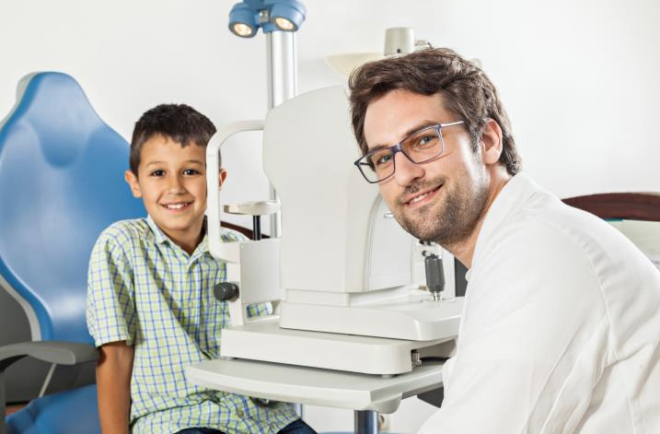
Doctor Recommended
33 percent of parents of children who wear eyeglasses consider the recommendation of the dispenser or eye doctor as a “very important” factor.
Source: Vision Council Visionwatch Parent Child Vision Care Report, Jan. 2016
Notes:
It starts with the doctor’s recommendation.

Slide 36
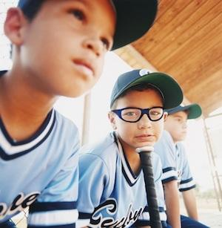
Impact Protection
More than 40,000 sports-related eye injuries occur each year.
90% could have been prevented with the right eyewear.
To prevent injuries, kids should wear protective glasses when they’re playing sports, or even rough-housing. For contact sports consider wrap around glasses or goggles.
Notes:
This can be an opportunity to approach sports organizations to educate them about proper eye protection.
https://www.thevisioncouncil.org/content/sports-protection

Slide 37
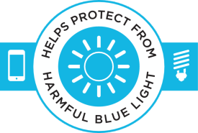
Photochromic Lenses
One pair does it all!
Blocks 100% UVA and UVB
Transitions lenses bock at least 20% of harmful blue light indoors – and block over 85% outdoors
Comfort in any light
Convenience of variable tint
Clear vision combined with protection is a bargain.
¹Transitions® lenses block 20% to 36% of harmful blue light indoors excluding CR607 Transitions® Signature® VII products which block 14% to 19%. The 2 times comparison refers to typical clear 1.50 and polycarbonate hard-coated lenses.
²Transitions® XTRActive® lenses and Transitions® Vantage® lenses block 34% to 36% of harmful blue light indoors excluding CR607 Transitions® XTRActive® products which block 27% to 31%. The 3 times comparison refers to typical clear 1.50 and polycarbonate hard-coated lenses.
Notes:
Transitions lenses block 100% of UVA and UVB rays and also reduce painful glare, allowing children to see their best in any light condition. Even kids that don’t need vision correction should wear UV-blocking sunlenses when outside. Not all sunlenses block 100% UV rays – so make sure your child's eyes are covered. It is important that we remind parents that children’s eyes are more vulnerable to damage from UV due to the filtering of the lens being undeveloped.
One pair is easy for kids and eliminates lost or forgotten sunwear. With photochromic lenses one pair does it all!
Transitions lenses are the ideal choice for kids because they seamlessly help to protect kids vision indoors and out from harmful blue light and UV.
Cost – compared to other things parents spend their money on kids, clear vision combined with protection is a bargain.

Slide 38
Insert Kids VLL Video
Video can be downloaded from here:
https://drive.google.com/drive/folders/0B8jvqvV77pcJejF2LUQwbmtGVUU?usp=sharing

Slide 39
Anti-Reflection
Give kids clear and comfortable vision reducing glare and reflections of polycarbonate
AR reduces eye strain
Offers aesthetic benefits to the child’s glasses
Notes:
There are many good reasons to include AR in your prescription for kids. The vision and aesthetic improvements AR provides helps facilitate a positive experience with prescription eyeglasses.
Polycarbonate has a higher index of refraction and lower abbe vs. standard plastic which creates more reflections.
With children spending more time in classroom fluorescent lighting conditions, in front of computer screens and digital devices, watching TV and playing video games, AR lenses provide significant benefits for their eye health, clear vision and comfort.
Remember that vision is a key factor in a child’s emotional and intellectual development. Kids should want to wear their glasses. They should feel comfortable wearing their glasses. Younger children can become discouraged if they suspect people have trouble seeing them clearly. The child can be confident and comfortable knowing that other people can see their eye without trouble.
Note: adding a blue blocker, does not add much to the protection you already get from Transitions.

Slide 40
Frame and Other Recommendations
_{Second Pair}
Sports pair
Backup pair
Computer pair
Fashion - Whether full or part-time eyeglass wearers, kids like their glasses to look “cool.” We want them to wear the glasses. Fun colour, patterns and styles make glasses appealing.
Plastic or Metal – In the past plastic was considered better as they were considered more durable. That is no longer the case with improvements from manufacturers.
Proper Bridge Fit – Young children’s noses are not fully developed so fit can make the difference of glasses staying in place.
Temples – Cable temples, straps, skull temples.
Spring Hinges – Prevents the need for frequent adjustment and repair.
Notes:
It’s just as important with kids as with adults that we start with Lenses First. Prescribing the best visual solution for the child is the priority. Then we move to finding the best frame that matches the child's activity level, face shape, bridge, eye size (giving room to grow, but not too much as comfort is more important). Sports Rx for protection are should be considered just like protective gear for sports. Can the child study at school, ride a bike etc., without their glasses? If not, a back up pair is a necessity. Besides being a back up pair, they can be used just like adults do as a fashion statement or accessory. Two different styles can make wearing glasses more fun by changing it up a bit.
When recommending photochromic lenses, of finding a frame that looks equally good as an indoor pair as well as an outdoor pair. Some indoor frames would not look good as a sunglass, and vice versa.

Slide 41
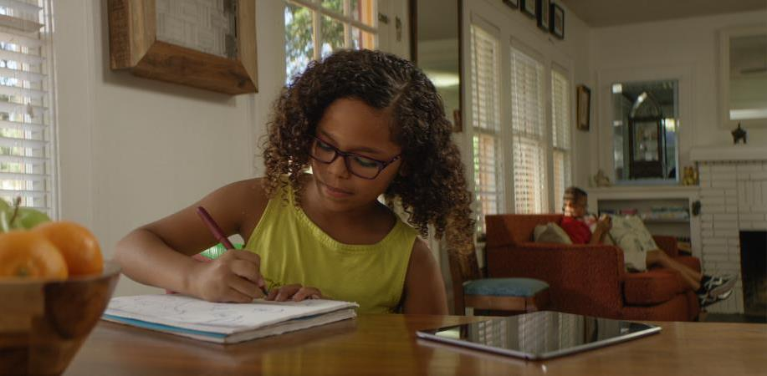
What Do Kids Think About Eyewear?
They look smart
They look honest
Kids prefer Transitions® lenses 9 out of 10 times to regular clear lenses
Glasses are a great accessory
Sources: Ophthalmic and Physiological Optics, May 2008, Romeu ML 2003
Notes:
In a study of kids between ages 6 -10 at Ojai State University and published in the Journal Ophthalmic and Physiological Optics, May 2008
Kids said eyeglasses make kids Look Smart and Look Honest.
A study performed in the U.S. by Madeline Romeu, O.D. and Susan Stenson, M.D. in 2003 found that children significantly preferred photochromic lenses over clear lenses. In fact, Kids Prefer Transitions lenses 9 out of 10 times to regular clear lenses.
Great accessory – Kids without a Rx are purchasing non-prescription glasses at retailers such as Claire’s as an fun accessory.

Slide 42
Tips for Success
Prescribe the BEST visual solution(s) for your patient’s needs
Simplify – TMI
“Your lenses come with”
Talk with the child and the parent together – GenZ influences decisions
Use kid-friendly language or buzz words
Photochromic lenses are magic or transformer lenses
Computer lenses are the Xbox or technology lenses
Notes:
In our conversations, it is the combination of product, knowledge, price and how we present it to our patients, parents or guardians. Stop thinking “parents don’t want to spend money on their kids glasses.” If we think they can’t afford the best lens solution or don’t want to spend the money on eyeglasses, they will too. We tend to give options of good, better, best, which parents contribute to price when we should be looking at what the child needs. We are creating fear and insecurity in making the wrong decision with the parents and possibly push back on the best solution for the child. We have to be confident in prescribing with recommending the best solution – that might include a sports pair or back-up pair.
We are only protecting the child and helping the parent make a good and informed decision. Remember Gen Z really influences the buying decision, so don’t hesitate to talk with children as well.

Slide 43
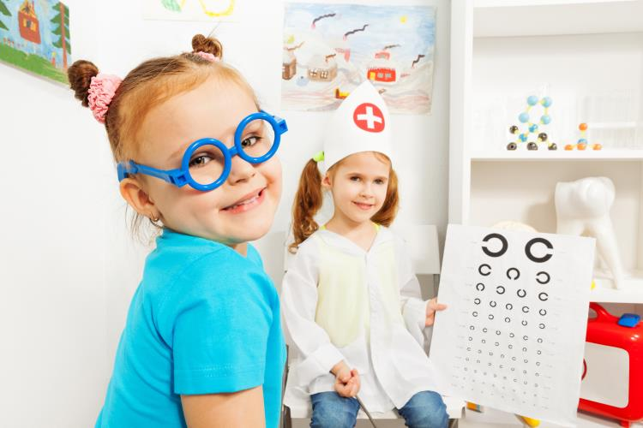
Be Kid-Friendly
Scaled-down tables and chairs
Fun mirrors
Bright colour
Things to do – play area with colouring books and crayons, sturdy quiet toys
A DVD player with age-appropriate videos can make the waiting experience pleasant
Notes:
Consider designating a dispensing area just for children if you don’t have one now. Choose a theme to carry through the area to make it more fun. If you are utilizing a specific space in your dispensary for kids, you may want to choose a corner area near the front of the office. It makes it convenient, controlled, and allows you to promote that you offer kids’ selections to each person who walks through the door.
When it comes to kids furniture, remember– Size, Durability and washable. Maybe add a couple of adult-sized chairs or a bench for parents, but it is supplemental to the kids furnishings. Remember what you leave in the area needs to be childproof. If you have a computer in this area, remember they may not hesitate to see if you have their favorite games loaded on your computer while you aren’t paying attention.
Often, siblings and young friends tag along. Having a computer designated for the kids in this area can solve the problem. Cycloplegics are often involved for children's refractions, so waiting while it takes effect can be boring and having activities for the kids can help with patience and frustration. Have a plan for cleaning the area frequently to prevent spread of germs. A changing table in the patients restroom is a big help for parents of babies and toddlers.

Slide 44
Connection Checklist
Communicate in shorter bursts of “snackable content” – their attention span is only about 8 seconds
Don’t talk down….talk to them as adults
They have opinions and influence family decisions
Be humble
Talk to them about value (they care about the cost of things)
Feed their curiosity
Let them activate photochromic lenses with a UV flashlight or demo
Notes:
Connecting with Gen Z is a little different than the last generations. Studies have shown that these young minds have famously short attention spans of a brief 8 second frame of mind into 4 second filters. In other words, because of their increasing use of digital media. Entities like Snapchat and Instagram are examples of specialized catering to this decreasing attention span. Short and to the point dominates any strategy for reaching Gen Z. Accommodating their window of attention is crucial in trying to reach Gen Z since time is so valuable to them.
Gen Z has more influence on parents than the past, so remember to talk directly to them and their parents.
We are fortunate to have tools of the trade to help us spike their curiosity. Help them understand the importance of UV with a UV flashlight. Show them the amazing magic of photochromic lenses with the demonstrator. Get them involved and let them hold the flashlight or put the lenses in the unit.

Slide 45
Tools You Can Use
What to Expect Kids Brochure
Counter Card
Social Media Assets
Symptoms to Watch For
Example referral and permission letters
Notes:
Note: Materials will be posted to www.TransitionsPro.com/Kids

Slide 46
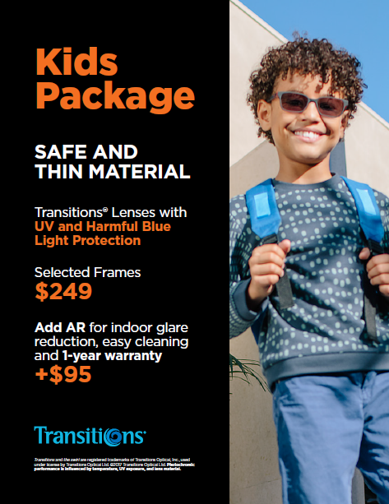
Kids Packages
Safe and thin material
Adaptive lenses with UV and harmful blue light protection
Selected frames
$249
Add AR for indoor glare reduction, easy cleaning and 1-year warranty
+$95
Notes:
In a kid-friendly dispensary you want to make sure young patients are getting what they need which often means recommending a number of options. There may be anxiety from parents at this point. They want to give their child every benefit they can however listing option after option can be overwhelming. Bundle lens options that provide visual comfort and savings to the family. This keeps things simple so parents are more comfortable, the child has less time to be distracted and you are able to offer premium lens solutions without hesitation.
Offer warranties but do limit them as kids Rx’s are only for a year rather than the adult 2-year Rx. Warranties represent added value, so make sure to tell them about every warranty. Even if it is coming from the manufacturer, they see it as coming from you. This is very helpful to the practice’s professional image.

Slide 47
Let’s Summarize KidZ Today
Educate and be an advocate for kids and their vision
GenZ spends more time with digital devices and less time outdoors
May affect visual development
Talk about blue light protection but don’t forget the sun
Protect kids from damaging UV, harmful blue light, eye trauma and glare with their Rx
Prescribe the best visual solution without hesitation
Notes:
We’ve learned that 80% of learning in a child’s first 12 years comes through his or her eyes. We can be an advocate and help educate our communities.
GenZ spends more time with digital devices and less time outdoors, which may affect visual development. Teach healthy eye habits – (20-20-20 rule), and talk to parents about the need for harmful blue light protection, but don’t forget the sun protections (the largest source of blue light)
Gen Z is a growing; and an opportunity for the ECP. We also learned a lot about kids’ eye development and the importance of protection. The opportunities for changing the future and how we look at kids and their vision is huge.

Slide 48
No doubt there is a BRIGHT side of KidZ
THANK YOU
Notes:
We wish you success and fun as you approach the opportunities with our Gen Z Kids.

