Slide 1
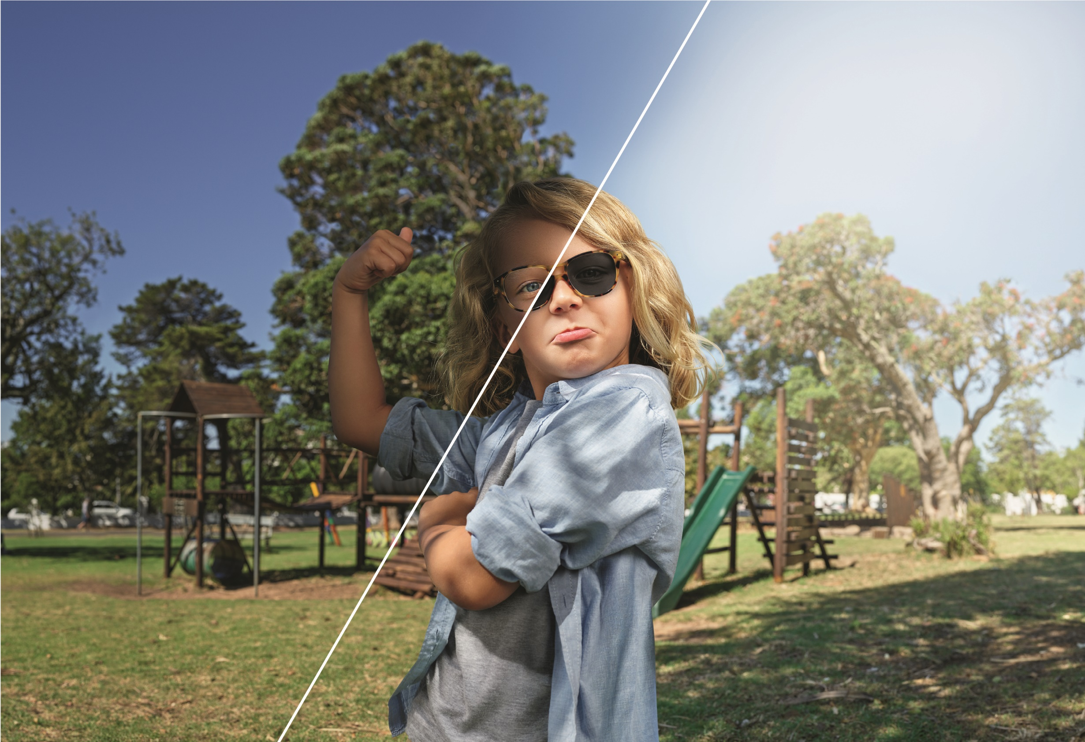
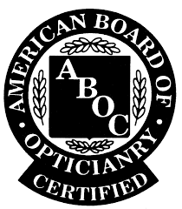
THE BRIGHT SIDE
OF GEN Z
Notes:
Kids, their beautiful eyes and smiles can brighten our day, or perhaps bring a few grey hairs. But as we know, they grow up so fast. In the blink of any eye they are teenagers, and you know how the rest goes.
We’ve heard so much about Baby Boomers and Millennials – generations that have their own unique eye care needs and behaviors. In today’s presentation we would like to take a closer look at our kids, those in the “Z” generation. They are a large group: two billion worldwide, and one-quarter of the North American population. Today, we would like to focus on better a understanding of childhood development and our kids’ market.
((Unless noted, all pictures are from Transitions Optical or purchased from Dreamtimes.com or ThinkStock.))

Slide 2
OBJECTIVES
EXPLORE
How different generations think about and use their eyes – and what this means for Gen Z
IMPORTANCE
Of vision in childhood development
THE NEED
For eye care and eye protection from UV and harmful blue light
HOW
Opticians and staff can provide the best possible eye care to younger patients
Notes:
In todays objectives we are going to explore how different generations think about their eyes.
We will review interesting facts about a child's eye development.
We will also focus on the need for promoting eyecare and eye protection. We’ve seen a great improvement on safety and protection for our kids. For example, sunscreen application, car seats that grow from infancy to childhood, bike helmets but we haven’t focused a lot on safety and protection of the eyes.
I can go on and on, but today we will focus on the Bright Side of Gen Z vision and the not so bright so we can better understand how to work with Generation Z and provide the best eyecare for our young patients.

Slide 3
CANADIAN POPULOUS BY AGE
22% Generation Z (1993 – Today)
29% Gen Y/ Millennials (1972-1992)
8% Gen X (1966 – 1971)
28% Boomers (1946 – 1965)
13% Traditionalists (1945+)
Source: Statistics Canada, 2011 Census
Notes:
Generation Z is 22% of Canada’s population according to Statistics Canada.
Millennial’s are the most researched generation in history. However, we are just beginning to understand the impact of what Gen. Z will have on the future.
Source: http://www12.statcan.gc.ca/census-recensement/2011/as-sa/98-311-x/2011003/tbl/tbl3_2-1-eng.cfm

Slide 4
 | BABY BOOMERS | GEN X | MILLENNIAL | GEN Z
Years | 1946-1964 | 1965-1976 | 1977-1993 | 1994 -
Ages | 71 - 53 | 52 - 41 | 40 - 24 | 23 and younger
Major Events | Civil rights Women’s liberation Cold War | Watergate Advent of MTV | AIDS Technology | 9/11 Iraq / Afghanistan Wars Market crash
Major Traits | Explore Optimistic Work-centric | Individualistic Flexible Skeptical | Tech-dependent Family-centric Optimistic | Political mistrust Always connected Multi-taskers
Attitudes About Eyewear | 77% wear eyeglasses Highest repurchase cycle and private pay More likely to buy from independents | 72% wear eyeglasses Almost 60% of all Sun Rx sold is sold to presbyopes | Most likely to… Feel blue light protection is important Prefer online customer service / text Buy from retail | ~1/3rd wear eyeglasses More likely to have lens purchase subsidized
Sources: 2017 Wakefield Research, VisionWatch
Notes:
So who is Gen Z?
Life is different today and Gen Z are using their eyes in different ways and this could have consequences – short and long term.
There used to be fluorescent lighting in the classroom, today there is LED.
Books are being replaced by iPads.
Candy Cane Lane and Monopoly to PlayStation and now VR.
With their dependency on technology it’s not surprising that millennials are more likely to say it is important to have blue light protection in their prescription eyeglasses.
Gen Z uses the internet from a young age and they are used to information about products and services.
These children will also influence their parents on the eyewear they purchase for them.
Gen Z uses the internet from a young age and they are used to information about products and services.
These children will also influence their parents on the eyewear they purchase for them.

Slide 5
PURHCASE DECISIONS INFLUENCED BY GEN Z
Source: “Meet Generation Z” by Sparts & Honey
Notes:
Studies show that Gen Z already influences household purchases more than the past generation kids. (Source JWT Intelligence)
(Another study with New York Agency Sparts & Honey’s report called “Meet Generation Z” found that GenZ influences major purchasing decision according to moms.) Their ability to influence purchase decisions shouldn’t be taken likely as this ability is very powerful.
Marcie Merriman, Executive director of Growth Strategy and Retail innovation at Ernst & Young, told Business Insider that Gen Z is influencing the way their parents are spending, more than millennials ever did, So talking to our Gen Z patients and parents is definitely different than previous generations when it comes to products.

Slide 6
Insert Meet GenZ Video
Video can be downloaded from here:
https://drive.google.com/drive/folders/0B8jvqvV77pcJejF2LUQwbmtGVUU?usp=sharing
Source: Washington Post

Slide 7
DO YOU KNOW?
80% of learning in a child’s first 12 years comes through the eyes.
However…
6 out of 10 children experiencing reading difficulties have uncorrected or undetected vision problems.
Almost 25% of school-age children have vision problems.
Sources: Canadian Association of Optometrists , National Coalition for Vision Health
Notes:
The studies are there that prove we need to pay more attention to our kids’ vision.
The Canadian Association of Optometrists shares that 80% of learning in the first 12 years of a child is with their eyes. This alone tells us how critical vision is in the early years.
The National Coalition for Vision Health estimates that 6 out of 10 children in Canada experiencing reading difficulties have uncorrected or undetected vision problems and almost 25% of school-age children have vision problems.
Unfortunately, kids don’t always know they are experiencing a vision problem. The symptoms might not be too difficult for us to notice as professionals, but we can do a better job on educating the parents, teachers, caretakers and their loved ones on symptoms to look for with children. We will go into more details on the symptoms a little later in the presentation.
There are many reasons children that need glasses don’t have them. Our hopes are that this number will decrease as we increase awareness about children’s vision and development.
7

Slide 8
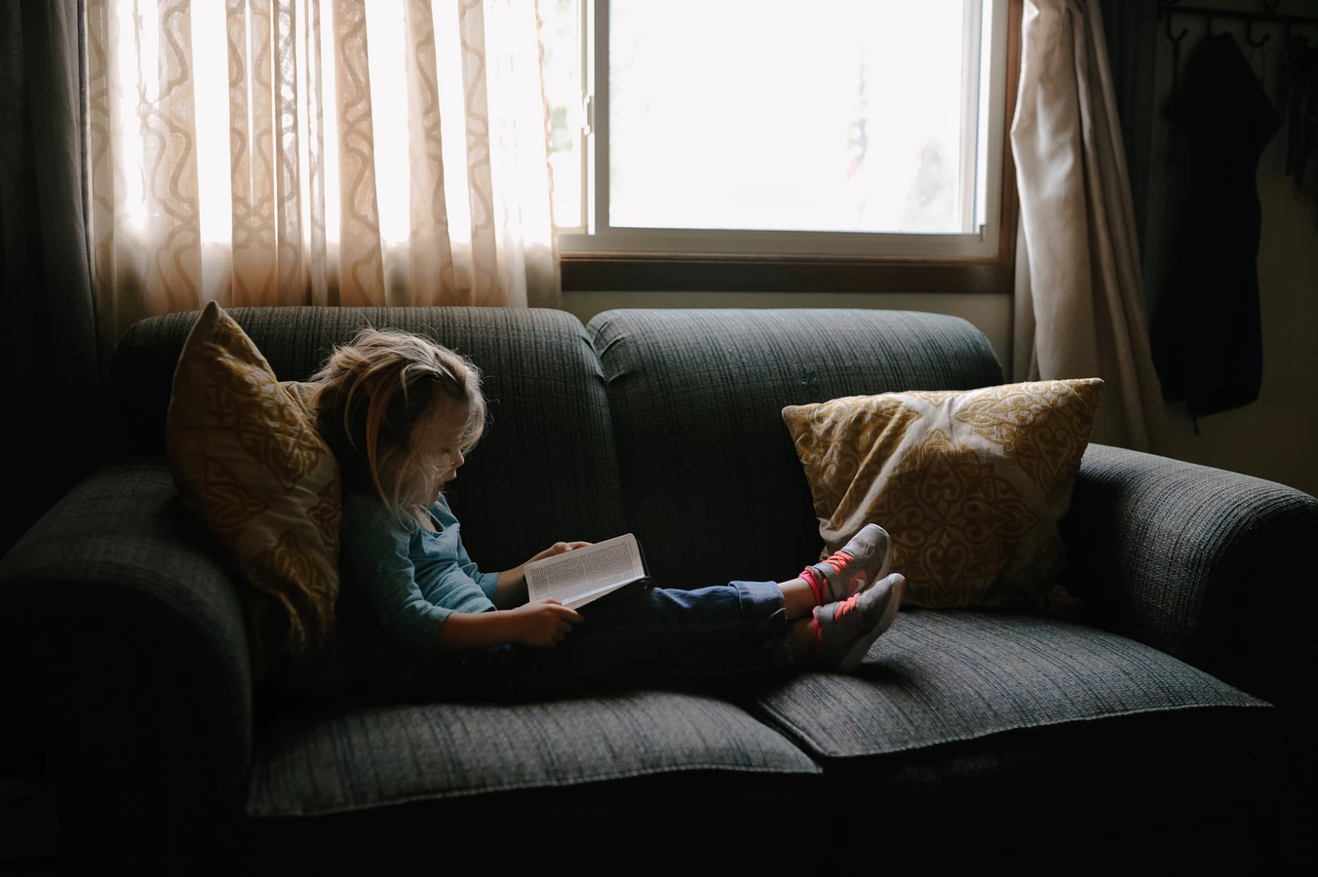
A NEED FOR ADVOCATES
Kids with undetected vision problems Can suffer from low self-esteem, frustration, poor literacy or physical side effects, like headaches
Sometimes They are even wrongly viewed as “slow learners”
Vision problems Can limit the ability of a child to learn as well as interact with other children.
Notes:
The last thing a parent wants to hear is that their child has a learning disability. Unfortunately many teachers and parents don’t know what to look for, so vision problems easily go undetected. Sometimes they are not only viewed as a “slow learner” but often a “problem child” as reported by the American Optometric Association. (According to the American Optometric Association, 6 out of 10 students identified as “problem learners” have undetected vision problems.)
According to the National Parent Teacher Association, more than 10 million children in this country have vision problems that contribute to poor academic performance
We often think about vision with visual acuity, but it is easy to forget how much vision can affect the social development of children. Simple daily activities like playing and interacting with others can be difficult for kids with vision problems. Teachers may associate behavior issues with ADD when it can actually be an indication of vision difficulties. It is especially important for those dealing with kids to be aware of the symptoms of vision problems.
We can be an advocate for kids by increasing awareness.
8

Slide 9
37% | Of parents report their child has never had an eye exam
58% | Claim their children DO NOT NEED an exam
38% | Believe that their children are too young to experience vision problems
Insurance coverage doesn’t have an impact
Source: Vision Council Visionwatch Parent Child Vision Care Report, January 2016
Notes:
Healthy sight and healthy eye habits are more important for children than adults because prevention is key. Childhood is a critical time in development of the eye, and when good and bad eye care habits are formed, meaning regular eye care and protection habits should begin early in life. We teach our kids from a young age that brushing and flossing their teeth, routine cleanings and exams are important. It would be wonderful if parents would think the same for routine eye exams.
37% of all parents with children living at home report that their child has never had an eye exam.
58% claim they have not done so because their children DO NOT NEED an exam. I can’t blame the parents. or caretakers as it’s not that they don’t care, they just don’t know. That is exactly why we are here today, to get the word out. Nephew example.
38% believe that their children are too young to experience vision problems.
The sad thing is that insurance coverage of any kind has little to no influence regarding the frequency or history of eye exams. Parents don’t recognize the need of early eye exams and don’t realize the impact on their ability to learn and behavior.
(Source: Vision Council Visionwatch Parent Child Vision Care Report, January 2016)
We hope to stop the problem now so that it doesn’t continue to effect the lives of children into adulthood.

Slide 10
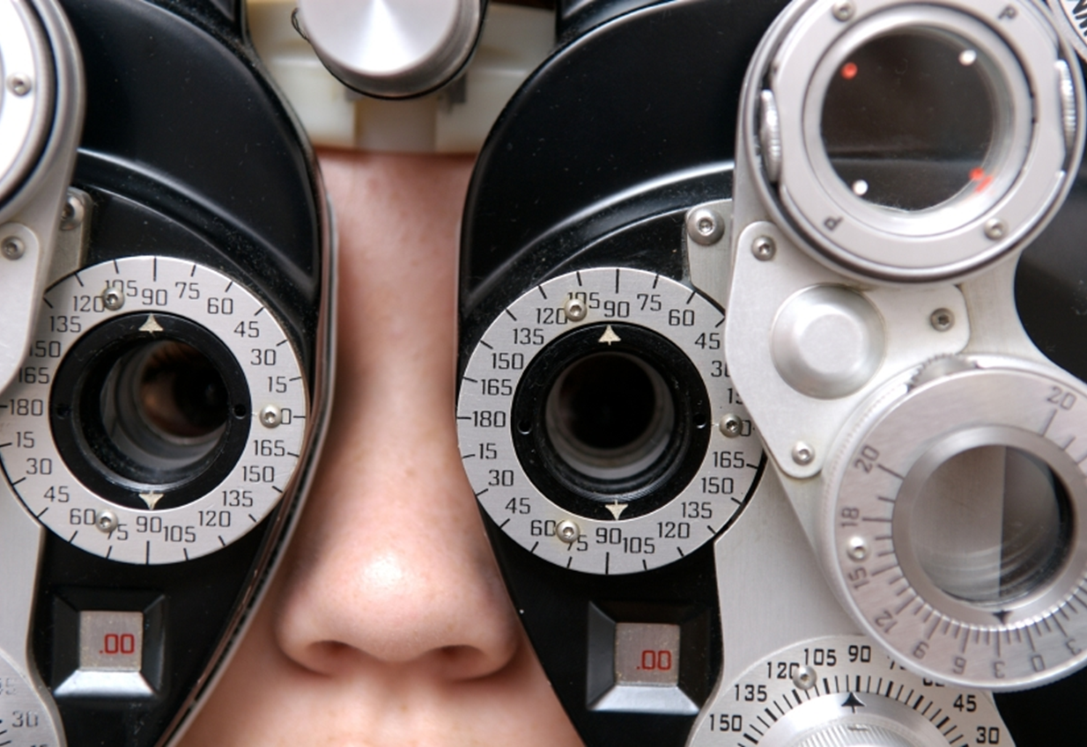
PREVENTION IS KEY
Some potential risks are cumulative
And can impact long-term ocular health
Prevention and intervention Can be time-sensitive
Ocular abnormalities need to be detected immediately
Refractive error
Amblyopia
Strabismus
Ocular Disease
Notes:
Early detection and treatment of serious ocular abnormalities is important
Quality lens enhancements to maximize both the quantity and quality of vision is important
All may play an important role in the development (ophthalmic, educational, functional, and social)
10

Slide 11
REGULAR EYE CARE IS KEY
5-15% of Children Worldwide Have Significant and Unaccounted for Refractive Errors
Myopia
Hyperopia
Astigmatism
Anisometropia
Source: WHO
Notes:
WHO has estimated that 5-15% of children worldwide have significant refractive errors.
Myopia –incidence of myopia is increasing.
Myopia increases from six per cent to 28.9 per cent between the ages of six and 13
Hyperopia –can lead to binocular disorders that can interfere with learning
Astigmatism –High amounts of uncorrected astigmatism can lead to refractive amblyopia
Anisometropia unequal refractive power.
https://opto.ca/news/canadian-study-finds-childrens-eyesight-worsening
11

Slide 12
Opportunity Awaits
To educate parents, teachers and loved ones
To understand the visual health differences of Generation Z and the opportunities for practice growth
To influence the lives of kids in a way that will influence their future as well as ours
Notes:
We see the changes and challenges of today’s world, but this just gives us opportunities as we begin to take a closer look at Generation Z. We always hear, the Kids are our future. Yes they are, and we can make a difference. This information leads us to realize that presenting eyewear to the child is just as important as presenting to the parent.

Slide 13
EDUCATE
Parents, Teachers and Loved Ones
Notes:
As an advocate for Gen Z, lets talk about educating those that can help.

Slide 14
TALK TO PARENTS / TEACHERS ABOUT THE SYMPTOMS TO WATCH FOR:
44% of parents are not aware that behavioral problems can be an indication that a child’s vision is compromised
Consistently sitting close to the TV or holding a book close
Notes:
First step. We need to get parents to realize they need to bring their kids in for an exam then this needs to be a message ECPs push to new potential patients -- through a blog, social, or through schools.
While it is myth that sitting too close to the TV will ruin your eyes, this habit could be a sign of a vision problem.

Slide 15
TALK TO PARENTS / TEACHERS ABOUT THE SYMPTOMS TO WATCH FOR:
Consistently sitting close to the TV or holding a book close | Frequent eye rubbing
Notes:
2. Yes, children do often rub their eyes when they are tired or upset. But if the child rubs his eyes while he is trying to concentrate on something, or while he is being active, it could mean that he has a vision problem.

Slide 16
TALK TO PARENTS / TEACHERS ABOUT THE SYMPTOMS TO WATCH FOR:
Consistently sitting close to the TV or holding a book close | Frequent eye rubbing | Losing place while reading or using a finger to guide eyes when reading
Notes:
3. When kids learn to read and are sounding out words, they’ll often use their finger to track which word they are on. But eventually they should be able to focus and not lose their place.

Slide 17
TALK TO PARENTS / TEACHERS ABOUT THE SYMPTOMS TO WATCH FOR:
Consistently sitting close to the TV or holding a book close | Frequent eye rubbing | Losing place while reading or using a finger to guide eyes when reading | Sensitivity to light and/or excessive tearing
Notes:
4. Are your child’s eyes particularly sensitive to indoor lighting, sunshine or camera flashes? Children with photophobia, or extreme sensitivity to light, can develop headaches and nausea.

Slide 18
TALK TO PARENTS / TEACHERS ABOUT THE SYMPTOMS TO WATCH FOR:
Consistently sitting close to the TV or holding a book close | Frequent eye rubbing | Losing place while reading or using a finger to guide eyes when reading | Sensitivity to light and/or excessive tearing
Closing one eye to read or watch TV
Notes:
5. Frequently closing one eye could indicate a refractive or binocular vision problem that interferes with the ability of the two eyes to work together comfortably as a team. While these problems are not life threatening, they need to be corrected early in order to avoid short- and long-term consequences that can follow them into adulthood.

Slide 19
TALK TO PARENTS / TEACHERS ABOUT THE SYMPTOMS TO WATCH FOR:
Consistently sitting close to the TV or holding a book close | Frequent eye rubbing | Losing place while reading or using a finger to guide eyes when reading | Sensitivity to light and/or excessive tearing
Closing one eye to read or watch TV | Receiving lower grades than usual
Notes:
6. If a child is having a hard time seeing what their teacher writes on the board because of poor vision, they may not tell you about it. As a result their grades can suffer.

Slide 20
TALK TO PARENTS / TEACHERS ABOUT THE SYMPTOMS TO WATCH FOR:
Consistently sitting close to the TV or holding a book close | Frequent eye rubbing | Losing place while reading or using a finger to guide eyes when reading | Sensitivity to light and/or excessive tearing
Closing one eye to read or watch TV | Receiving lower grades than usual | Avoiding using a computer, because it “hurts my eyes”
Notes:
7. Digital eye strain is common among children who are frequent users of computers or other digital devices.

Slide 21
TALK TO PARENTS / TEACHERS ABOUT THE SYMPTOMS TO WATCH FOR:
Consistently sitting close to the TV or holding a book close | Frequent eye rubbing | Losing place while reading or using a finger to guide eyes when reading | Sensitivity to light and/or excessive tearing
Closing one eye to read or watch TV | Receiving lower grades than usual | Avoiding using a computer, because it “hurts my eyes” | Squinting or tilting the head to see the classroom board
Notes:
8. Teachers should be on the lookout for students who have to squint or tilt their heads to see the board. Until an eye exam can be performed, consider moving the child closer to the board for easier viewing.

Slide 22
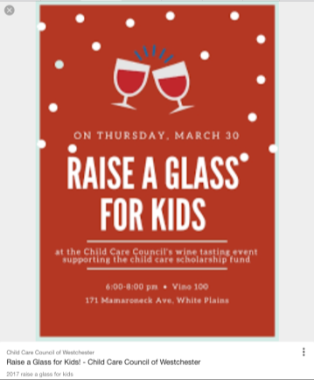
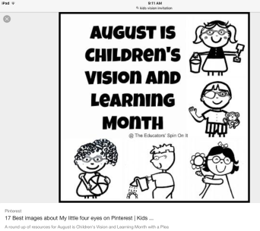
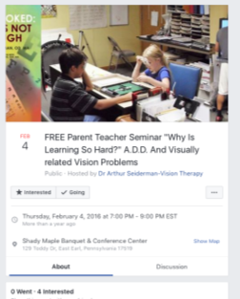
THINK OUTSIDE THE BOX
Spread the message through…
Social media
School / PTAs
Teachers / school visits
Nurses / eye first aid kits (DistinctiveStratagies.com)
Coaches / community sports teams
Notes:
Only a few organizations outside of those dedicated to eye care are addressing poor vision in children as an issue affecting literacy, which makes it so important that we as eyecare professions help our Z generation kids.
(ZabaJN, Mozlin R, Reynolds WT. Insights on the efficacy of vision examinations and vision screening for children first entering school. J Behav Optom 2003:123-126)
We can talk to parents, but there is so much more we can do to help parents and others realize the importance of eye exams throughout childhood. As professionals we can reach out to our communities through social media, school PTAs, school teachers, etc. We can think outside the box to get our message out there. Eye First Aid kits to every school, evening educational seminar for teachers, reaching out to coaches / community sports teams, etc.
Pinterest has great ideas when it comes to invitations for events that can invite teachers, school nurses, pediatricians or whoever you would like to make aware of understanding kids vision. This is a great opportunity to “give back” to the community but often it ends up “giving back” to the practice with referrals. DistinctiveStratagies.com has pre-made eye first aid kits for purchase. All you need to do is put your business card in them. If you go to a PTA meeting, present to the school nurse or principal.
Most recreational team sports have a signup day. AYSO, football, swimming, etc. Ask permission from appropriate personnel to attend. Bring a table and eye safety information/frames to share with attendees. Bring lens cleaner and cloths to clean glasses while you educate. We all fear kids getting hurt during sports, so this would be a great addition to any signup event.

Slide 23
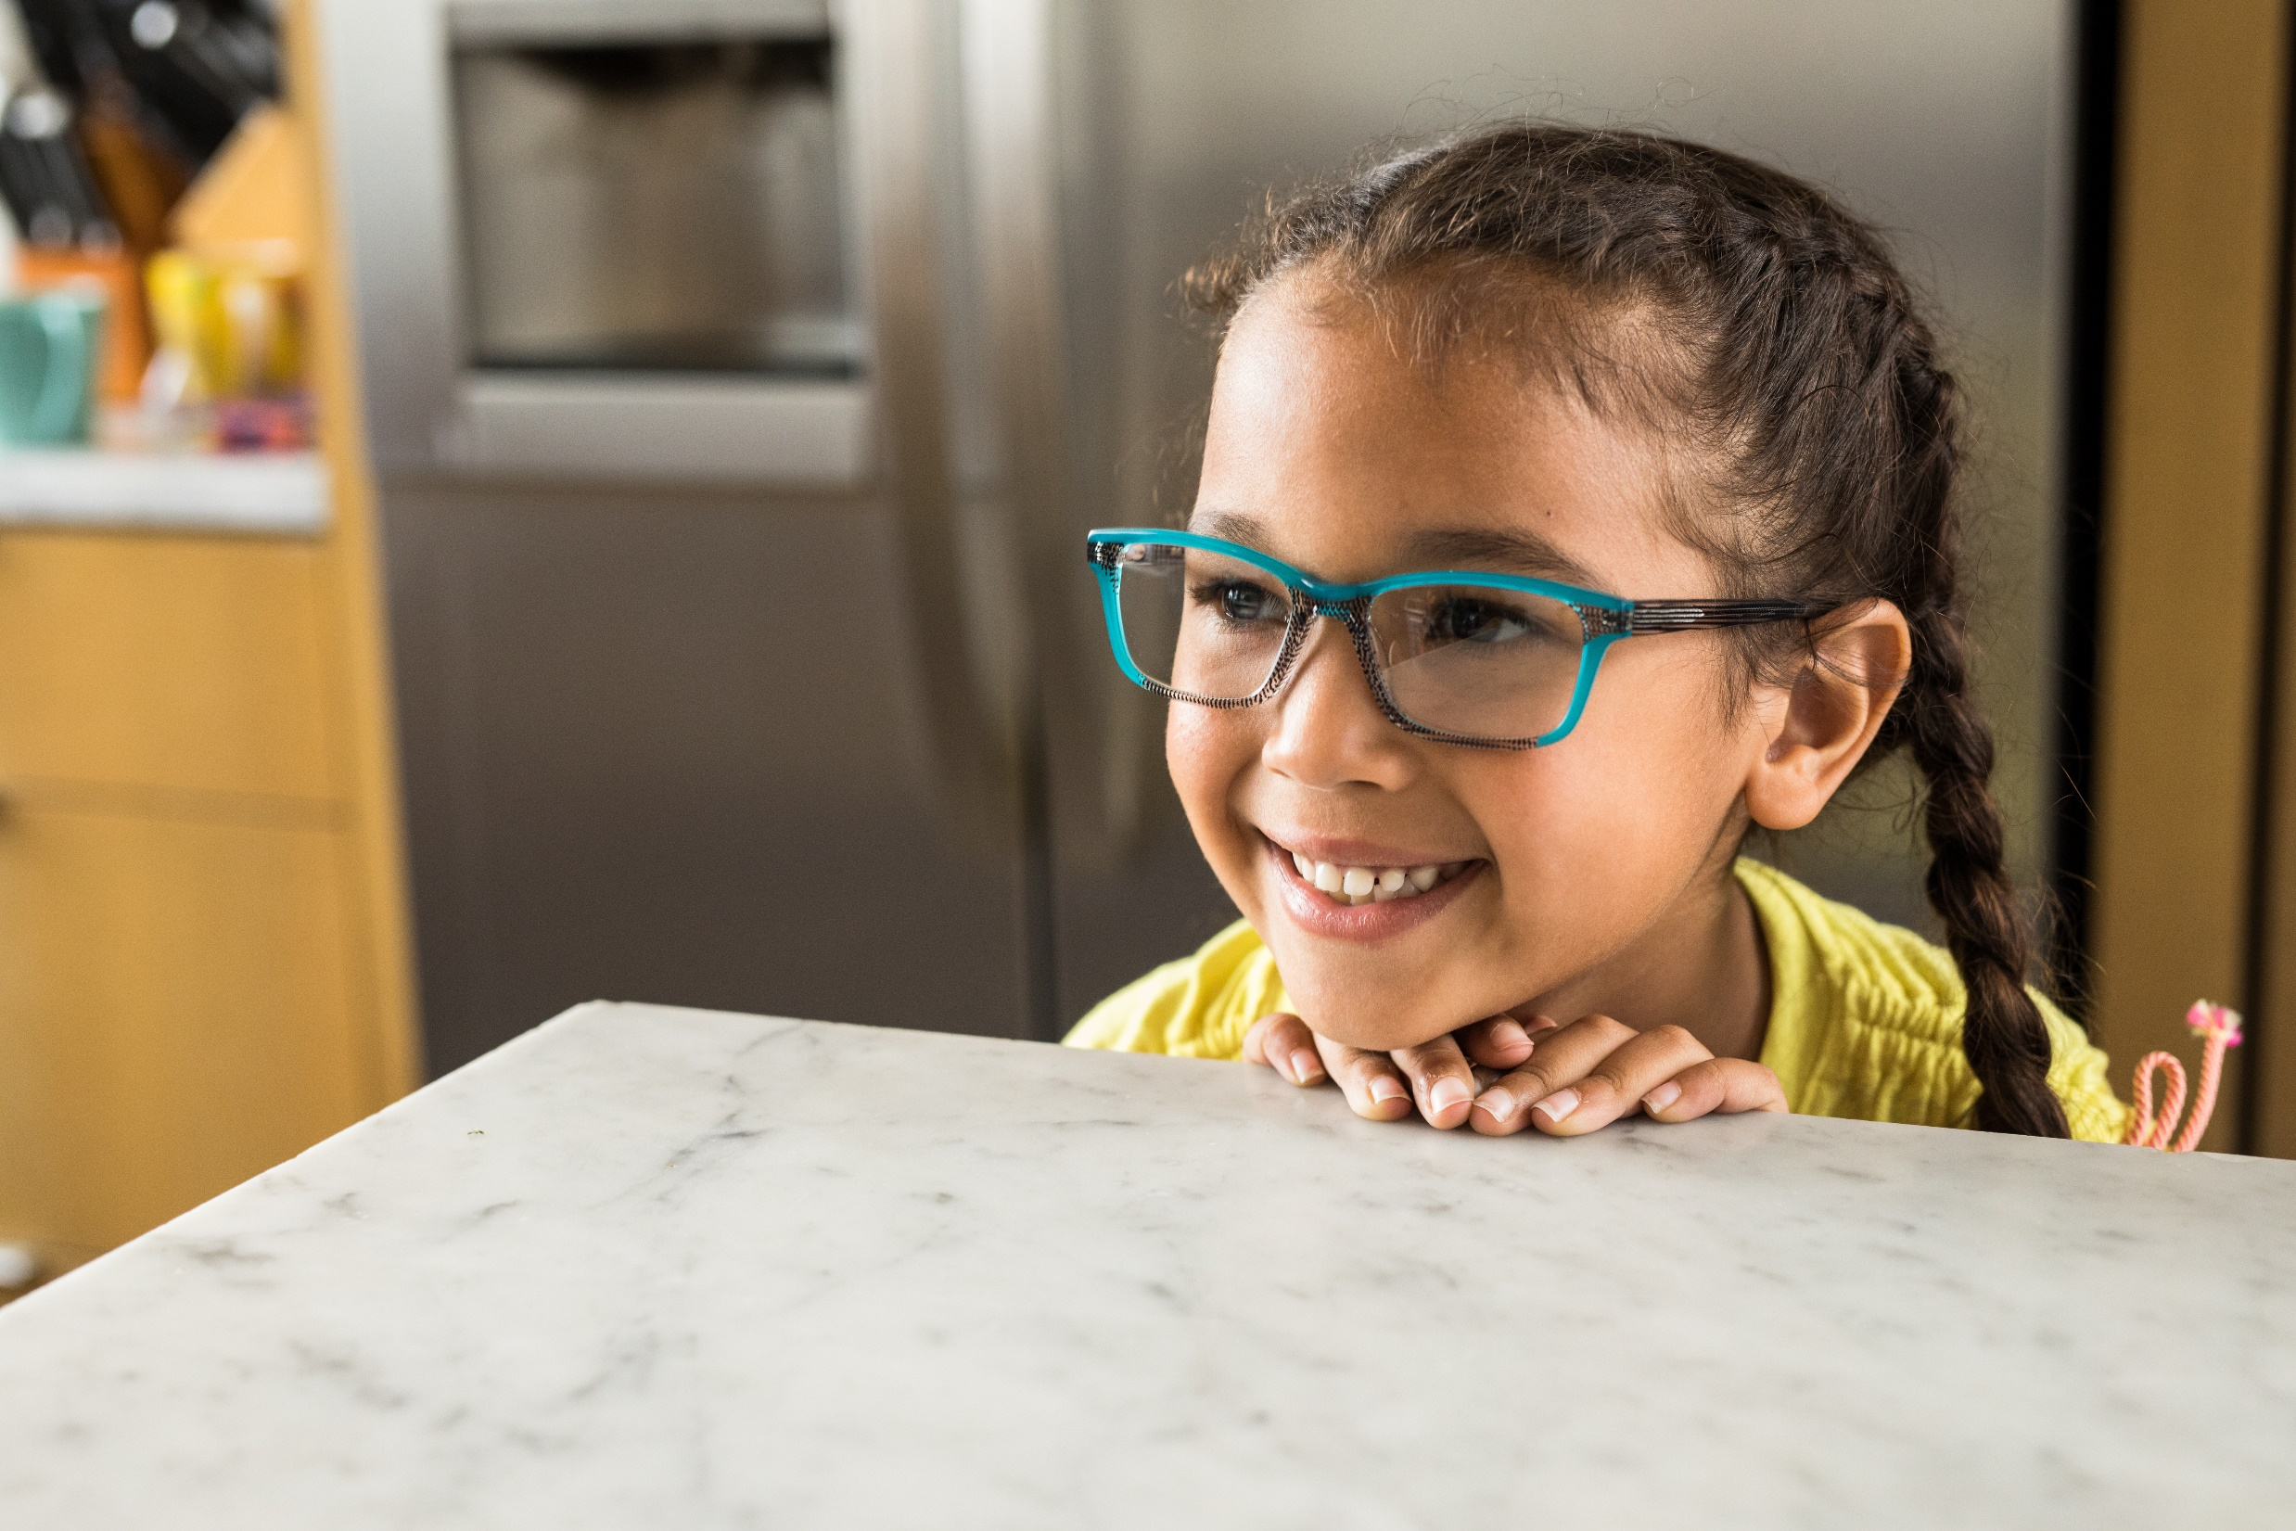
THE NEED
FOR PROTECTION
Notes:
The sweet smile of a child is the reward for the love and protection we give them.
23

Slide 24
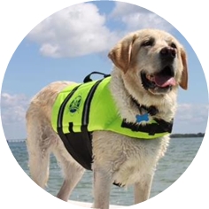
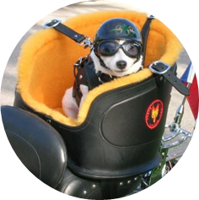
PROTECTING PETS…
Notes:
(These photos were not purchased)
It’s almost humorous the way we protect our four-legged friends. We need to do the same and better for our kids.

Slide 25
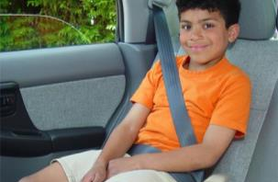
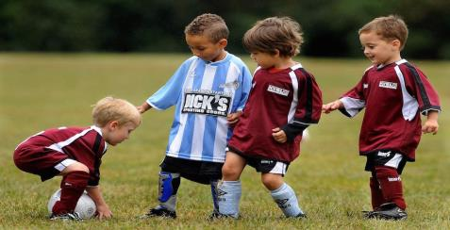
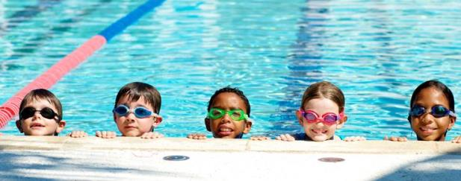
BODY / SKIN PROTECTION #1 WITH PARENTS
Car Seats
Sports Gear
Bike, baseball, soccer, swimming, basketball, track, volleyball, motorcycle riding, skiing, surfing, tennis, etc.
Sun Protection
Hats/clothing/sunscreen
Cold Protection
Jackets, ear muffs, gloves
Notes:
Kids’ protection has only gotten better as we learn more about the different needs of kids. We provide for our kids to make sure they are protected in sports, the car and from the weather.
We protect our kids in many other ways too. We have learned in child development is it good for an infant to crawl as it assists with hand eye coordination. We teach parents and caretakers these things. So as we learn more about protection and safety we are making great changes. We are now better understanding the developing eyes of a child and just like other parts of their body, we need to be aware of protection and safety as well. Let's take a closer look at the developing child's eye.

Slide 26
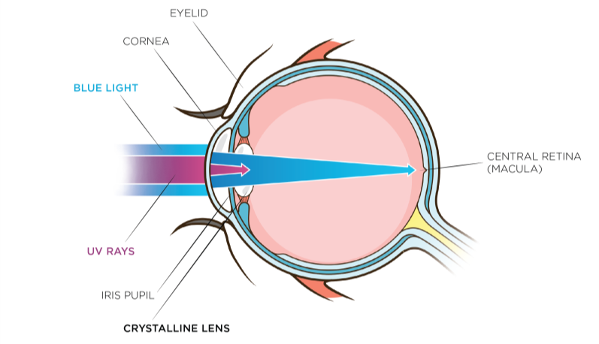
UV AND BLUE LIGHT
Young eyes allow more damaging light in.
Long-term exposure to harmful blue light has been linked to increased risk of developing age-related macular degeneration.
Sources: Sparrow 2000, Arnault 2013
Notes:
A child’s crystalline lenses are not yet fully developed to adequately filter UV rays, therefore more vulnerable to UV radiation and increased transmission inside the eye than an adult. (Sanford BE et al. Acta Ophtalmologica Scandinavica. 1996; 74:553-557.) Simply put, a child’s eyes are more vulnerable to UV and harmful blue light because their eyes are not fully developed.
Due to its higher level of energy than the other wavelengths in the visible spectrum, blue light is potentially harmful to the retina. Long term exposure to harmful blue light has been linked to increased risk of developing age-related macular degeneration (AMD) (Arnault 2013)
While UV transmittance is blocked primarily by the cornea and crystalline lens in healthy adults (not as much in kids), as a part of visible light, blue light passes through the eye structure, reaching the retina.
The amount of blue light reaching the retina depends on the age of the eye as, during a lifetime, there is a slight yellowing of the crystalline lens that would typically provide some absorption in the blue violet region.
Understanding the development a child’s eyes is important as we increase awareness on protection.
Sources:
Arnault E. Barrau C, Nanteau C. Gondouin P, Bigot K, et al. Phototoxic Action Spectrum on a Retinal Pigment Epithelium Model of Age-Related Macular Degeneration, PlosOne 8 (2013) http://dx.doi.org/10.1371/journal.pone.0071398
Sparrow J.R., Nakanishi K., Parish C.A., The Lipofuscin Fluorophore A2E Mediates Blue Light-Induced Damage to Retinal Pigmented Epithelial Cells, Invest. Ophthalmol. Vis. Sci. 41 (2000) 1981-1989 http://www.ncbi.nlm.nih.gov/pubmed/10845625

Slide 27
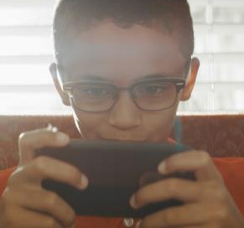
DIGITAL DEVICE USAGE
Harmful blue light and eye strain Are at the forefront of public consciousness because of the increased use of digital devices in recent years.
2 HOURS PER DAY IN FRONT OF SCREENS
Source: Active Healthy Kids Canada
Notes:
As we discussed, children today are living a different childhood.
In fact, on average, 3- to 5-year-olds in Canada spend about half of their waking hours in sedentary pursuits and an average of 2 hours per day in front of screens.
61% of Canadian parents agree that their kids spend too much time watching tv or using the computer.
Source: Active Healthy Kids Canada, 2014 Active Healthy Kids Canada Report Card On Physical Activity For Children And Youth
http://www.participaction.com/sites/default/files/downloads/Participaction-2014FullReportCard-CanadaInTheRunning_0.pdf
Some of our kids will never know the sound of a dial tone because they have only known cell phones. Kids today talk to their travelling parents with FaceTime. Consideration of time spent on digital devices because of the harmful blue light emitted, and eyestrain should be at the forefront of concern when it comes to kids’ vision. With studies of Gen Z and how they are using digital devices, we can offer better protection for them.

Slide 28
USING DEVICE DAILY
8-12 Year Olds
13-17 Year Olds
Source: “Meet Generation Z” by Sparts & Honey
Notes:
Kids are using all kinds of devices that project blue light. And it only increases as they get older.

Slide 29
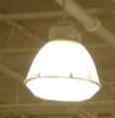
BLUE LIGHT SOURCES
INDOORS – Harmful blue light
OUTDOORS – UV and harmful blue light
LED Lights
Digital Devices
OVER 100 TIMES
MORE INTENSE THAN ELECTRONIC DEVICES AND SCREENS
THE SUN
Metal
Halide Lamps
Source: Baillet G., Granger B., How Transitions® lenses filter harmful blue light, Points de Vue, International Review of Ophthalmic Optics, March 2016
Notes:
What most people don’t know is that the sun is the largest singular source of harmful blue light, emitting over 100 times the intensity of electronic devices and screens.
And with all the activities that kids do outdoors (recess, soccer, baseball, etc.) – they are at risk for exposure.
With the combination of outdoor sun and indoor time with harmful blue light sources, it is important to provide a blue light filter for the developing children’s eyes. Transitions lenses are a great remedy as they filter both UV and harmful blue light.
---
Source: Baillet G., Granger B., How Transitions® lenses filter harmful blue light, Points de Vue, International Review of Ophthalmic Optics, online publication, March 2016
http://www.pointsdevue.com/article/how-transitionsr-lenses-filter-harmful-blue-light

Slide 30
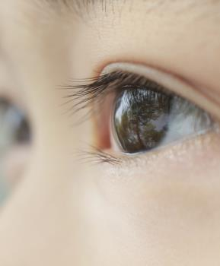
LIGHT – MAJOR FACTOR IN HUMAN DEVELOPMENT
ESSENTIAL TO HEALTHY DEVELOPMENT
NEEDED FOR OCCULAR GROWTH
Notes:
We need to protect kids from UV and harmful blue light whether they are an indoor or outdoor kid. But light is a major environmental factor in human development. Given that a child’s eye lets in six times the UV radiation as an adult’s eye, it is never too early to start protecting the eyes.
Numerous deprivation experiments have demonstrated that ocular growth and refraction development are regulated by visual information. Light is essential in providing this information.
The American Academy of Ophthalmology just reported early this year (2017) that research shows the sun is a key to our eye health. They also mentioned that the eyes and skin need protection from UV while outdoors.

Slide 31
TIME OUTDOORS AND MYOPIA
Spending time outdoors may lower risk of nearsightedness
70% of youth spend less than 1 hour outside daily
Source: Edelman Berland, Unilever’s OMO/Persil and the Dirt is Good campaign
Notes:
70% of youth (between the ages of 13-20) spend about an hour or less outside each day.
(Source: David Suzuki Foundation's 2012 Youth Survey on Nature and the Outdoors
http://www.davidsuzuki.org/media/news/2012/09/majority-of-canadian-youth-spend-an-hour-or-less-outside-each-day/)
With less time outdoors, we are seeing an increase of myopia.
There is growing evidence that spending more time outdoors may lower the risk of nearsightedness in children and adolescents. The AAO also reported that nearsightedness is more common today in the US and many other countries than it was in the 1970s. The findings show that because kids are spending more time indoors on digital devices, instead of out door play time, we are seeing increased myopia.
One of the studies showed that for each additional hour the children spend outdoors per week, their risk of being nearsighted dropped by about 2 percent.
Nearsighted children in this study spent an average of 3.7 fewer hours per week outdoors than those with normal or farsighted vision
Studies have shown that daily light exposure required in childhood to slow axial eye growth and in turn, reduce the development and progression of myopia. We can already see the increasing myopia in China as daily light exposure has been reduced over the years.

Slide 32
VISUAL FATIGUE
20-20-20 rule
Every 20 minutes, look at something about 20 feet away for 20 seconds.
Computer Eyewear
Don’t be afraid to address visual fatigue with small plus lens
Night Shift Mode
On iPhone after 7pm, or change electronic device screens from blue to brown.
Notes:
So our Generation Z kids are spending less time outside and more time on digital devices which brings in the next issue we need to protect kids from: visual fatigue. We need remind patients of all ages of the new 20/20 rule. We need to see if there is another opportunity to solve the vision problem with eyewear to protect them from the symptoms of visual fatigue.

Slide 33
MEDICATIONS
Many medications, both prescription and over-the counter, can cause the pupil to remain in a dilated state, making the eye more sensitive to visible and UV light.
Antibiotics
Pain relievers
Medicine for allergies, asthma and ADHD
13% of kids take prescription
medication for 3 months
Source: Canadian Health Measures Survey
Notes:
Increased UV sensitivity and dry eye can be related to medications kids are taking.
Some medications that fall into this category include antibiotics, pain relievers, and medicine for allergies or asthma.
It is important that this factor is looked at when we look at eye protection for kids.
According to results of the 2007 to 2011 Canadian Health Measures Survey from Statistics Canada, 12% of 6- to 14-year-olds are taking prescription medication.
(Source: http://www.statcan.gc.ca/pub/82-003-x/2014006/article/14032-eng.htm)

Slide 34
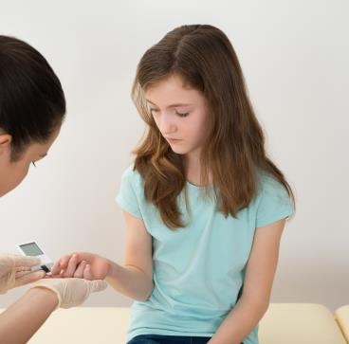
OVERALL HEALTH ISSUES
Diabetes is one of the most common chronic diseases affecting children.
Can lead to serious vision problems or blindness
Complications from diabetic retinopathy may appear earlier or be more severe with kids
Kids with diabetes may also be more likely to develop cataract and glaucoma as adults
Notes:
Kids may not know or understand diabetes. Most caretakers understand what a good diet provides for growing children, but don’t realize an annual exam can also help detect possible vision problems from diabetes.

Slide 35
VISION EXAM
CONSIDERATIONS FOR PEDIATRIC VISION EXAMS
Notes:
Now, lets dive into some of the special considerations for pediatric vision exams.
35

Slide 36
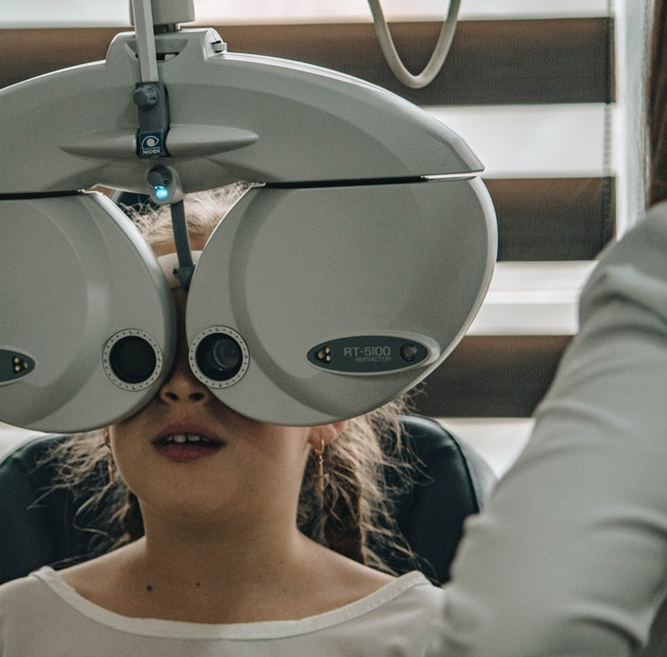
RECOMMENDED FREQUENCY
6-12 months of age
Once between
2–5 years
Annually,
6–18 years
Notes:
The Canadian Association of Optometrists recommends that children get a comprehensive eye exam:
At 6-12 months of age
Once between 2–5 years
Annually, 6–18 years
Early diagnosis and treatment of vision have more positive outcomes if identified and treated early.

Slide 37
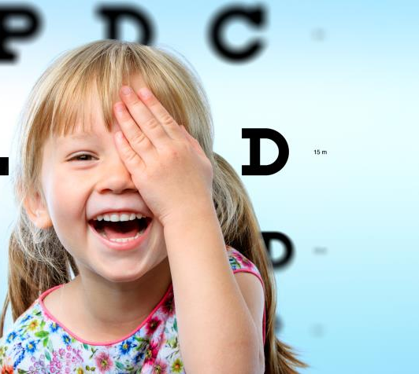
COMPREHENSIVE EYE EXAMS
Vision screenings ≠ comprehensive exam
Screenings typically only assess visual acuity
Comprehensive eye exams identify:
Ocular health examination
Refractive errors
Neurological integrity
Binocularity
Accommodative ability
Vision-threatening ocular disease, Strabismus, Amblyopia
Notes:
Vision screenings can miss up to a third of children with vision problems.
More than 40 percent of children who had a vision problem identified during a screening did not see an eye care professional for follow-up care.

Slide 38
BEFORE THE EXAM
Family health and eye conditions
Child’s health
Medications
Activities
School performance
Special considerations:
Head or eye injuries
Pre- and post- natal complications (prematurity, birth weight, trauma, etc.)
Developmental delays
Notes:
Health: Allergies, frequent colds, ear infections?
Activities: Sports, reading, music, video games, TV. Likes to be outdoors or indoors.
Prescription, over the counter, herbal medications
Special considerations:
Head or eye injuries
Pre- and post- natal complications (prematurity, birth weight, trauma, etc.).
Infections
developmental delays
The recognition of some conditions can require specific optical recommendations.

Slide 39
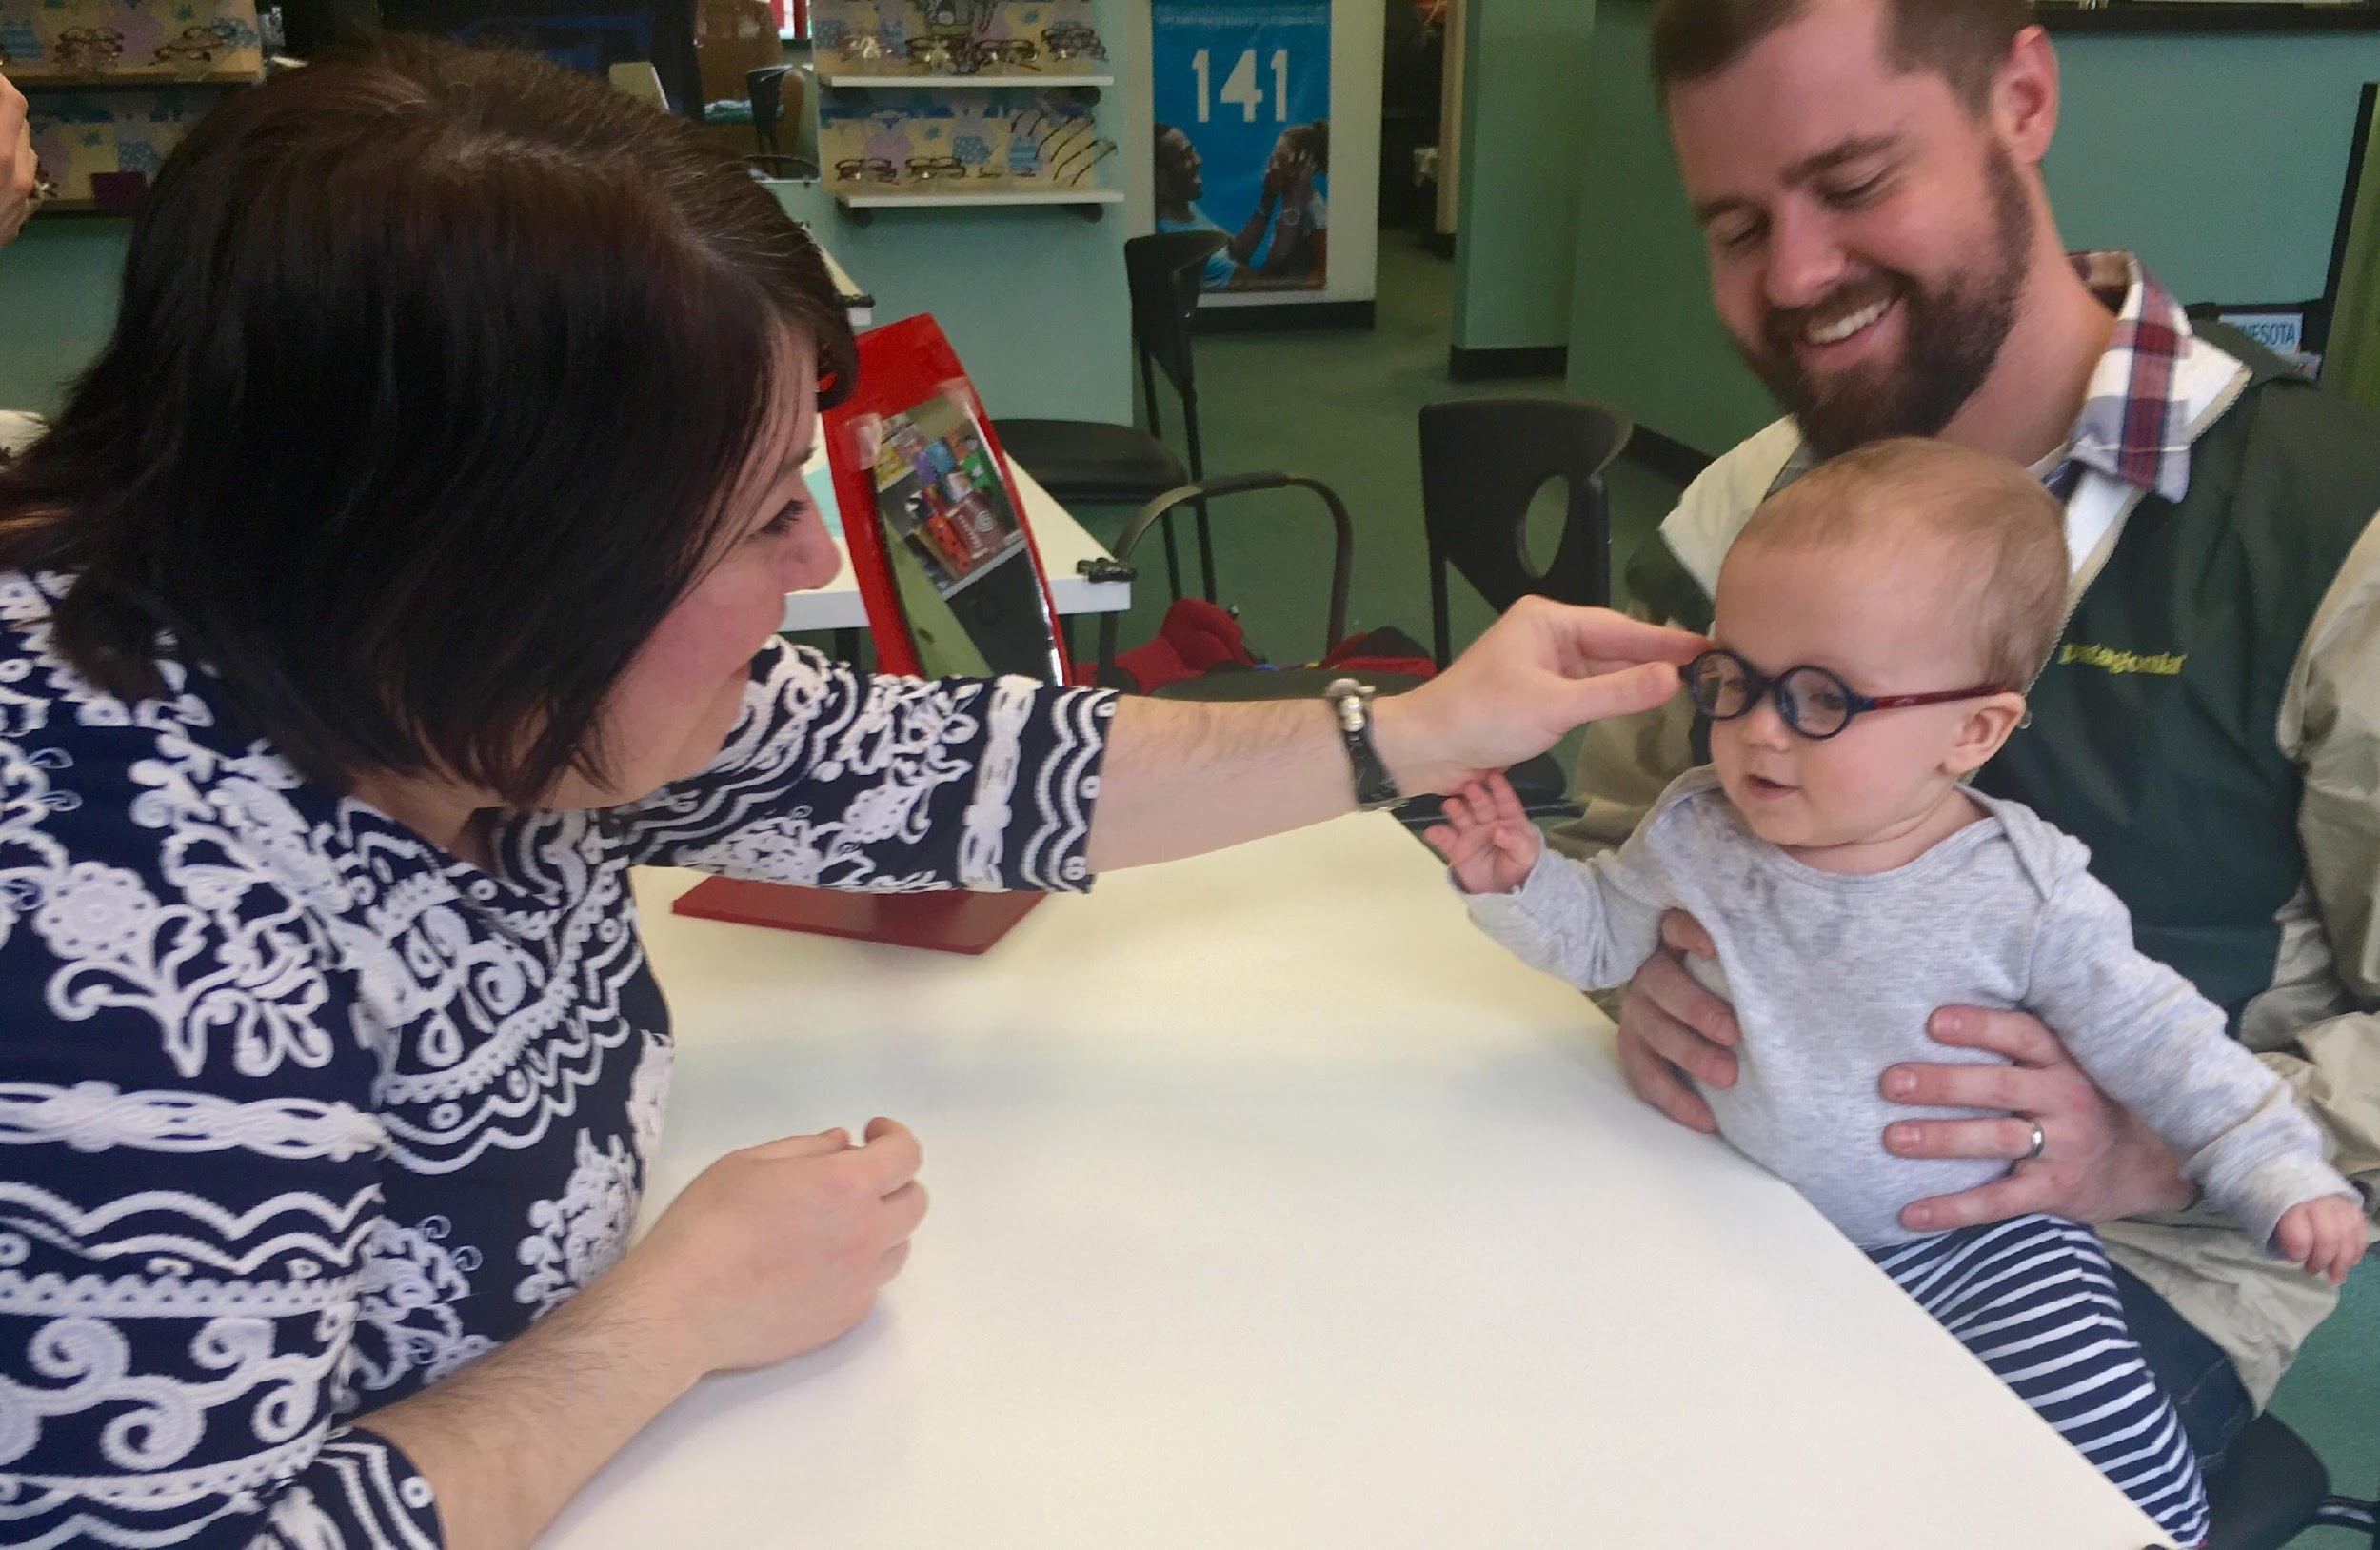
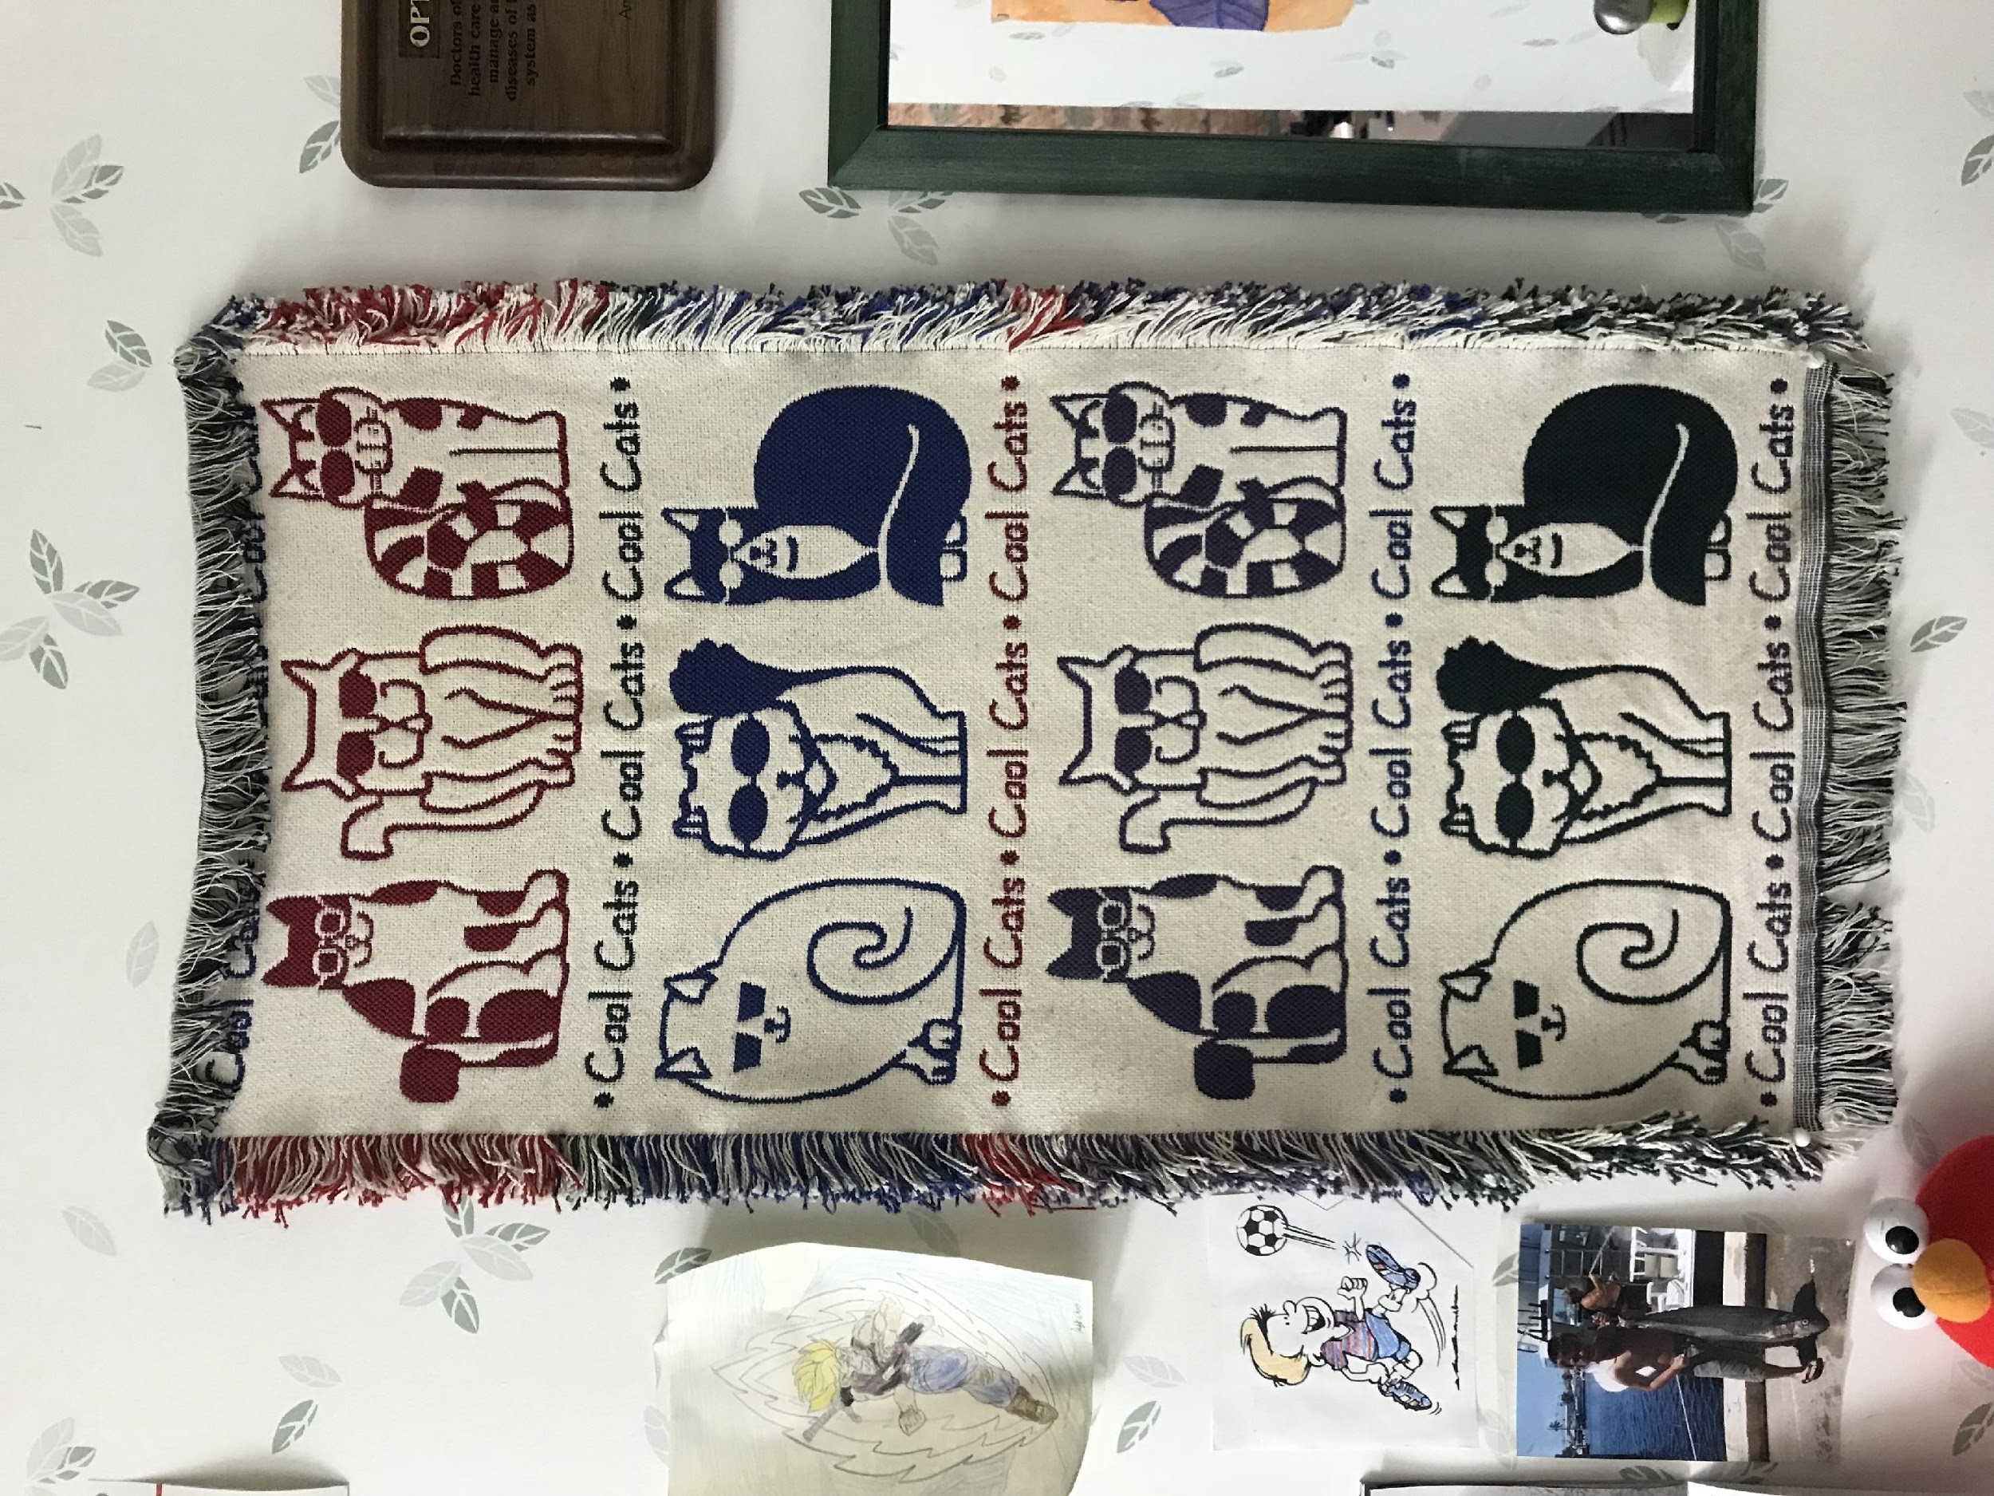
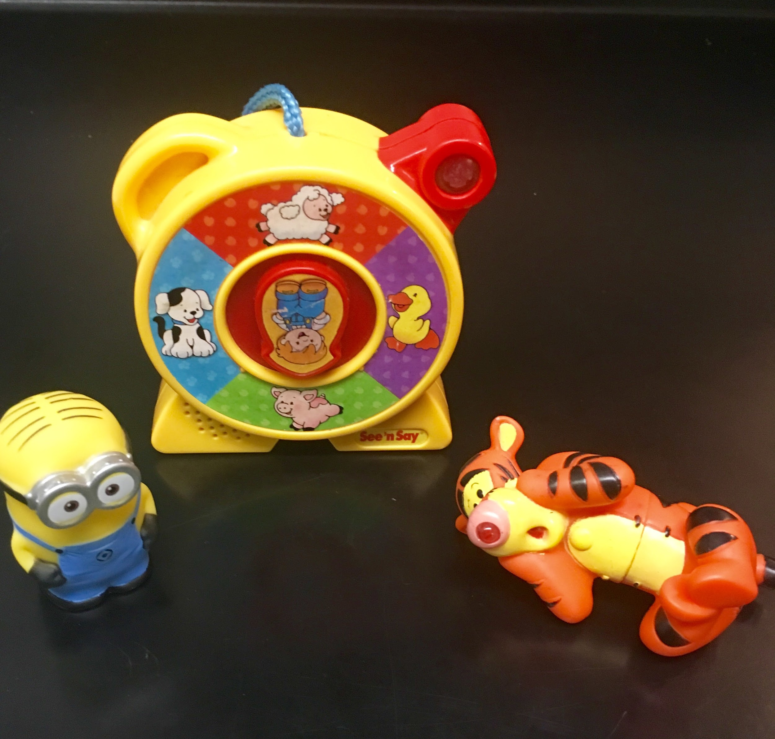
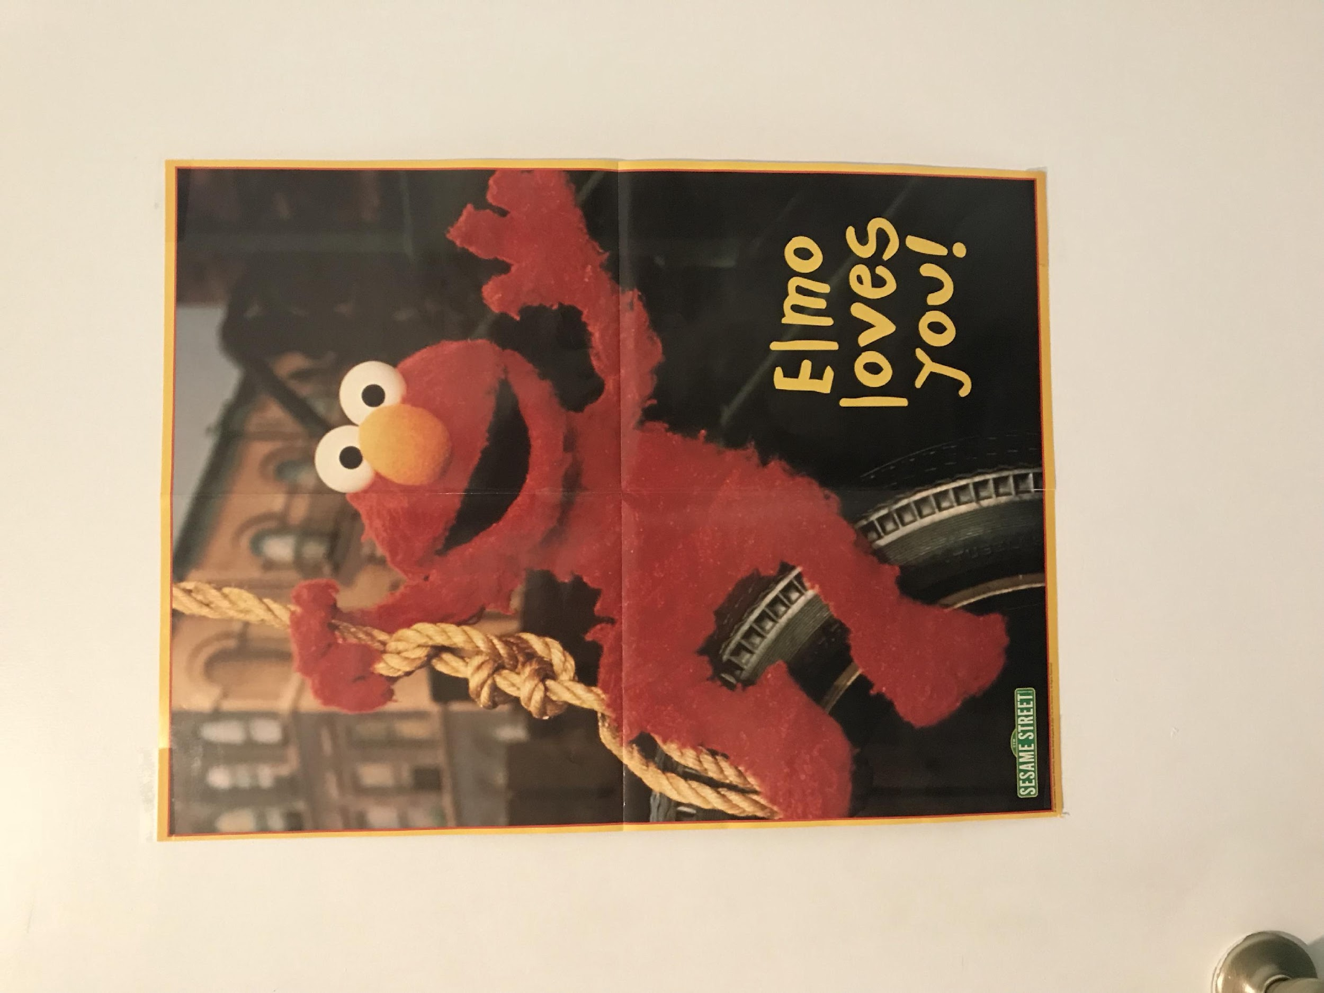
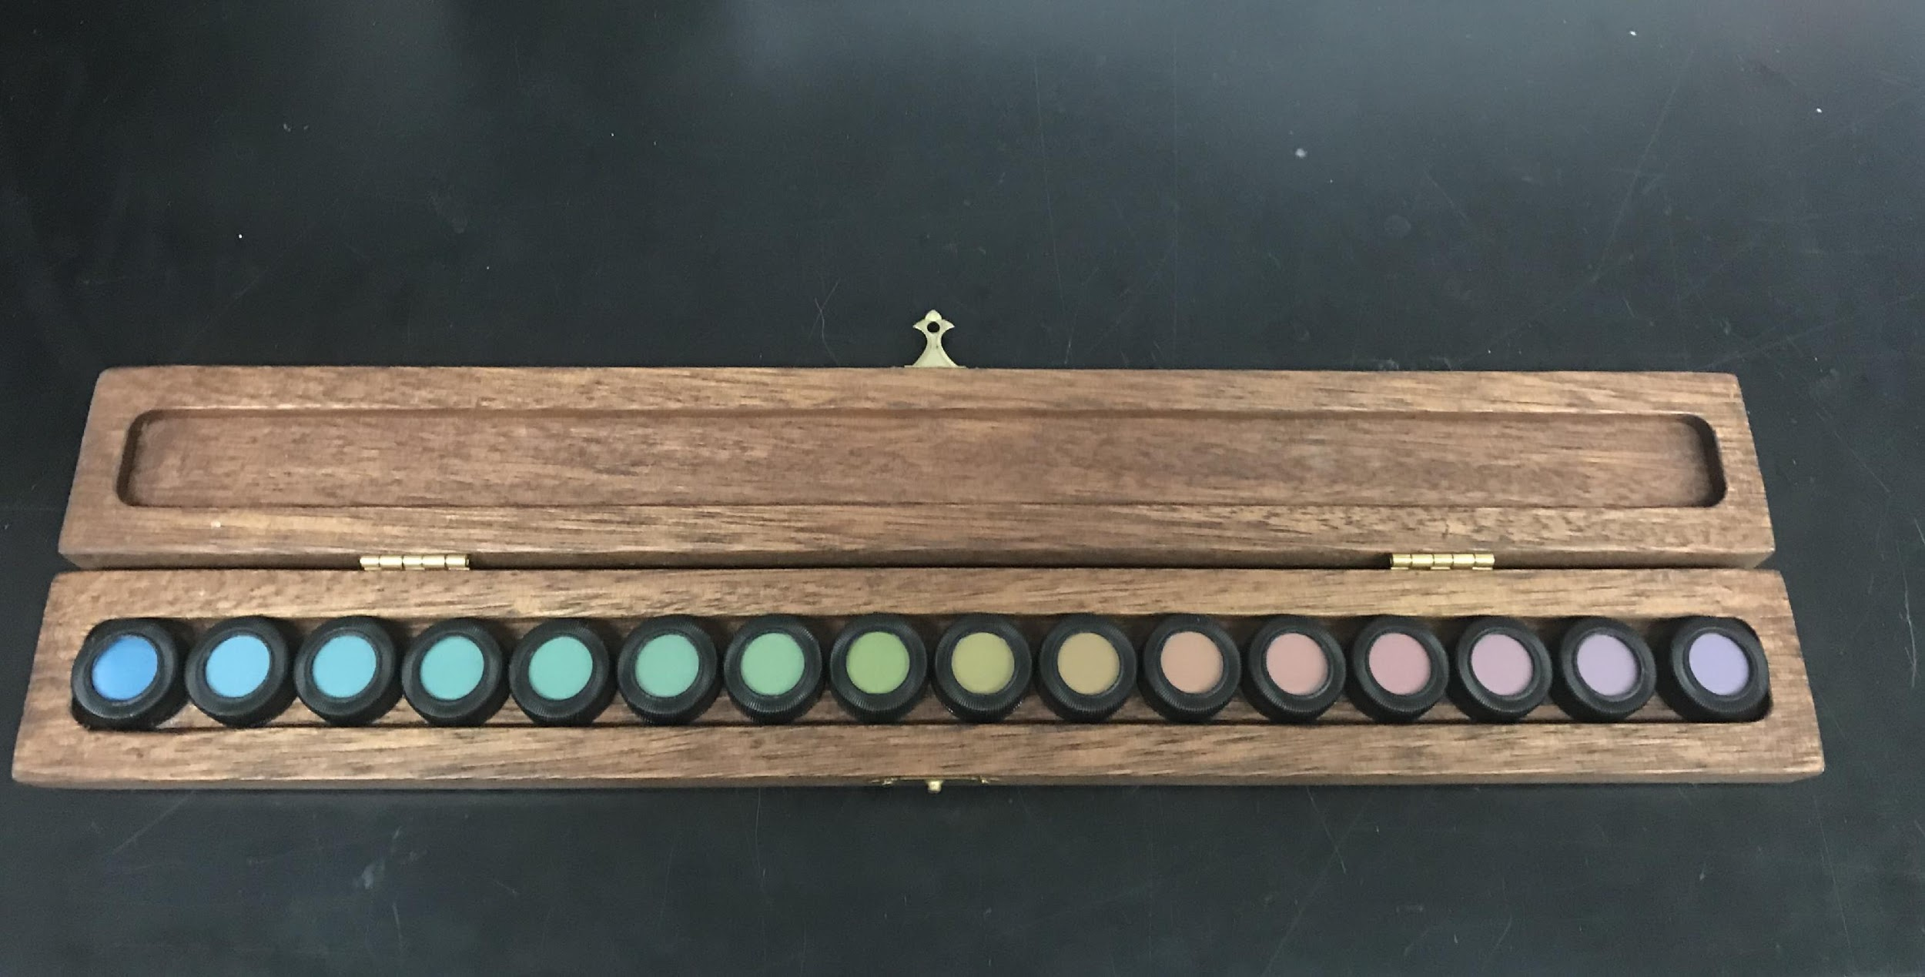
TIPS FOR THE KIDS EXAMS
Create a comfortable environment, White coat can be intimidating
Don’t expect to do everything in the same order
Be flexible & quick
Incorporate familiar characters into the exam
Notes:
Create a comfortable environment
Have pictures on the wall.
Pictures drawn by other kids.
Family photos or photos of pets can start a conversation and help them relax.
Let younger patients sit on parent’s lap
White coat can be intimidating
Don’t expect to do everything in the same order.
Be flexible & quick.
Incorporate familiar characters into the exam

Slide 40
DIS PENSING
FOR GEN Z
Notes:
Just as kids and young adults have different visual needs, we also need to treat them differently when dispensing.
40

Slide 41
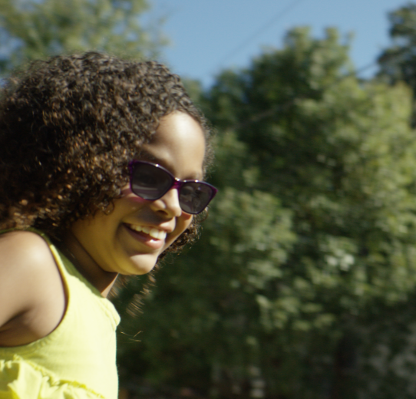
PROTECTION SHOULD INCLUDE
Impact resistance
UV radiation
Harmful blue light – devices and especially the SUN
Glare
Dry eye
Fatigue
Visual acuity
Notes:
It is important that we address kids’ vision and protection. If we educate properly, parents and caretakers shouldn’t hesitate with our prescriptions for Polycarbonate, photochromic lenses (Transitions for both UV and harmful blue light), computer eyewear, etc.

Slide 42
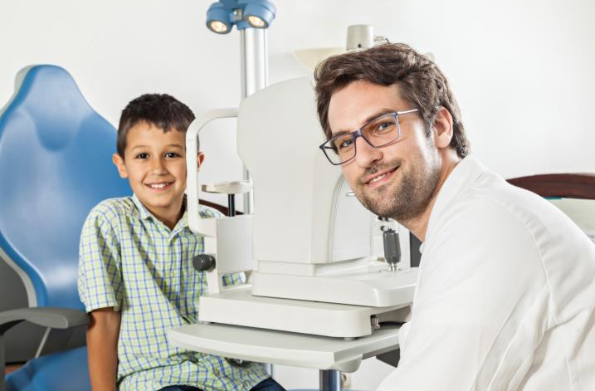
DOCTOR RECOMMENDED
33 percent of parents of children who wear eyeglasses consider the recommendation of the dispenser or eye doctor as a “very important” factor.
Source: Vision Council Visionwatch Parent Child Vision Care Report, Jan. 2016
Notes:
It starts with the doctor’s recommendation, a very important factor. I love chairside doctor recommendations as the patient may understand the recommendation as a medical need rather than a buying decision. As an optician, I would be working with patients making recommendations and answering questions. Dr. would walk in, make the same recommendation and patient wouldn’t hesitate to say if Dr. recommends, they want it. Done deal.

Slide 43
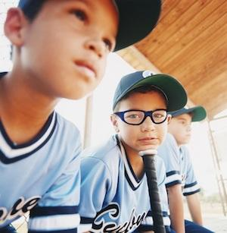
40,000 | Sports-related eye injuries occur each year
90% | Are preventable
Kids should wear protective glasses when they’re playing sports, or even rough-housing.
For contact sports consider wrap around glasses or goggles
Notes:
We talked about impact protection earlier in the presentation. Protective eyewear should be automatic, just like we fit kids with protective helmets, padding, shin guards and other gear. Prevention is key when it comes to eye injuries.
https://www.thevisioncouncil.org/content/sports-protection

Slide 44
PHOTOCHROMIC LENSES
One pair does it all!
Blocks 100% UVA and UVB
Transitions lenses bock at least 20% of harmful blue light indoors – and block over 85% outdoors
Comfort in any light
Convenience of variable tint
Clear vision combined with protection is a bargain.
Notes:
Transitions lenses block 100% of UVA and UVB rays and also reduce painful glare, allowing children to see their best in any light condition. Even kids that don’t need vision correction should wear UV-blocking sunlenses when outside. Not all sunlenses block 100% UV rays – so make sure your child's eyes are covered. It is important that we remind parents that children’s eyes are more vulnerable to damage from UV due to the filtering of the lens being undeveloped.
One pair is easy for kids and eliminates lost or forgotten sunwear. With photochromic lenses one pair does it all!
Transitions lenses are the ideal choice for kids because they seamlessly help to protect kids vision indoors and out from harmful blue light and UV.
Cost – compared to other things parents spend their money on kids, clear vision combined with protection is a bargain.

Slide 45
Insert Kids VLL Video
Video can be downloaded from here:
https://drive.google.com/drive/folders/0B8jvqvV77pcJejF2LUQwbmtGVUU?usp=sharing

Slide 46
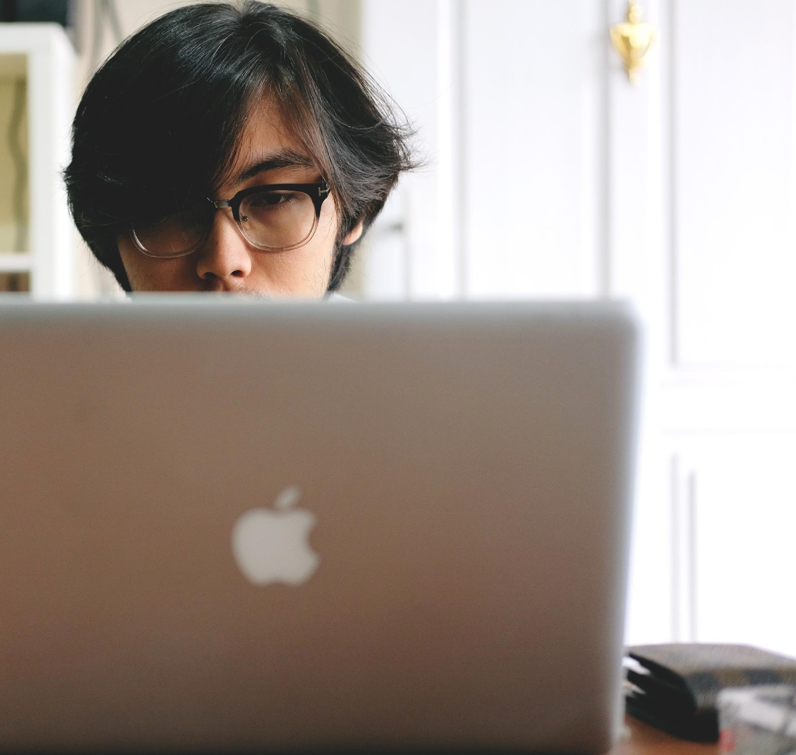
ANTI-REFLECTION
Give Gen Z clear and comfortable vision
Reduces glare and reflections of polycarbonate
Reduces eye strain
Offers aesthetic benefits
Notes:
There are many good reasons to include AR in your prescription for kids. The vision and aesthetic improvements AR provides helps facilitate a positive experience with prescription eyeglasses.
Polycarboante has a higher index of refraction and lower abbe vs. standard plastic which creates more reflections.
With children spending more time in classroom fluorescent lighting conditions, in front of computer screens and digital devices, watching TV and playing video games, AR lenses provide significant benefits for their eye health, clear vision and comfort.
Remember that vision is a key factor in a child’s emotional and intellectual development. Kids should want to wear their glasses. They should feel comfortable wearing their glasses. Younger children can become discouraged if they suspect people have trouble seeing them clearly. The child can be confident and comfortable knowing that other people can see their eye without trouble.
Note: adding a blue blocker, does not add much to the protection you already get from Transitions.

Slide 47
FRAME AND OTHER RECOMMENDATIONS
Fashion
Gen Z like their glasses to look “cool”
Fun colours, patterns and styles make glasses appealing
Plastic or Metal
Plastic used to be considered more durable
No longer the case with improvements from manufacturers
Proper Bridge Fit
Young noses are not fully develop
Fit can make the difference of glasses staying in place
Temples
Cable temples, straps, skull temples
Spring Hinges
Prevents frequent adjustment/repair
Second Pair
Sports pair
Backup pair
Computer pair
Notes:
It’s just as important with kids as with adults that we start with lenses first. Prescribing the best visual solution for the patient is the priority. Then we move to finding the best frame that matches the patient's activity level, face shape, bridge, eye size (giving room to grow, but not too much as comfort is more important). Sports Rx for protection are should be considered just like protective gear for sports. Can the patient study at school, ride a bike etc., without their glasses? If not, a back up pair is a necessity. Besides being a back up pair, they can be used as a fashion statement or accessory. Two different styles can make wearing glasses more fun by changing it up a bit.
When recommending photochromic lenses, find a frame that looks equally good as an indoor pair as well as an outdoor pair. Some indoor frames would not look good as a sunglass, and vice versa.

Slide 48
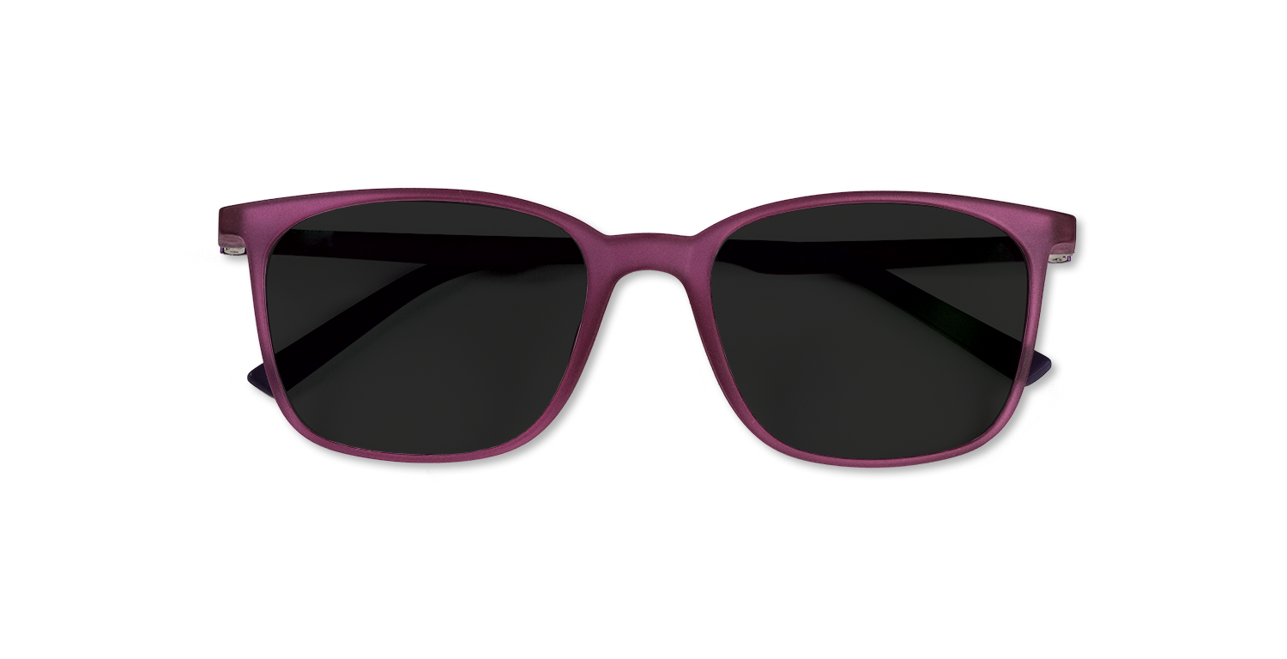
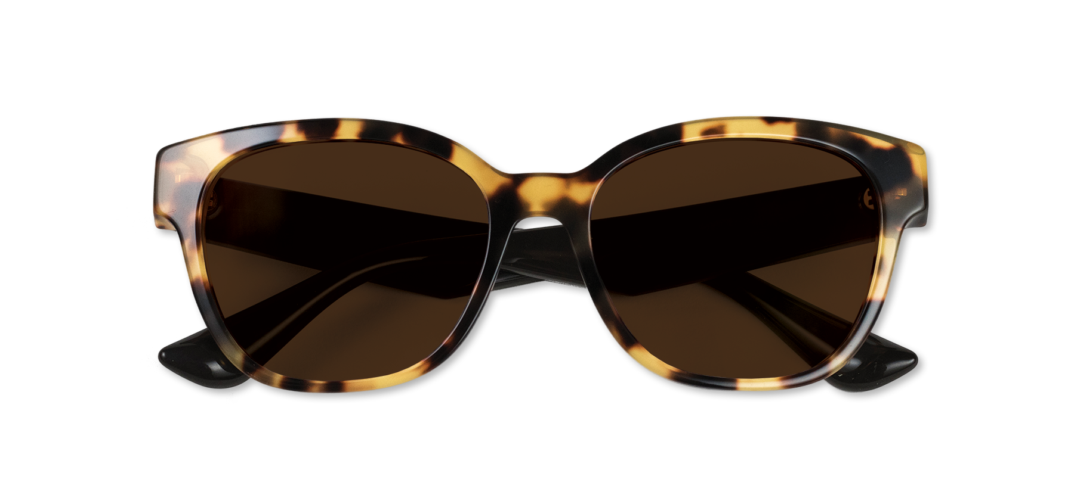
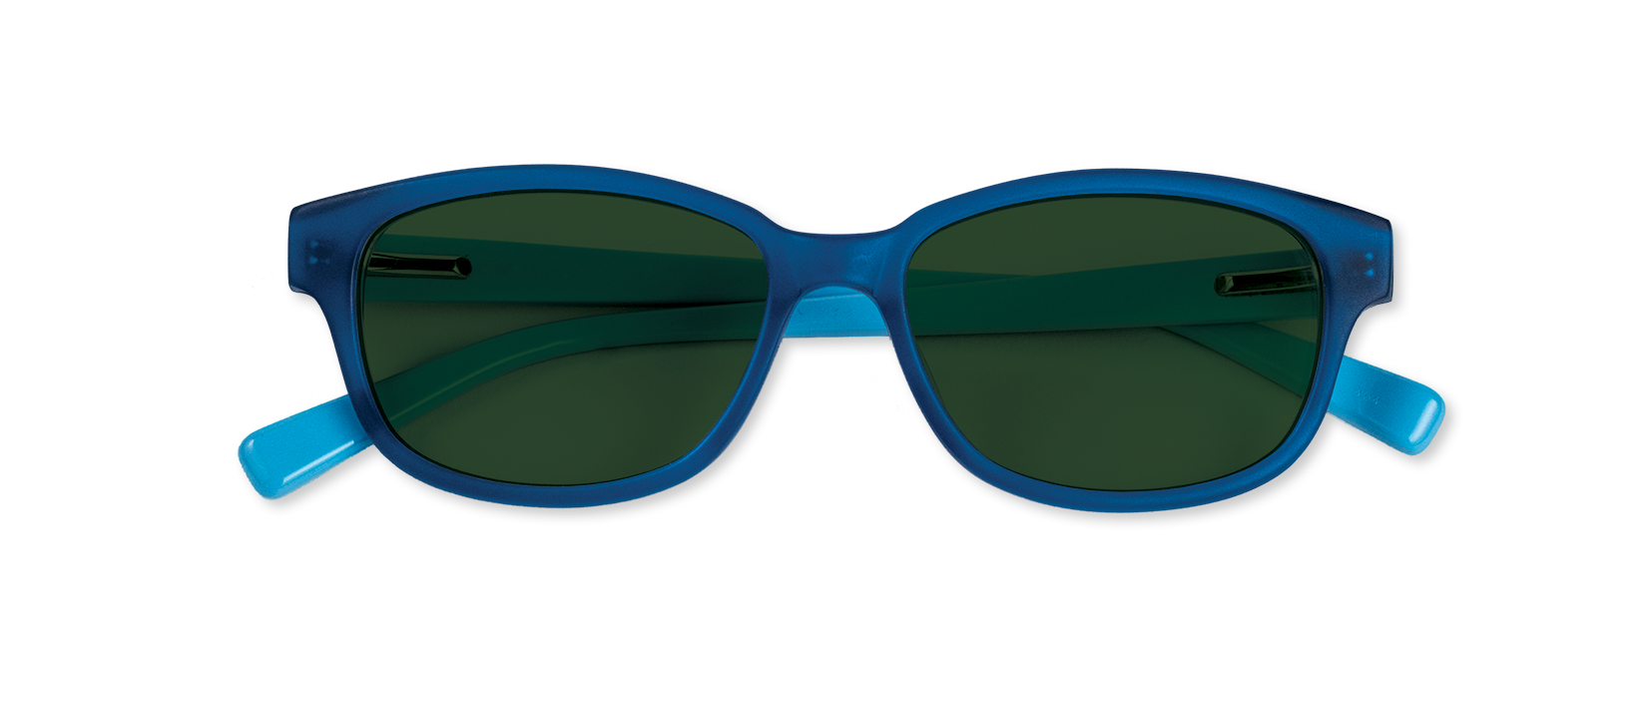
FINDING THE STYLE IN LENSES
Lenses
Offer both style and functionality that will appeal to Gen Z
Different lens colors
Can enhance the look of your patient’s glasses
Educate patients
About how the perfect combination of a frame and lens will enhance all of their favorite activities
Purple frames
Gray lenses
Tortoise frames
Brown lenses
Blue frames
Graphite green lenses
BREAK THE COMMON RULES TO CREATE A UNIQUE LOOK.
Notes:
Today, more than ever, eyewear has evolved from pure function to a fashion statement. With Transitions lenses, you are looking at both the style and the functionality. Transitions lenses adapt to changing light conditions and help protect against harmful UV and harmful blue light. They also create multiple looks as the lens tint changes.
Keep this in mind, and pair Transitions lenses with bold frames that work both indoors and outdoors. And thanks to the colour choices offered by Transitions – gray, brown and graphite green – more and more people are pairing a variety of frame shapes, colors and textures with different lens colors to make fashion statements.

Slide 49
WHAT DO KIDS THINK ABOUT EYEWEAR?
They look smart
They look honest
Kids prefer Transitions® lenses 9 out of 10 times to regular clear lenses
Glasses are a great accessory
Sources: Ophthalmic and Physiological Optics, May 2008, Romeu ML 2003
Notes:
In a study of kids between ages 6 -10 at Ojai State University and published in the Journal Ophthalmic and Physiological Optics, May 2008
Kids said eyeglasses make kids Look Smart and Look Honest.
A study performed in the U.S. by Dr.'s (Madeline) Romeu, (O.D.) and (Susan) Stenson,( M.D. in 2003) found that children significantly preferred photochromic lenses over clear lenses. In fact, Kids Prefer Transitions lenses 9 out of 10 times to regular clear lenses.
Glasses are a Great accessory – Even Kids without a Rx are purchasing non-prescription glasses at retailers for a fun way to accessorize.

Slide 50
TIPS FOR SUCCESS
Prescribe the BEST visual solution(s) for your patient’s needs
Simplify – TMI
“Your lenses come with”
Younger Gen Z
Talk with the child and the parent together – Gen Z influences decisions
Use kid-friendly language or buzz words
Photochromic lenses are magic Computer lenses are the Xbox or technology lenses
Older Gen Z
Highlight the style aspect of eyeglasses and lenses
Talk about the harmful blue light protection offered by photochromic lenses
Notes:
In our conversations, it is the combination of product, knowledge, price and how we present it to our patients, parents or guardians. Stop thinking “parents don’t want to spend money on their kids glasses.” If we think they can’t afford the best lens solution or don’t want to spend the money on eyeglasses, they will too. We tend to give options of good, better, best, which parents contribute to price when we should be looking at what the child needs. We are creating fear and insecurity in making the wrong decision with the parents and possibly push back on the best solution for the child. We have to be confident in prescribing with recommending the best solution – that might include a sports pair or back-up pair.
We are only protecting the child and helping the parent make a good and informed decision. Remember Gen Z really influences the buying decision, so don’t hesitate to talk with children as well.
Start by asking questions like “do you have a favorite color?” and “Is there a frame you saw on a friend that you liked?”
From there grab 10 frames to get them started. Create a Yes, No, Maybe pile.
Encourage parents and patient to walk around if they’d like, but most parents are happy when you get them started with piles.
For older Gen Z, highlight the style aspect of lenses and frames. Talk about the harmful blue light and UV protection offered by Transition lenses. Being a little older, these young patients can better understand the importance of this protection.

Slide 51
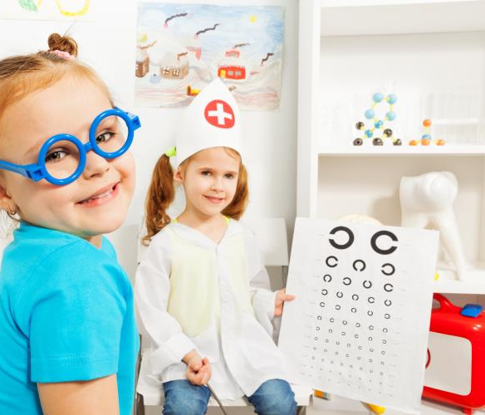
BE KID FRIENDLY
Scaled-down tables and chairs
Fun mirrors
Bright colors
Things to do
Play area with coloring books and crayons, sturdy quiet toys
DVD player with age-appropriate videos
Notes:
Consider designating a dispensing area just for children if you don’t have one now. Choose a theme to carry through the area to make it more fun. If you are utilizing a specific space in your dispensary for kids, you may want to choose a corner area near the front of the office. It makes it convenient, controlled, and allows you to promote that you offer kids’ selections to each person who walks through the door.
When it comes to kids furniture, remember– Size, Durability and washable. Maybe add a couple of adult-sized chairs or a bench for parents, but it is supplemental to the kids furnishings. Remember what you leave in the area needs to be childproof. If you have a computer in this area, remember they may not hesitate to see if you have their favorite games loaded on your computer while you aren’t paying attention.
Often, siblings and young friends tag along. Having a computer designated for the kids in this area can solve the problem. Cycloplegics are often involved for children's refractions, so waiting while it takes effect can be boring and having activities for the kids can help with patience and frustration. Have a plan for cleaning the area frequently to prevent spread of germs. A changing table in the patients restroom is a big help for parents of babies and toddlers.
Ask younger patients to hang their drawings on the wall in your office or exam room to create a more comfortable atmosphere.
The space should be both kid and parent friendly!

Slide 52
KIDS CONNECTION CHECKLIST
Communicate
In shorter bursts of “snackable content” – their attention span is only about 8 seconds
Don’t talk down
They have opinions and influence family decisions
Feed their curiosity
Let them activate photochromic lenses with a UV flashlight or demo
Notes:
Connecting with Gen Z is a little different than past generations. Studies have shown that these young minds have famously short attention spans of a brief 8 seconds. Entities like Snapchat and Instagram are examples of specialized catering to this decreasing attention span. Short and to the point dominates any strategy for reaching Gen Z. Accommodating their window of attention is crucial in trying to reach Gen Z since time is so valuable to them.
Gen Z has more influence on parents than the past, so remember to talk directly to them and their parents.
We are fortunate to have tools of the trade to help us spike their curiosity. Help them understand the importance of UV by letting them use the UV flashlight demo Transitions offers. Show them the amazing magic of photochromic lenses with the UV light demonstrator. These young patients appreciate being involved to show the parent the value of your recommendation.

Slide 53
TOOLS YOU CAN USE
Kids and Blue Light
Counter Card
Dispending Guide
Social Media Assets
Symptoms to Watch For
Example referral and permission letters
Notes:
Note: Materials posted on www.TransitionsPro.com/Kids

Slide 54
KIDS PACKAGES
Safe and thin material
Adaptive lenses with UV and harmful blue light protection
Selected frames
$249
Add AR for indoor glare reduction, easy cleaning and 1-year warranty
+$95
Notes:
In a kid-friendly dispensary you want to make sure young patients are getting what they need which often means recommending a number of options. There may be anxiety from parents at this point. They want to give their child every benefit they can however listing option after option can be overwhelming. Bundle lens options that provide visual comfort and savings to the family. This keeps things simple so parents are more comfortable, the child has less time to be distracted and you are able to offer premium lens solutions without hesitation.
Offer warranties but do limit them as kids Rx’s are only for a year rather than the adult 2-year Rx. Warranties represent added value, so make sure to tell them about every warranty. Even if it is coming from the manufacturer, they see it as coming from you. This is very helpful to the practice’s professional image.

Slide 55
LET’S SUMMARIZE GEN Z TODAY
Educate
Be an advocate for kids and young adults and their vision
More time with digital devices / less time outdoors
May affect visual development / Talk about blue light protection but don’t forget the sun
Protect Gen Z with their Rx
Damaging UV, harmful blue light, eye trauma and glare
Prescribe
The best visual solution without hesitation
Notes:
We’ve learned that 80% of learning in a child’s first 12 years comes through his or her eyes. We can be an advocate and help educate our communities.
GenZ spends more time with digital devices and less time outdoors, which may affect visual development. Teach healthy eye habits – (20-20-20 rule), and talk to parents about the need for harmful blue light protection, but don’t forget the sun protections (the largest source of blue light)
Gen Z is a growing; and an opportunity for the ECP. We also learned a lot about kids’ eye development and the importance of protection. The opportunities for changing the future and how we look at kids and their vision is huge.

Slide 56
THE BRIGHT SIDE
OF GEN Z
THANK
YOU!
Notes:
We wish you success and fun as you approach the opportunities with Gen Z

