Slide 1
OVERVIEW AND ENTRY GUIDE
VISIT TRANSITIONS.COM/AWARDS
Notes:
The Transitions Innovation Awards program recognizes and celebrates loyal partners and individual optical industry professionals from Canada and the U.S. who have shown the highest level of commitment to growing its business with Transitions Optical’s family of products and programs over the past year.

Slide 2
WHO IS ELIGIBLE TO APPLY?
Independent eyecare professionals and practices
Optical industry professionals and educators
National and regional retailers
Optical laboratories
Managed Vision Care companies
Lens manufacturers and buying groups

Slide 3
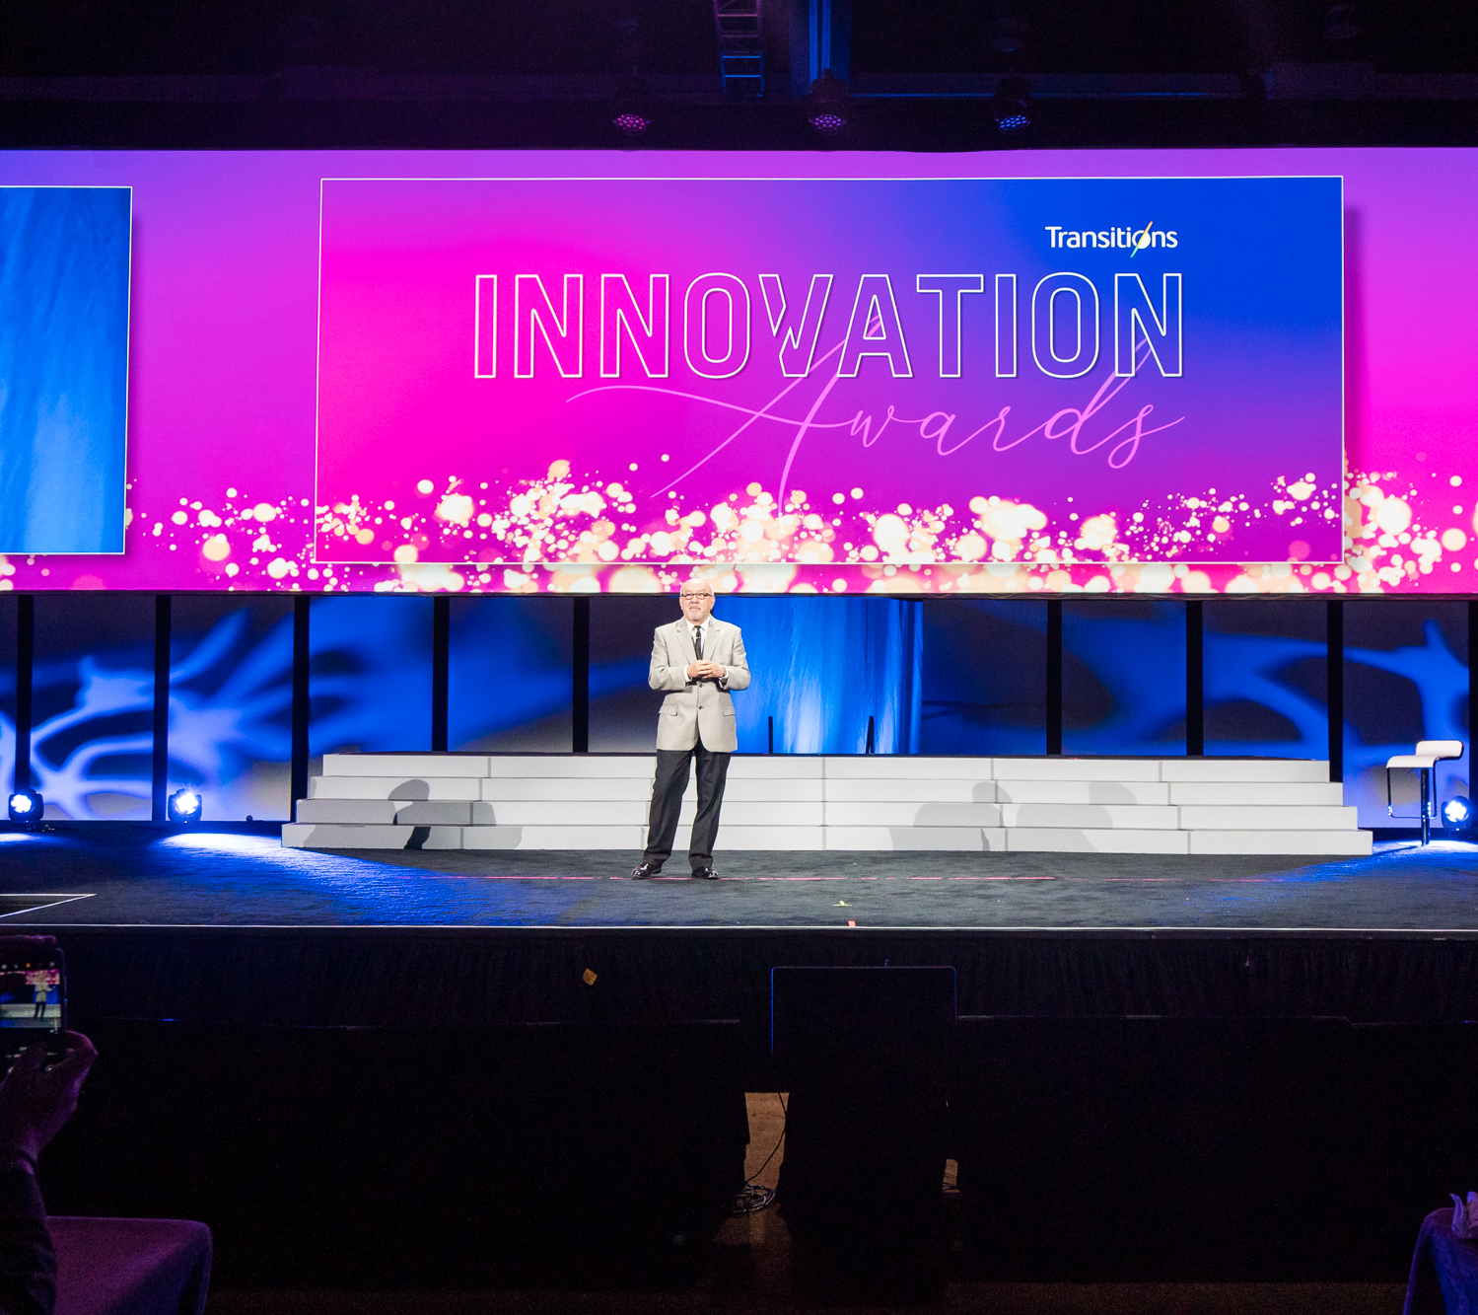
CATEGORIES INCLUDE:
Transitions Brand Ambassador
Retailer of the Year U.S.
Retailer of the Year Canada
Eyecare Practice of the Year U.S.
Eyecare Practice of the Year Canada
Best in Training
Best in Marketing
Transitions Brand Ambassador
Retailer of the Year U.S.
Retailer of the Year Canada
Eyecare Practice of the Year U.S.
Eyecare Practice of the Year Canada
Best in Training
Best in Marketing
Notes:
Transitions Brand Ambassador: This award goes to the individual who best showcases their dedication to being an influential advocate of the Transitions® brand, whether amplifying peer-to-peer conversations, social media or having an unparalleled commitment to incorporating Transitions® lens products into their business goals, patient interactions, training efforts or promotion of healthy vision in their community.
Retailer of the Year U.S., Retailer of the Year Canada: Awarded to a retailer for actively supporting the Transitions brand and demonstrating a commitment to enhancing the vision of their customers and communities. U.S. and Canadian retailers with 20 or more locations are eligible for this award. The award will be presented to one retailer from the US and one retailer from Canada. Nominees are judged on several factors, including overall photochromic growth; efforts to support the Transitions brand through marketing programs and promotions; quality of education provided to optical employees; efforts to promote healthy sight in their local community and support and involvement with public service programs; and an overall commitment to educating customers about the importance of healthy sight and benefits of Transitions lenses.
Eyecare Practice of the Year U.S., Eyecare Practice of the Year Canada: The Eyecare Practice of the Year Award recognizes independent eyecare practices and retailers with less than 20 locations in the U.S. and Canada that are actively promoting healthy sight to their patients and within their local communities, and who have demonstrated excellence in supporting the Transitions brand. The award will be presented to one retailer from the US and one retailer from Canada. All nominees are evaluated on their performance in several factors, including commitment to photochromic growth; alignment to Transitions Optical and participation in programs and promotions; marketing initiatives; education and training efforts; and community involvement.
Best in Training: Presented to an individual, company or educator that has shown creativity in developing or offering training and education opportunities that include dispensing photochromics, the Transitions brand or family of products. This could include integrating Transitions Optical’s messaging or education resources into staff or industry training efforts, or helping to increase participation in training events that include Transitions Optical (such as CE training seminars, education and other training offered through lab and/or lens manufacturer partners).
Best in Marketing: Awarded to an individual or company for employing creative and strategic marketing tactics to effectively promote the Transitions brand or family of products among customers or within their communities. Marketing initiatives could include incorporating the Transitions brand within marketing and advertising campaigns, sales/staff promotions, point-of-sale, in-office materials, or digital communications (email, website, social media, etc). Nominees should also demonstrate how the execution of the marketing tactics helped to “break through the clutter” and add value to their business objectives.

Slide 4
WHAT DO YOU WIN?
A trip for two to Transitions Academy in Orlando, Fla.
Recognition at Transitions Academy
Coverage in trade news publications (examples follow)
A shiny trophy
Transitions Brand Ambassador
Retailer of the Year U.S.
Retailer of the Year Canada
Eyecare Practice of the Year U.S.
Eyecare Practice of the Year Canada
Best in Training
Best in Marketing

Slide 5
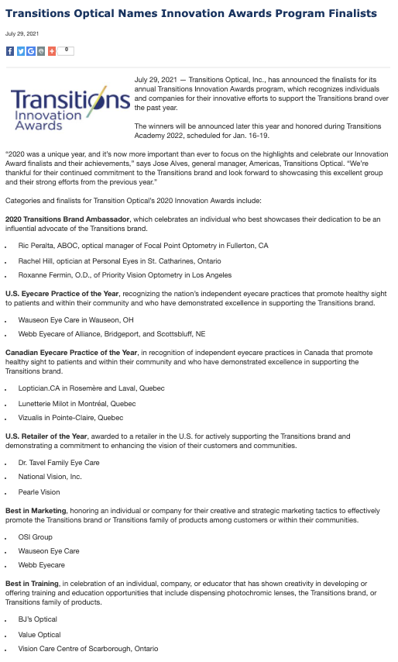
VISION MONDAY AND EYECARE BUSINESS MAGAZINE ONLINE
Notes:
https://www.visionmonday.com/business/article/transitions-optical-announces-2020-innovation-awards-finalists/
https://www.eyecarebusiness.com/news/2021/transitions-optical-names-innovation-awards-progra

Slide 6
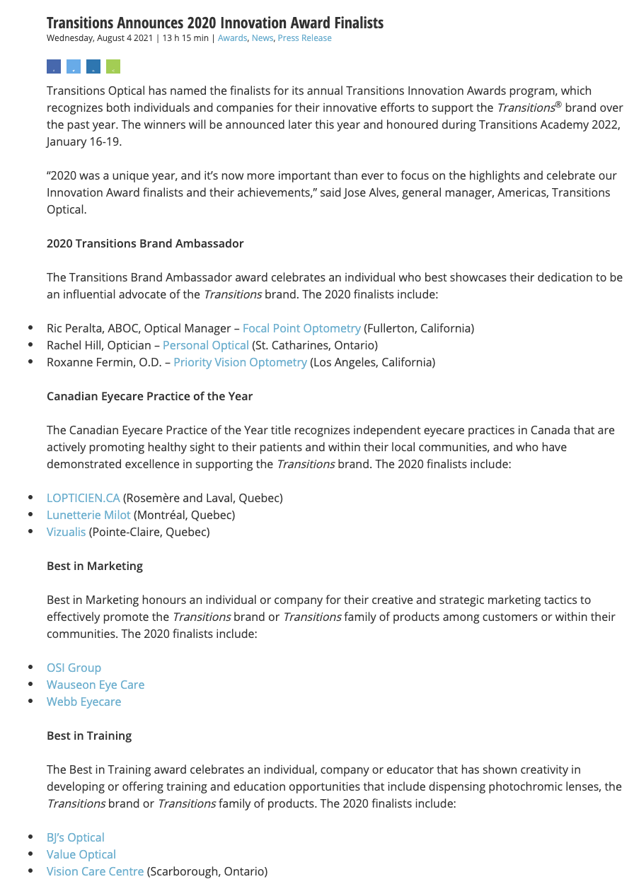
OPTICAL PRISM MAGAZINE AND OPTIK ONLINE
Notes:
https://opticalprism.ca/transitions-optical-announces-2020-innovation-award-finalists/?fbclid=IwAR2Yw4esdmNzveTJaAwIFWoAE5PPmgYw-mFCrvHMvSlv9xyjrvoUOXKS2R0
https://www.optiknow.ca/2021/08/04/transitions-announces-2020-innovation-award-finalists/

Slide 7
HOW DO YOU ENTER?
Nominations will be accepted online at Transitions.com/Awards in October 2021.
Notes:
Nominations will be accepted online at TransitionsPRO.com/Awards in October 2021.
To enter, candidates must complete a nomination form and detail their 2021 efforts in the following evaluation areas: commitment and inspiration, goals, plan and creativity, and impact and results.
Nominees are welcome to enter more than one category and can self-enter, or can be nominated by a lab, lens manufacturer, industry colleague or other industry organization representative.

Slide 8
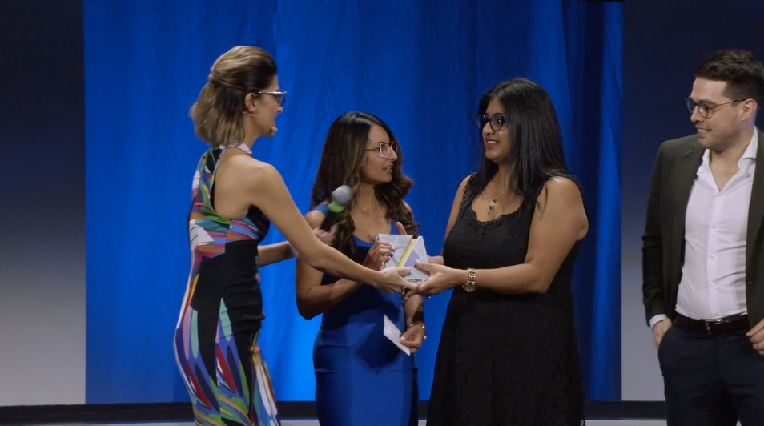
GET INSPIRED
Watch this video from the Innovation Awards Ceremony:
Notes:
https://vimeo.com/392964907

Slide 9
HOW TO CREATE A WINNING ENTRY
Visit Transitions.com/Awards

Slide 10
START PLANNING NOW!
Start by deciding which specific award(s) you want to win and review the evaluation areas.
Set your goal for 2021 and benchmark where you are to measure your success.
Put a plan in place to help achieve that goal.
Start tracking now!
Use the Entry Guide and Workbook to Help!
Notes:
Start by deciding which specific award(s) you want to win and review the evaluation areas
Set your goal for 2021 and benchmark where you are to measure your success
TIP: Align your goal(s) with the award you want to enter. For example, if you are seeking the Best in Training award your goal might be to increase staff knowledge and recommendations. Benchmark where you are by testing their product knowledge now and at the end of the year to show your progress
Put a plan in place to help achieve that goal.
Whatever your goal is, make sure you are taking action now and throughout the year to help achieve it.
Start tracking now!
You’ve established your goal and your plans for achieving it. Now you need to keep track of the actions you are taking and your progress towards your goal along the way.
It can be difficult to remember all that you did at the end of the year, so we’ve included slides in this guide for you to document your journey along the way.

Slide 11
TIPS FROM THE JUDGES
Establish clear, measurable goals and show how your results align (even if you don’t achieve your goal).
Report your metrics (results, YOY data) graphically.
Show visuals of what you did to achieve your goals.
Highlight areas that you want the judges to pay particular attention to.
Correctly use branded product names, logos and images.
If you attended Transitions Academy, show how you applied your learnings.
Try to keep submission to 10 slides.
Notes:
Tips from the Judges:
Don’t submit one PowerPoint presentation for multiple categories. Customize each submission to the category you are applying for.
Establish clear measurable goals right now. Show how your results align with your goal. Even if you don’t achieve your goal, show how you made progress towards it.
Report your metrics (results, YOY data) graphically.
Take pictures, videos and show visuals of what you did to achieve your goals. Snapshots taken on a smart phone are perfectly acceptable.
Highlight areas, through changed text/colors, that you want the judges to pay particular attention to.
Correctly use branded product names, logos and images.
If you attended Transitions Academy, show how you applied your learnings.
Try to keep submission to 10 slides. Think critically about what information is needed and then only go over the limit if more slides are needed to communicate the information that is asked for.

Slide 12
PAST WINNER PROFILES

Slide 13
WALMAN OPTICAL BEST IN TRAINING
The largest independent wholesale lab in America
Leveraged the Transitions® Signature® GEN 8™ launch
Used a combination of in-person trainings, webinars and a new Transitions Ambassadors Program
Paired style colors and style mirrors in Walman Optical frames
Efforts resulted in around 5,000 more pairs per month over the last 2 years
Comments from the judges: Through their efforts in 2019, Walman Optical has shown that a multi-tiered approach to training can be extremely successful. Their decision to provide additional support to accounts with the highest growth potential for Transitions share through the Transitions Ambassador Program showed innovation and dedication that left us truly impressed.
Notes:
Walman Optical is the largest independent wholesale lab in America, providing eyecare professionals with what's best for their patients, through their expansive and unbiased product offering, programs and education.
Their objective in 2019 was to leverage the Transitions® Signature® GEN 8™ launch to help eyecare professionals increase revenue and patient satisfaction. They created a robust training program through a combination of in-person trainings, webinars and a new Transitions Ambassadors Program. Walman Optical saw an average of 5% share growth from the accounts that participated in the Transitions Ambassador program, showing that a focused effort on select accounts pays-off.
Walman Optical also used the Transitions® Signature® style color and Transitions® XTRActive® style mirrors lenses and put them in Walman Optical Frames to offer a differentiated product in the marketplace. By focusing on style colors and the Transitions Signature GEN 8 launch they were able to continue to grow their Transitions lens share, which resulted in around 5,000 more pairs per month over the last 2 years.
Comments from the judges: Through their efforts in 2019, Walman Optical has shown that a multi-tiered approach to training can be extremely successful. Their decision to provide additional support to accounts with the highest growth potential for Transitions share through the Transitions Ambassador Program showed innovation and dedication that left us truly impressed.

Slide 14
VALUE OPTICAL BEST IN MARKETING
Chain of retail optical stores with 13 locations located in the Caribbean Island of Trinidad and Tobago
Focused on reaching a younger demographic
Launched a Carnival, Easter and style colors campaign
Introduced Transitions Signature GEN 8 at trade conference
Led to an 84% share of Transitions lenses in 2019
Comments from the judges: Each year, Value Optical achieves amazing results that are hard to beat, and yet year after year they outdo themselves. Their approach to using a combination of efforts to target a younger demographic was strategic and thoughtful, and their results clearly demonstrate that they were effective as well.
Notes:
Value Optical is a chain of retail optical stores with 13 locations located in the Caribbean Island of Trinidad and Tobago.
In 2019, Value Optical focused on reaching a younger demographic through colorful campaigns featuring Transitions Signature GEN 8 and Transitions style colors. Their campaigns used a combination of traditional advertising, social media influencers and presence at trade conventions.
Value Optical launched a Carnival campaign, an Easter campaign and a style colors campaign that featured their own staff modeling the lenses. Social media influencers were also used during the style colors campaign to help reach the younger demographic and show the style aspect of Transitions lenses. Value Optical also introduced Transitions Signature GEN 8 at their largest regional trade conference and ran a billboard advertisement that saw 100,000 viewers per month.
The combination of Value Optical’s efforts led to 84% sale of Transitions lenses in 2019 and an increase in their single-vision sharing showing a positive impact of their campaign strategy.
Comments from the judges: Each year Value Optical achieves amazing results that are hard to beat, and yet year after year they outdo themselves. Their approach to using a combination of efforts to target a younger demographic was strategic and thoughtful, and their results clearly demonstrate that they were effective as well.

Slide 15
GRIMARD OPTIQUE CANADA RETAILER OF THE YEAR
Made up of 22 eyewear stores with over 130 opticians, assistants and optometrists
Set a challenge to inform all their customers about Transitions lenses
Set monthly objectives in all their clinics
Focused on increasing patient awareness around Transitions lenses
Saw a 153% increase in Transitions single-vision lens sales
Comments from the judges: Grimard Optique not only made strong efforts to train their staff about Transitions lenses, but they also put a real emphasis on educating their patients about the products as well. Their new focus on sensitivity to light and the large number of Open-Door events and other patient advertising resulted in strong success in 2019.
Notes:
Founded in 1980, Grimard Optique currently has 22 eyewear stores with over 130 opticians, assistants and optometrists, all driven by the desire to take care of the eye health of customers and to offer a high-quality shopping experience.
Eye health being their main concern, Grimard Optique’s challenge was to inform all their customers and to offer them Transitions lens products. They committed to talking about the benefits of Transitions lenses, in terms of eye health, practicality, aesthetics and fashion.
To help achieve this, Grimard Optique set monthly objectives in all their clinics and focused on increasing patient awareness on Transitions lenses. The monthly objectives were accompanied by training on Transitions products through a new approach pertaining to sensitivity to light, a monthly webinar by the sales director to inform teams of the Transitions lens sales results for each store and each group, and monthly incentives for store employees for meeting their objectives. To help increase awareness with patients Grimard Optique organized 14 “Open-Door” events where Transitions lenses were offered to every customer, had Transitions lens displays in every office, ran promotional radio ads, and sent an electronic text or email message accompanying each appointment confirmation with “Don’t forget to ask for your Transitions lens rebate at your next visit.”
Through their efforts, Grimard Optique Saw a 153% increase in Transitions single-vision lens sales.
Comments from the judges: Grimard Optique not only made strong efforts to train their staff about Transitions lenses, but they also put a real emphasis on educating their patients about the products as well. Their new focus on sensitivity to light and the large number of Open Door events and other patient advertising resulted in strong success in 2019.

Slide 16
HENRY FORD OPTIMEYES U.S. RETAILER OF THE YEAR
Team of highly skilled doctors and healthcare professionals at 20 locations around the metro Detroit area
A top goal was to attract new millennial patients
Built excitement and awareness around Transitions style colors and style mirrors through many efforts
Achieved double digit growth every month of 2019
Comments from the judges: Henry Ford OptimEyes really capitalized on the launch of Transitions style colors and style mirrors to help them achieve their goals! They featured Transitions lenses in virtually all their materials for patients, and also put an emphasis on their staff both by offering them new training and a free pair of Transitions lenses.
Notes:
Henry Ford OptimEyes is a team of highly skilled doctors and healthcare professionals dedicated to providing the full spectrum of quality eye care for the whole family at 20 locations around the metro Detroit area.
A top goal in 2019 for Henry Ford OptimEyes was to attract new millennial patients, in line with Transitions Optical’s goal to attract a younger patient base. They also sought to re-energize their team in Transitions lens sales; excite their current patient base, as well as recruit new wearers of the younger generation with new and innovative products; and use the new Transitions style color lenses and mirrors to help patients personalize their frame and lenses.
With the launch of Transitions style colors and style mirrors, Henry Ford OptimEyes created excitement and awareness around the products through many efforts! They featured Transitions lenses in their In-Focus Magazine, sent out postcards promoting the new style colors and style mirrors to over 13,000 homes, set up hold message for all offices throughout the year that included information on the new products, trained all employees on new Transitions lens products, and offered all team members a free frame and a free pair of Transitions style colors or style mirror finishes to create excitement.
As a result of their efforts, Henry Ford OptimEyes achieved double digit growth every month of 2019.
Comments from the judges: Henry Ford OptimEyes really capitalized on the launch of Transitions style colors and style mirrors to help them achieve their goals! They featured Transitions lenses in virtually all of their materials for patients, and also put an emphasis on their staff both by offering them new training and a free pair of Transitions lenses.

Slide 17
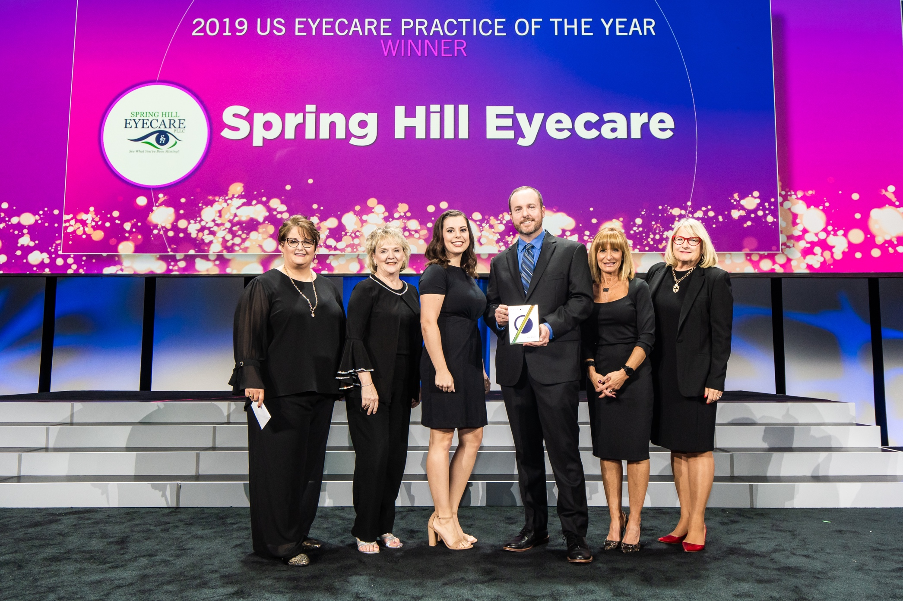
SPRING HILL EYECARE U.S. EYECARE PRACTICE OF THE YEAR
Privately owned optometry office located in Spring Hill, Tennessee
Educated staff on Transitions lenses through training sessions and free fits
Encouraged patient engagement through written product reviews and an interactive lens display
Increased Transitions lens share by 22%
Comments from the judges: Spring Hill Eyecare’s dedication to educating their staff and patients is remarkable. From tackling common objections with unique in-store materials to including Transitions lenses on their lens menu, they’re continuously finding new ways to recommend.
Notes:
Spring Hill Eyecare is a privately owned optometry office located in Spring Hill, Tennessee.
Spring Hill Eyecare’s secret to success started with education--discussing Transitions lenses at meetings, holding training sessions, and sharing experiences and patient responses. They also fitted each staff member with a pair of Transitions® Signature® GEN 8 lenses.
In their optical, they encouraged engagement with the Transitions brand by asking patients to leave a written review. The positive patient feedback reassured new wearers in their decision to purchase. They also created an interactive lens display where patients could demo the Transitions® Signature® style colors in frames.
These initiatives helped Spring Hill Eyecare increase their Transitions lens share by 22%.
Comments from the judges: Spring Hill Eyecare’s dedication to educating their staff and patients is remarkable. From tackling common objections with unique in-store materials to including Transitions lenses on their lens menu, they’re continuously finding new ways to recommend.

Slide 18
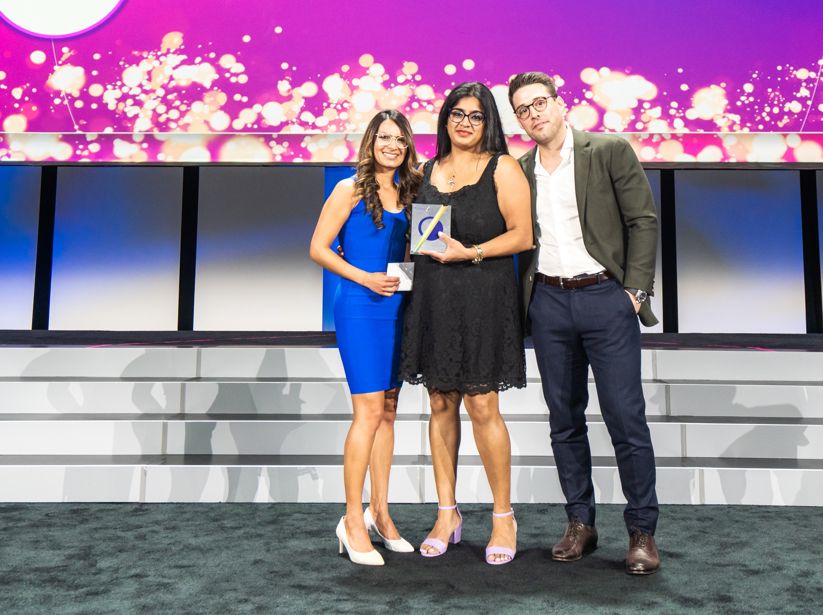
VISION CARE CENTRE CANADA EYECARE PRACTICE OF THE YEAR
An independent optometric practice in Toronto, Canada
Developed comprehensive approach to include Transitions lenses in the patient journey
Began pre-testing lenses and practicing doctor-driven dispensing
Created a Transitions Style Bar
Recreated Transitions Academy experience for their staff and drafted new scripts for overcoming patient objections
Grew penetration rate to 36.5%
Comments from the judges: Vision Care Centre’s application of their learnings from Transitions Academy is truly impressive. Not only did they change the way they were recommending, but they also converted their staff to become Transitions brand advocates.
Notes:
Vision Care Centre is an independent optometric practice in Toronto, Canada.
Vision Care Centre developed a comprehensive approach to include Transitions lenses as a part of the patient journey. They began pre-testing all patient lenses to see if their current eyewear had sun protection and practiced doctor-driven dispensing. They also created a Transitions Style Bar and encouraged patients to try the lens.
After attending Transitions Academy in 2019, they recreated the experience for staff by reviewing the educational content and creating new scripts to overcome patient objections.
Through these efforts, Vision Care Centre was able to reach all patient demographics, change perceptions about the brand and grow their penetration rate to 36.5%.
Comments from the judges: Vision Care Centre’s application of their learnings from Transitions Academy is truly impressive. Not only did they change the way they were recommending, but they also converted their staff to become Transitions brand advocates.

Slide 19
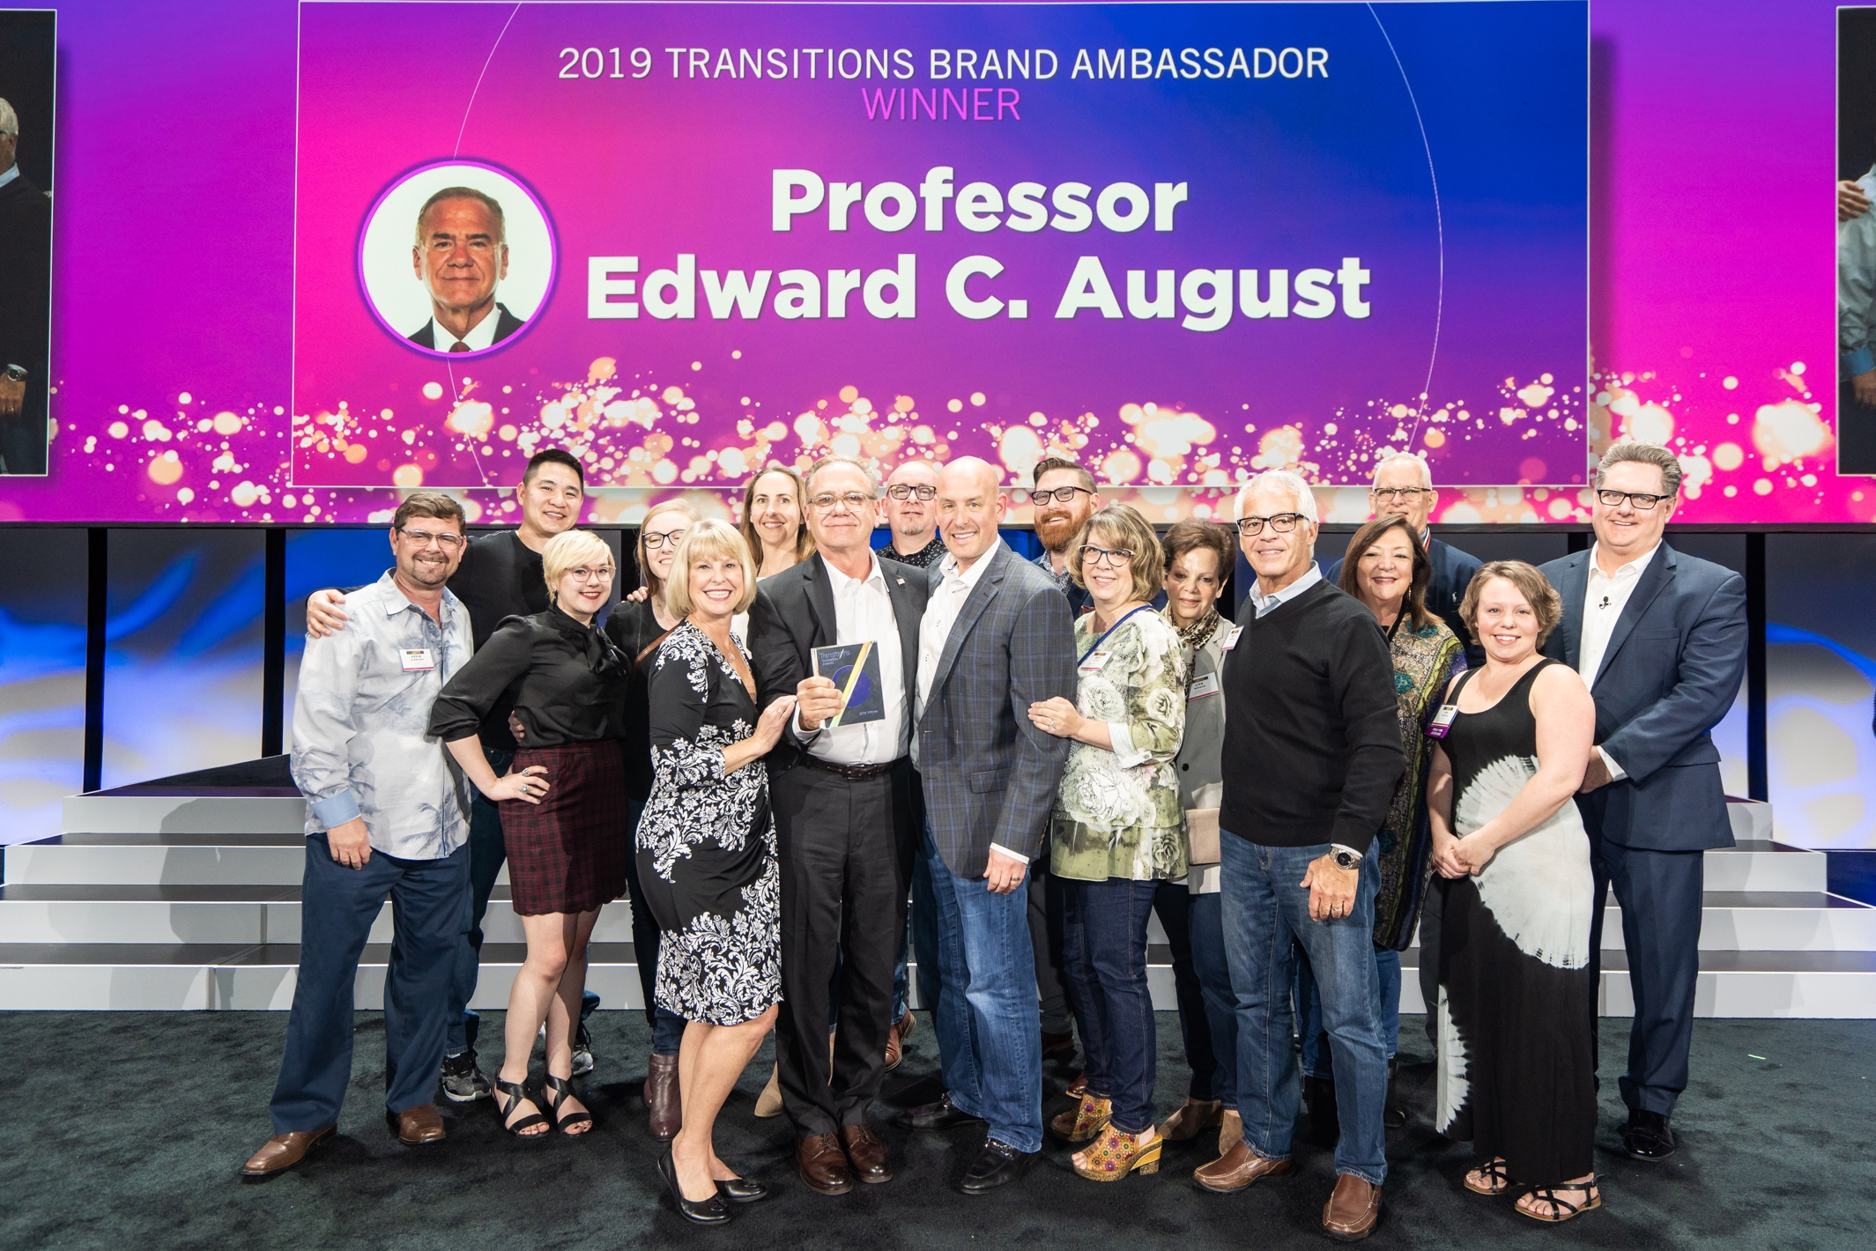
PROFESSOR EDWARD C. AUGUST TRANSITIONS BRAND AMBASSADOR
Master optician with nearly 50 years of experience
President of August Enterprise and owner of The Optical Retail Group (TORG)
Includes Transitions lenses in Sunwear-o-logy presentation
Speaks on Transitions lenses across the globe
Utilizes prescription analysis to talk about Transitions lenses with each patient
Efforts have increased Transitions lens sales by 25%
Comments from the judges: Professor Edward C. August is the definition of a Transitions Brand Ambassador because of his lifelong commitment to the brand. It’s incredible how he takes Transitions lens information and utilizes it on speaking tours worldwide.
Notes:
Professor Edward C. August is a master optician with nearly 50 years of optical experience. He is also the president of August Enterprise and owner of The Optical Retail Group (TORG). Professor Edward C. August has been committed to the Transitions brand since the early 1990s. He is a huge advocate and speaks regularly on the Transitions brand, including it as a part of his Sunwear-o-logy presentation. In 2019, he spoke to over 10,000 eyecare professionals in the U.S. Canada, England, Scotland and China.
Through TORG, Professor Edward C. August encourages all retailers to prescribe Transitions lenses to every patient and discuss the family of Transitions brands. He also teaches prescription analysis which is the art and science of communicating the features and benefits of products, utilizing the quality education products supplied by Transitions lenses.
These collective efforts have helped him increase Transitions lens sales for TORG by 25%.
Comments from the judges: Professor Edward C. August is the definition of a Transitions Brand Ambassador because of his lifelong commitment to the brand. It’s incredible how he takes Transitions lens information and utilizes it on speaking tours worldwide.

Slide 20
ENTRY GUIDE
Use these slides and the entry guide and workbook to make your plan

Slide 21
COMMITMENT AND INSPIRATION
What prompted your dedication to the Transitions® brand this year? What was the inspiration behind your work? Was it in response to an existing problem or was it a new objective?
Suggestions from the judges: Consider answering these questions as you set your goals and plan

Slide 22
GOALS
What did you hope to achieve? Who were you trying to reach and how did their needs, preferences, opinions play a role?
Suggestions from the judges: Align your goals with the award you are entering for and benchmark where you are now.
Notes:
Determine your S.M.A.R.T. (specific, measurable, attainable, relevant, time-bound) goal(s)

Slide 23
PLAN AND CREATIVITY
How did you plan to achieve your goals? What innovative approaches did you use to help you succeed? Did you use a completely new approach, a tried-and-true tactic or a mix of both? How was the Transitions® brand or products included in your plans?
Suggestions from the judges: Keep your engagement high throughout the year by refreshing your efforts quarterly.

Slide 24
TRACK YOUR ACTIVITIES
Suggestions from the judges: Capture photos and / or examples of your activities throughout the year.
 | Dispensary | Social Media | Team Building | Doctor Involvement | Incentives | Promotions | Training | Other
January
February
March
April
May
June
July
August
September
October
November
December

Slide 25
Use this slide if you are submitting a nomination for Retailer of the Year, ECP of the Year, Best in Marketing or Best in Training
IMPACT AND RESULTS
How did things turn out? How did you evaluate your success? Did you meet - or exceed - your goals? How will you build on your success? How did you impact Transitions® lens sales?
Suggestions from the judges: Track your progress monthly or quarterly. Success isn’t just evaluated by sales; consider other ways to evaluate your impact such as staff or customer satisfaction.
We are intentionally comparing 2019 to 2021 to avoid the impact of COVID-19 in 2020.
 | 2019 | 2021 | % Increase
Pairs of Transitions® lenses sold (If relevant, split out Transitions® Signature® GEN 8™ lenses, Transitions® XTRActive® lenses, Transitions® XTRActive® new generation lenses, Transitions® Vantage® lenses, Transitions® XTRActive® Polarized™ lenses, Transitions® Drivewear® lenses, etc.)
Share of overall sales (% of your overall lenses sold that are Transitions lenses)
Notes:
If relevant, be sure to include your photochromic lens sales (including pair growth and share of overall mix).

Slide 26
Use this slide if you are submitting a nomination for Brand Ambassador
IMPACT AND RESULTS
Tell us how things turned out including the results you had and the impact you made
How did you evaluate your success?
Can you compare to your efforts from previous year?
Social media on Transitions posts: reach/impressions/engagement/views
Training or speaking engagements: quantity and audience size
Media: articles, interviews
Did you meet - or exceed - your goals?
How will you build on your success?
Did your plan impact Transitions lens sales? If so, to include your photochromic lens sales (including pair growth and share of overall mix)

Slide 27
Use this slide if you are submitting a nomination for Brand Ambassador
BUSINESS IMPACT
Fill out the below chart with your results
 | 2019 | 2021 | % Increase
Social Media (Transitions® lenses related posts): Total posts, Impressions, Reach, Video Views, Engagements, etc | Total Posts Reach Impressions Video Views Engagement Click-Through | Total Posts Reach Impressions Video Views Engagement Click-Through
Trainings: topic, location, audience size | Total Trainings Audience Size | Total Trainings Audience Size
Speaking Engagements: topic, location, audience size | Total Speaking Engagements Audience Size | Total Speaking Engagements Audience Size
Articles/Interviews: topic, reach, etc. | Total Speaking Engagements Audience Size/Reach Topics | Total Speaking Engagements Audience Size/Reach Topics
Business Impact: Pairs of Transitions lenses sold (If relevant, split out Transitions® Signature® GEN 8™ lenses, Transitions® XTRActive® lenses, Transitions® XTRActive® new generation lenses, Transitions® Vantage® lenses, Transitions® XTRActive® Polarized™ lenses, Transitions® Drivewear® lenses, etc.) | Total lenses sold Total Transitions lenses sold | Total lenses sold Total Transitions lenses sold
Share of overall sales (% of your overall lenses sold that are Transitions lenses)

Slide 28
GOOD LUCK!
TRANSITIONS.COM/AWARDS

