Slide 1
Overview and Entry Guide
Visit Transitions.com/Awards
Notes:
The Transitions® Innovation Awards program recognizes and celebrates loyal partners and individual optical industry professionals from Canada and the U.S. who have shown the highest level of commitment to growing its business with Transitions Optical’s family of products and programs over the past year.

Slide 2
Who Is Eligible to Apply?
Independent eyecare professionals and practices
Optical industry professionals and educators
National and regional retailers
Optical laboratories
Managed Vision Care companies
Lens manufacturers and buying groups

Slide 3
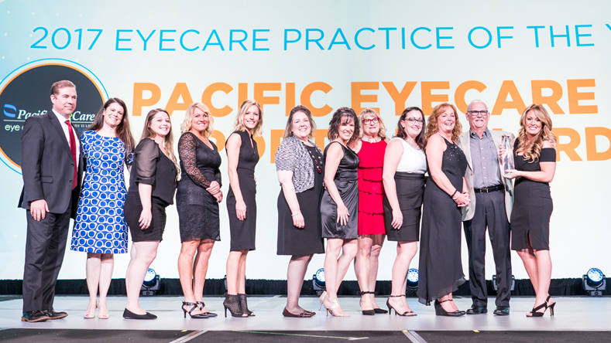
Categories Include:
Transitions Brand Ambassador
Retailer of the Year U.S., Retailer of the Year Canada
Eyecare Practice of the Year
Best in Training
Best in Marketing
Notes:
Transitions Brand Ambassador: This award goes to the individual who best showcases their dedication to being an influential advocate of the Transitions® brand, whether amplifying peer-to-peer conversations, social media or having an unparalleled commitment to incorporating Transitions® lens products into their business goals, patient interactions, training efforts or promotion of healthy vision in their community.
Retailer of the Year U.S., Retailer of the Year Canada: Awarded to a retailer for actively supporting the Transitions brand and demonstrating a commitment to enhancing the vision of their customers and communities. U.S. and Canadian retailers with 20 or more locations are eligible for this award. The award will be presented to one retailer from the US and one retailer from Canada. Nominees are judged on several factors, including overall photochromic growth; efforts to support the Transitions brand through marketing programs and promotions; quality of education provided to optical employees; efforts to promote healthy sight in their local community and support and involvement with public service programs; and an overall commitment to educating customers about the importance of healthy sight and benefits of Transitions lenses.
Eyecare Practice of the Year: The Eyecare Practice of the Year Award recognizes independent eyecare practices and retailers with less than 20 locations that are actively promoting healthy sight to their patients and within their local communities, and who have demonstrated excellence in supporting the Transitions brand. All nominees are evaluated on their performance in several factors, including commitment to photochromic growth; alignment to Transitions Optical and participation in programs and promotions; marketing initiatives; education and training efforts; and community involvement.
Best in Training: Presented to an individual, company or educator that has shown creativity in developing or offering training and education opportunities that include dispensing photochromics, the Transitions brand or family of products. This could include integrating Transitions Optical’s messaging or education resources into staff or industry training efforts, or helping to increase participation in training events that include Transitions Optical (such as CE training seminars, education and other training offered through lab and/or lens manufacturer partners).
Best in Marketing: Awarded to an individual or company for employing creative and strategic marketing tactics to effectively promote the Transitions brand or family of products among customers or within their communities. Marketing initiatives could include incorporating the Transitions brand within marketing and advertising campaigns, sales/staff promotions, point-of-sale, in-office materials, or digital communications (email, website, social media, etc). Nominees should also demonstrate how the execution of the marketing tactics helped to “break through the clutter” and add value to their business objectives.

Slide 4
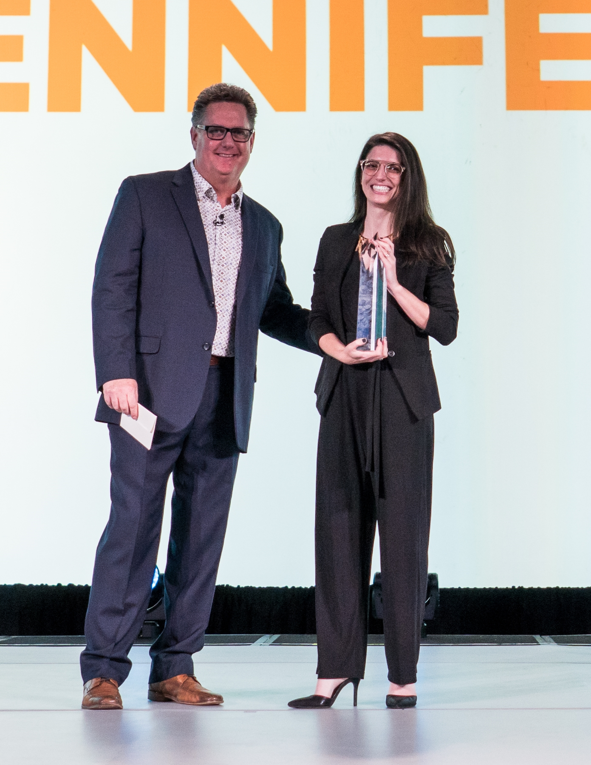
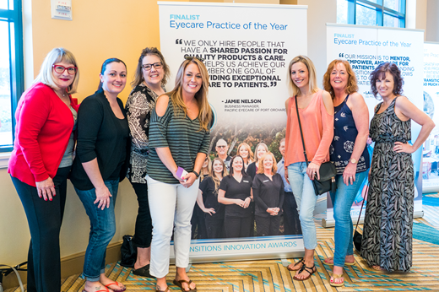
What Do You Win?
A trip for two to Transitions Academy in Orlando, Fla.
Recognition at Transitions Academy
Coverage in trade news publications (examples follow)
A shiny trophy

Slide 5
Coverage on Vision Monday Online

Slide 6
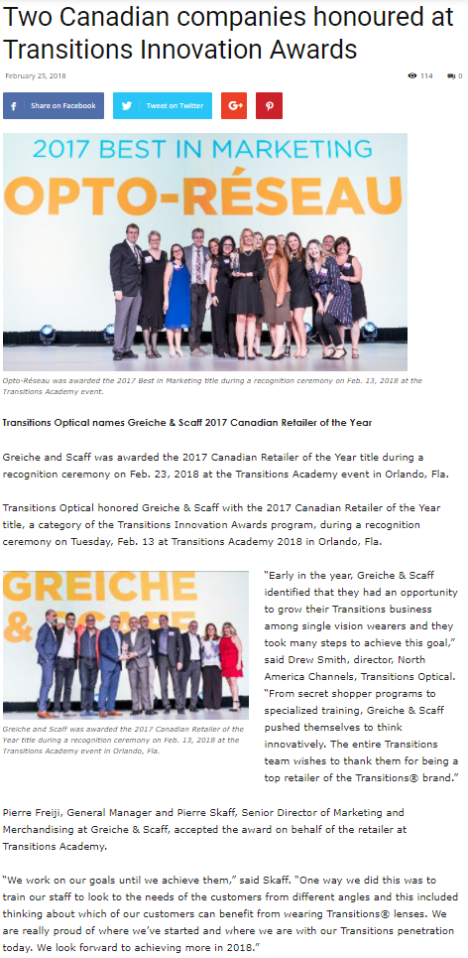
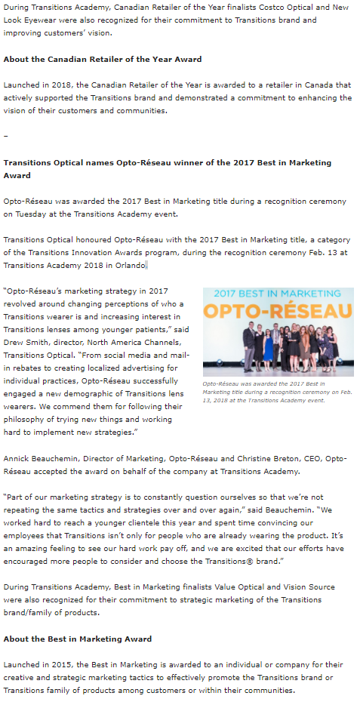
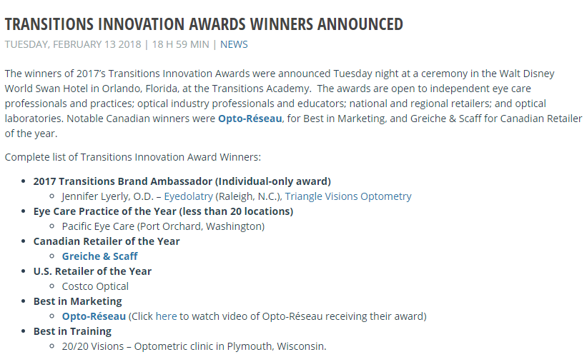
Coverage on Optical Prism and Optik Online

Slide 7
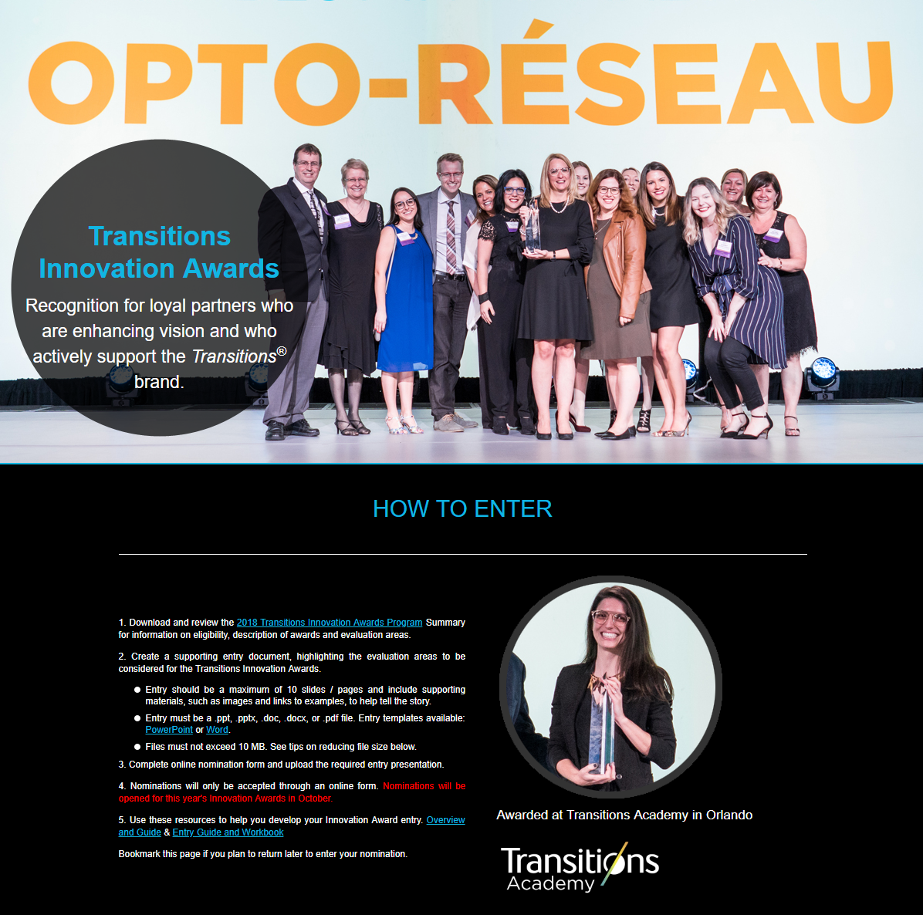
How Do You Enter?
Nominations will be accepted online at Transitions.com/Awards from October 1 - 31, 2018
Notes:
Nominations will be accepted online at Transitions.com/Awards from October 1 - 31, 2018.
To enter, candidates must complete a nomination form and detail their 2018 efforts in the following evaluation areas: commitment and inspiration, goals, plan and creativity, and impact and results.
Nominees are welcome to enter more than one category and can self-enter, or can be nominated by a lab, lens manufacturer, industry colleague or other industry organization representative.

Slide 8
Innovation Awards Ceremony
Notes:
Download videos from:

Slide 9
How to Create a Winning Entry
Visit Transitions.com/Awards

Slide 10
Start planning now!
Start by deciding which specific award(s) you want to win and review the evaluation areas.
Set your goal for 2018 and benchmark where you are to measure your success.
Put a plan in place to help achieve that goal.
Start tracking now!
Use the Entry Guide and Workbook to Help!
Notes:
Start by deciding which specific award(s) you want to win and review the evaluation areas
Set your goal for 2018 and benchmark where you are to measure your success
TIP: Align your goal(s) with the award you want to enter. For example, if you are seeking the Best in Training award your goal might be to increase staff knowledge and recommendations. Benchmark where you are by testing their product knowledge now and at the end of the year to show your progress
Put a plan in place to help achieve that goal.
Whatever your goal is, make sure you are taking action now and throughout the year to help achieve it.
Start tracking now!
You’ve established your goal and your plans for achieving it. Now you need to keep track of the actions you are taking and your progress towards your goal along the way.
It can be difficult to remember all that you did at the end of the year, so we’ve included slides in this guide for you to document your journey along the way.

Slide 11
Tips From The Judges
Don’t submit one presentation for multiple categories.
Establish clear, measurable goals and show how your results align (even if you don’t achieve your goal).
Report your metrics (results, YOY data) graphically.
Show visuals of what you did to achieve your goals.
Highlight areas that you want the judges to pay particular attention to.
Correctly use branded product names, logos and images.
Try to keep submission to 10 slides.
Notes:
Tips from the Judges:
Don’t submit one PowerPoint presentation for multiple categories. Customize each submission to the category you are applying for.
Establish clear measurable goals right now. Show how your results align with your goal. Even if you don’t achieve your goal, show how you made progress towards it.
Report your metrics (results, YOY data) graphically.
Take pictures, videos and show visuals of what you did to achieve your goals. Snapshots taken on a smart phone are perfectly acceptable.
Highlight areas, through changed text/colors, that you want the judges to pay particular attention to.
Correctly use branded product names, logos and images.
Try to keep submission to 10 slides. Think critically about what information is needed and then only go over the limit if more slides are needed to communicate the information that is asked for.

Slide 12
Past Winner Profiles

Slide 13
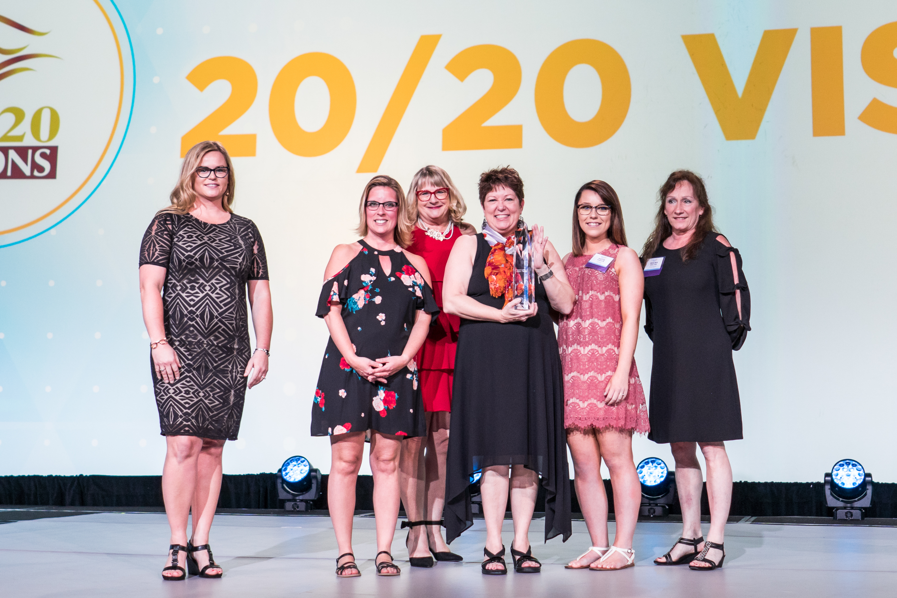
20/20 Visions – Best in Training
Independent eye care practice in Plymouth, Wisconsin
2017 goal was to ensure all patients were educated on the benefits of selecting Transitions® lenses.
Wanted to differentiate themselves by becoming a blue light office
Developed what they called a BLT -- or Blue Light Technology -- speech, as an easy way to talk to every patient about Transitions.
Comments from the judges: By challenging their opticians to take ownership of their individual Transitions lens sales, 20/20 Visions was able to motivate the entire team to learn as much as they could about the Transitions® family of products and offer them to every patient!
Notes:
20/20 Visions is an independent eye care practice in Plymouth, Wisconsin.
They made their goal for 2017 to ensure all patients were educated on the benefits of selecting Transitions® lenses, and they trained their staff through weekly sessions and mini games.
20/20 Visions also wanted to differentiate themselves by becoming a blue light office. They developed what they called a BLT -- or Blue Light Technology -- speech, as an easy way to talk to every patient about Transitions.
Comments from the judges: By challenging their opticians to take ownership of their individual Transitions lens sales, 20/20 Visions was able to motivate the entire team to learn as much as they could about the Transitions® family of products and offer them to every patient!

Slide 14
Opto-Réseau – Best in Marketing
Canadian optical network with more than 80 clinics
Focused their 2017 marketing efforts around promoting Transitions to their younger patient base
Created a new campaign focused on Transitions® lenses and promoted it on Instagram and Facebook .
Comments from the judges: From social media and mail-in rebates to creating localized advertising for individual practices, Opto-Réseau successfully engaged a new demographic of Transitions lens wearers. We commend them for following their philosophy of trying new things and working hard to implement new strategies.
Notes:
Opto-Réseau is a Canadian optical network with more than 80 clinics.
Opto-Réseau focused their 2017 marketing efforts around promoting Transitions to their younger patient base. One way they reached their younger target was through social media. They created a new campaign focused on Transitions® lenses and promoted it on Instagram and Facebook to reach over 538,000 followers on Facebook alone.
Transitions products and promotions were also featured on their homepage for more than half of 2017.
Comments from the judges: From social media and mail-in rebates to creating localized advertising for individual practices, Opto-Réseau successfully engaged a new demographic of Transitions lens wearers. We commend them for following their philosophy of trying new things and working hard to implement new strategies.

Slide 15
Greiche & Scaff – Canada Retailer of the Year
Optical retailer with over 75 locations across the province of Quebec
Ran a secret shopper program in 2017 to evaluate how they were bringing up Transitions® lenses to patients
Describe Transitions lenses as built-in smart lenses that adjust to light intensity, to give perfect protection in any light condition
Comments from the judges: From secret shopper programs to specialized training, Greiche & Scaff pushed themselves to think innovatively. Greiche & Scaff identified that they had an opportunity to grow their Transitions business among single vision wearers and they took many steps to achieve this goal.
Notes:
Greiche & Scaff is an optical retailer with over 75 locations across the province of Quebec.
To help their staff recommend Transitions lenses, Greiche & Scaff ran a secret shopper program in 2017 to evaluate how they were bringing up Transitions® lenses to patients. Their findings influenced their training and furthered their mission, which is helping patients get the best vision and best quality products possible.
When talking with their patients, Greiche & Scaff describe Transitions lenses as built-in smart lenses that adjust to light intensity, to give perfect protection in any light condition.
Comments from the judges: From secret shopper programs to specialized training, Greiche & Scaff pushed themselves to think innovatively. Greiche & Scaff identified that they had an opportunity to grow their Transitions business among single vision wearers and they took many steps to achieve this goal.

Slide 16
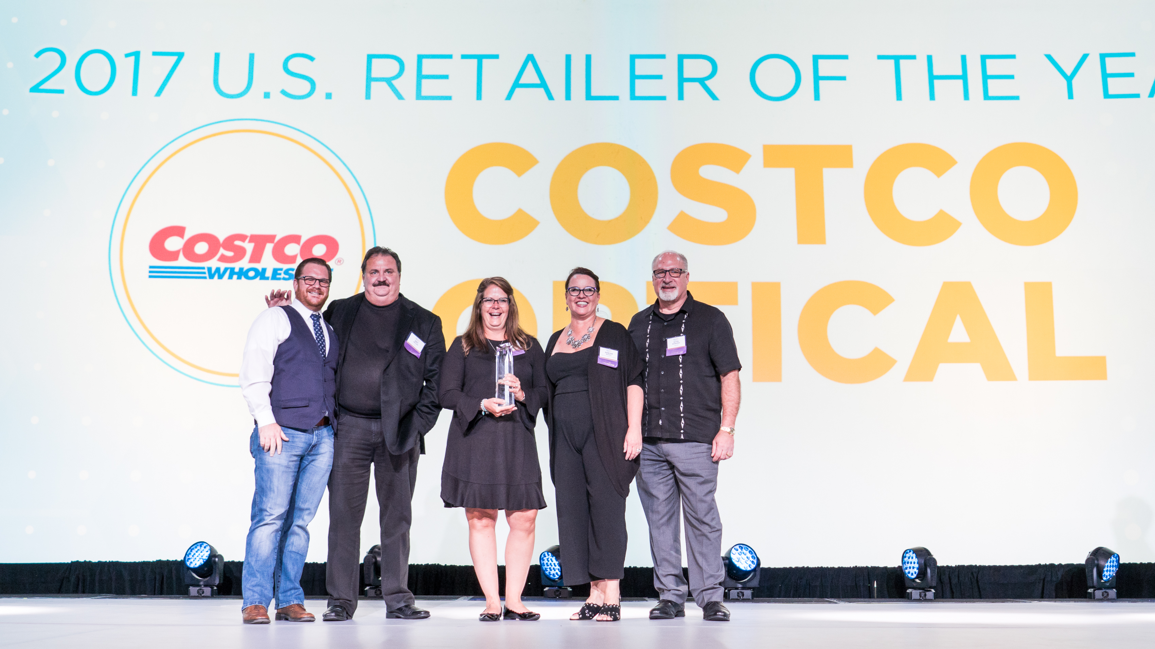
Costco Optical – U.S. Retailer of the Year
Eye care center inside 512 warehouse locations in 44 states
Developed a new approach to recommending Transitions® lenses called “The Perfect Pair”
Created a new in-frame Transitions® Drivewear ® demo with a stylish flash mirror coating.
Comments from the judges: Costco Optical certainly put their best foot forward this year in terms of training employees and identifying opportunities for growth. By utilizing all the tools at their disposal, including education on Transitions® lenses and harmful blue light protection, lens demonstrators and training programs, they are creating excitement and interest in the Transitions® brand within their stores and communities.
Notes:
Costco Optical is an eye care center inside 512 warehouse locations in 44 states.
In 2017, Costco developed a new approach to recommending Transitions® lenses called “The Perfect Pair,” where opticians recommend Transitions® Signature® VII as a member’s primary indoor pair and Transitions® Drivewear® as a member’s primary outdoor pair.
Costco also saw success with their new in-frame Transitions Drivewear demo, which allowed members to experience the lens featuring a stylish flash mirror coating.
Comments from the judges: Costco Optical certainly put their best foot forward this year in terms of training employees and identifying opportunities for growth. By utilizing all the tools at their disposal, including education on Transitions® lenses and harmful blue light protection, lens demonstrators and training programs, they are creating excitement and interest in the Transitions® brand within their stores and communities.

Slide 17
Pacific Eye Care – Eyecare Practice of the Year
Independent practice in Port Orchard, Washington
Made it their mission to continue to raise awareness on healthy sight, to reach a younger crowd, and to grow with Transitions® lenses
Created an “inspiration board” that included quotes, phrases, and ideas gathered from Academy 2017
Comments from the judges: Approaching the year with fresh eyes and vowing to never settle for ‘good enough’ helped the Pacific Eye Care team achieve success with the Transitions® brand this past year. Their inspiration board was a great way to motivate and constantly improve every day in order to achieve their patient care, community outreach and business growth goals.
Notes:
Pacific Eye Care is an independent practice located in Port Orchard, Washington.
In 2017, Pacific Eye Care made it their mission to continue to raise awareness on healthy sight, to reach a younger crowd, and to grow with Transitions® lenses. They achieved this by getting involved with their community through events like their “Back to School Celebration” and “Cares Fair.”
After attending Academy 2017, Pacific Eye Care created an “inspiration board” that included quotes, phrases, and ideas gathered from Academy and discussed them during staff meetings.
Comments from the judges: Approaching the year with fresh eyes and vowing to never settle for ‘good enough’ helped the Pacific Eye Care team achieve success with the Transitions® brand this past year. Their inspiration board was a great way to motivate and constantly improve every day in order to achieve their patient care, community outreach and business growth goals.

Slide 18
Jennifer Lyerly – Transitions Brand Ambassador
O.D. at Triangle Visions Optometry and Transitions Change Agent
Challenged herself to help change the mindset of younger doctors about Transitions® lenses.
Achieved this by writing for her blog and optical publications, creating Instagram content, encouraging young eye care professionals to use social media, lecturing through Defocus Media, and hosting local presentations to doctors and opticians
Comments from the judges: As a Transitions Change Agent in her second year and an optometrist wholly committed to the best for her patients, Dr. Lyerly embodies the spirit of a Transitions Brand Ambassador. She not only takes great care to communicate the benefits of Transitions lenses to her patients, but also inspires other young ODs and students through her vibrant social media presence filled with creative content.
Notes:
Dr. Jennifer Lyerly is an O.D. at Triangle Visions Optometry and a Transitions Change Agent. She is also the founder of Eyedolatry Blog and the co-founder of Defocus Media.
In 2017, she challenged herself to help change the mindset of younger doctors about Transitions® lenses and used her personal optometric outreach to achieve this goal and connect with her target.
In order to achieve her goals, Dr. Lyerly employed many tactics. These included writing for her blog and optical publications about millennials and the importance of prescribing lens solutions, creating Instagram content through Eyedolatry, encouraging young eye care professionals to use social media for their profession, lecturing through Defocus Media, and hosting local presentations to doctors and opticians through Triangle Visions Optometry.
Comments from the judges: As a Transitions Change Agent in her second year and an optometrist wholly committed to the best for her patients, Dr. Lyerly embodies the spirit of a Transitions Brand Ambassador. She not only takes great care to communicate the benefits of Transitions lenses to her patients, but also inspires other young ODs and students through her vibrant social media presence filled with creative content

Slide 19
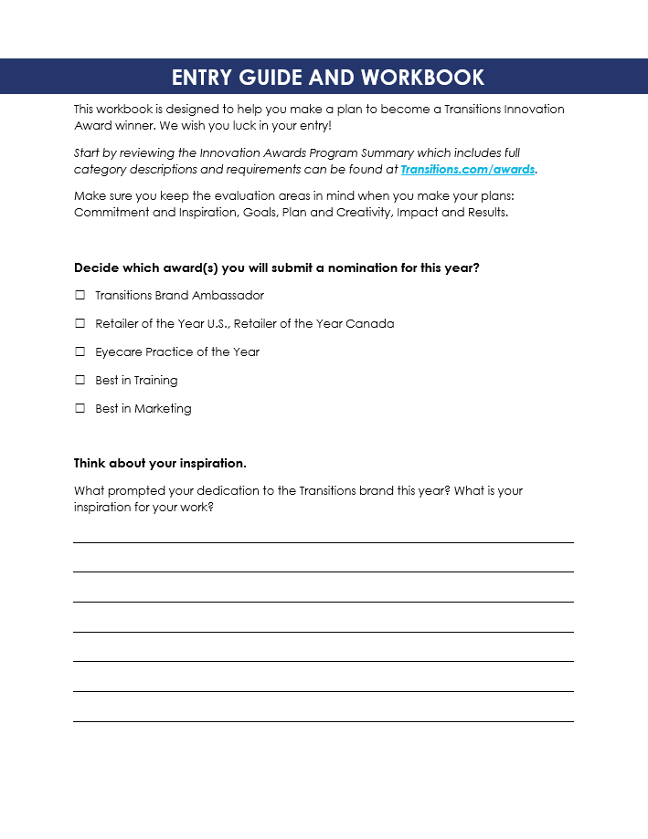
Entry Guide
Use these slides and the entry guide and workbook to make your plan

Slide 20
Commitment and Inspiration
What prompted your dedication to the Transitions® brand this year? What was the inspiration behind your work? Was it in response to an existing problem or was it a new objective?
Suggestions from the judges: Consider answering these questions as you set your goals and plan

Slide 21
Goals
What did you hope to achieve? Who were you trying to reach and how did their needs, preferences, opinions play a role?
Suggestions from the judges: Align your goals with the award you are entering for and benchmark where you are now.
Notes:
Determine your S.M.A.R.T. (specific, measurable, attainable, relevant, time-bound) goal(s)

Slide 22
Plan and Creativity
How did you plan to achieve your goals? What innovative approaches did you use to help you succeed? Did you use a completely new approach, a tried-and-true tactic or a mix of both? How was the Transitions® brand or products included in your plans?
Suggestions from the judges: Keep your engagement high throughout the year by refreshing your efforts quarterly.

Slide 23
Track your Activities
Suggestions from the judges: Capture photos and / or examples of your activities throughout the year.
 | Dispensary | Social Media | Team Building | Doctor Involvement | Incentives | Promotions | Training | Other
January
February
March
April
May
June
July
August
September
October
November
December

Slide 24
Impact and Results
How did things turn out? How did you evaluate your success? Did you meet - or exceed - your goals? How will you build on your success? How did you impact Transitions® lens sales?
Suggestions from the judges: Track your progress monthly or quarterly. Success isn’t just evaluated by sales; consider other ways to evaluate your impact such as staff or customer satisfaction.
 | 2017 | 2018 | % Increase
Pairs of Transitions® lenses sold (If relevant, split out Transitions® Signature® lenses, Transitions® XTRActive® lenses, Transitions® Vantage® lenses, Transitions® Drivewear® lenses, etc.)
Share of overall sales (% of your overall lenses sold that are Transitions® lenses)
Notes:
If relevant, be sure to include your photochromic lens sales (including pair growth and share of overall mix).

Slide 25
Good Luck!

